Slide 1
1D simulation for complex object
SimInTech as universal integrated developer platform for 1D simulation in design process and different industry
ЗVS, LLS
2024

Slide 2
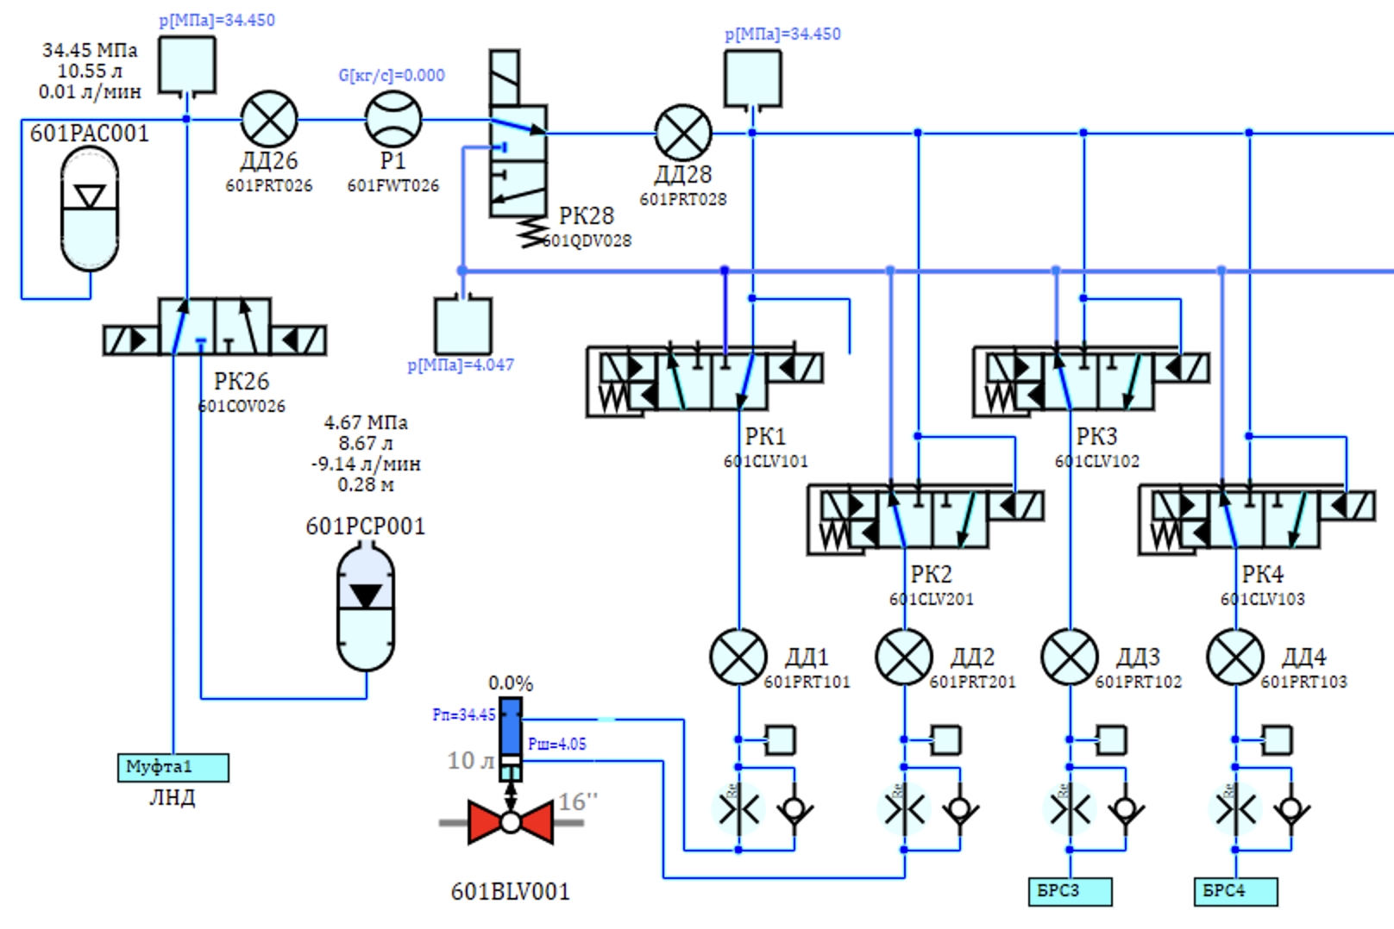
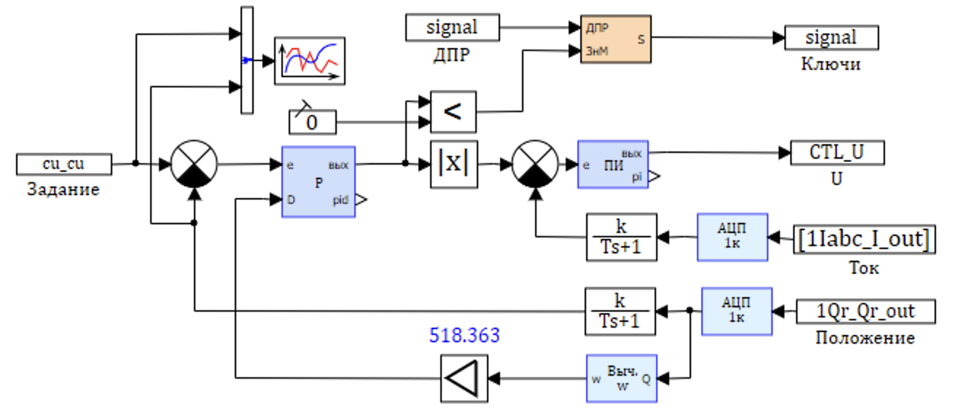
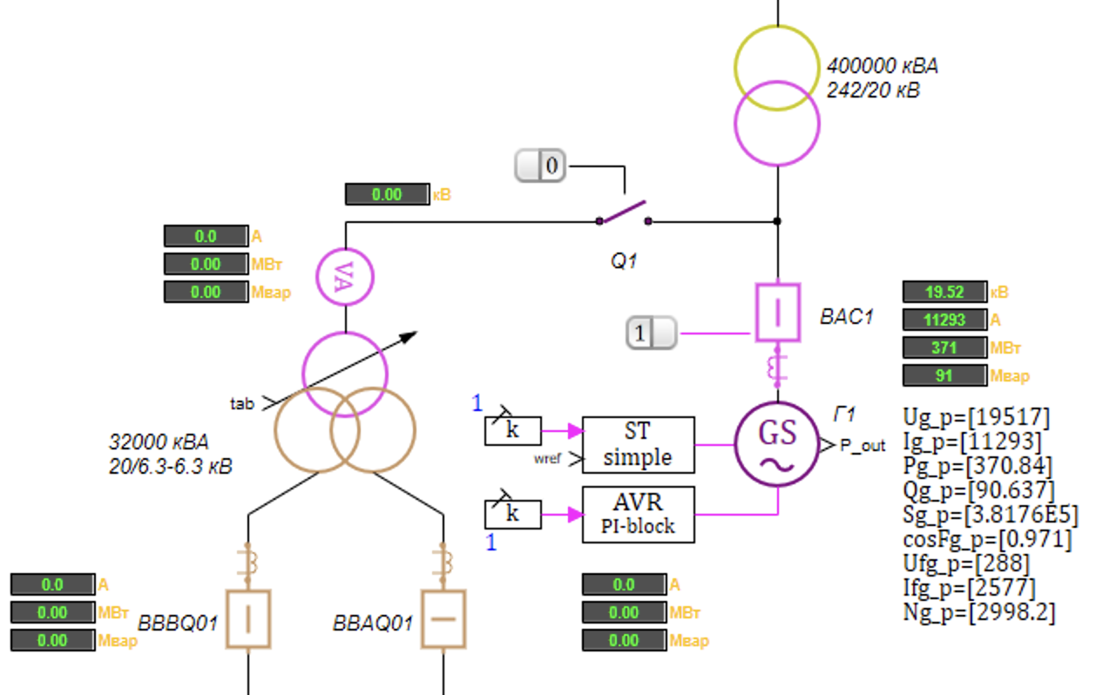
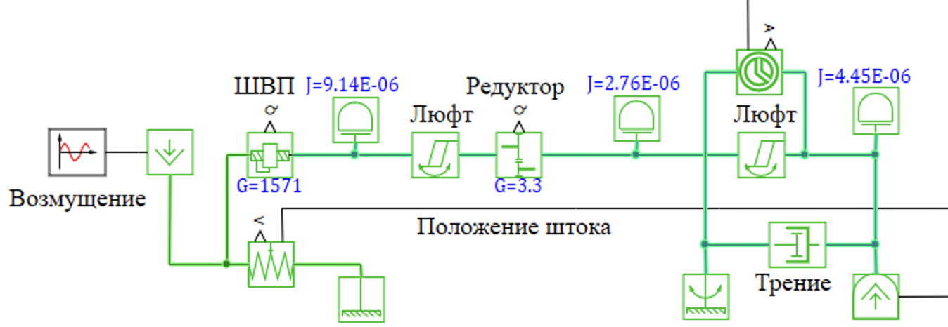
SimInTech as simulation platform
Dynamical simulation software in technical systems «SimInTech» is computer aided engineering (CAE) for 1D simulation in different industries
Software for science and engineering simulation.
Provide:
Complex 1D simulation for thetical systems with different physical process.
FBD diagram programming language for developed a control systems software with a auto generation a source code for different computer platform.
Usage:
R&D for technical system in different industries.
Design and develop for control systems.
Digital tweens.
Education for Automate control theory.
Main competitor:
MATLAB Simulink, Siemens Amesim, ANSYS SCADE
Hydraulic
CS
electric
mechanic

Slide 3
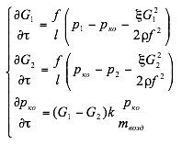
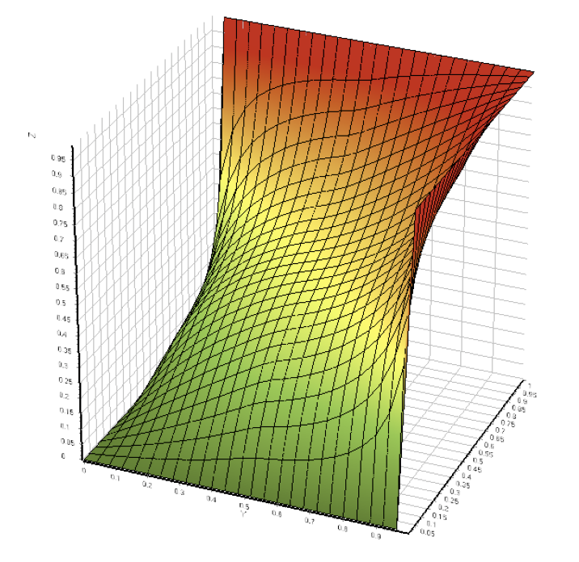
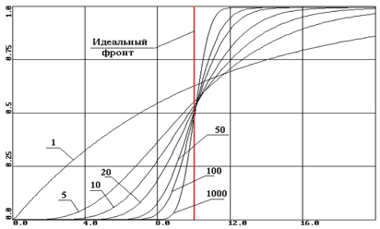
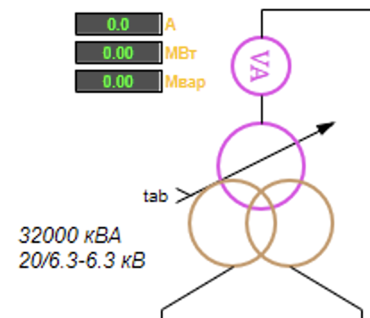
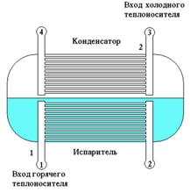
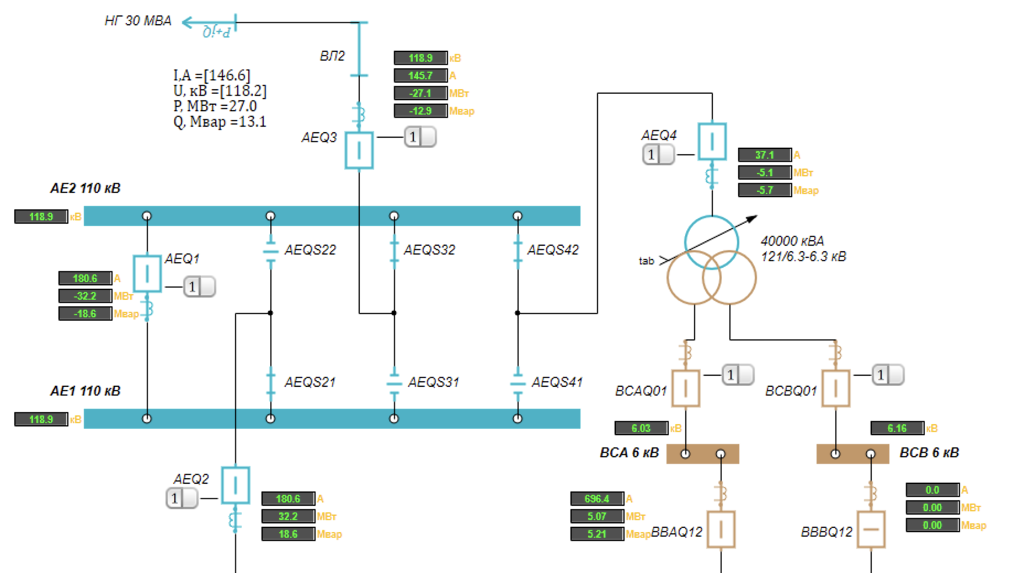
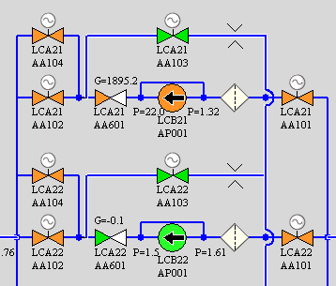
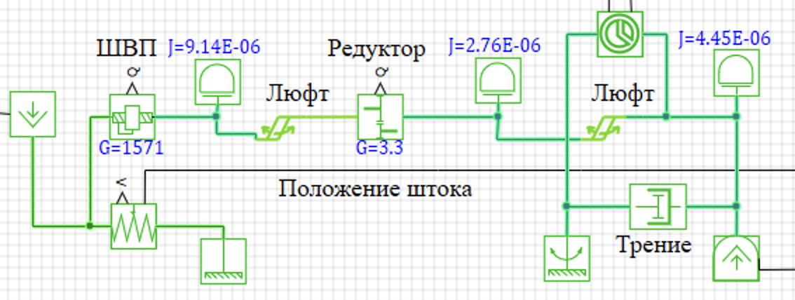
1D simulation in SimInTech
SimInTech converts a science knowledge and a empirical experience to engineering tool for design and develop technical systems
Science knowledge
Mathematical description
of physical process
1D Core
Mathematical model libraries of technical systems components
20%
elemets
library
Multi-physics 1D simulation
system simulation
complex simulation
Engineering tool

Slide 4
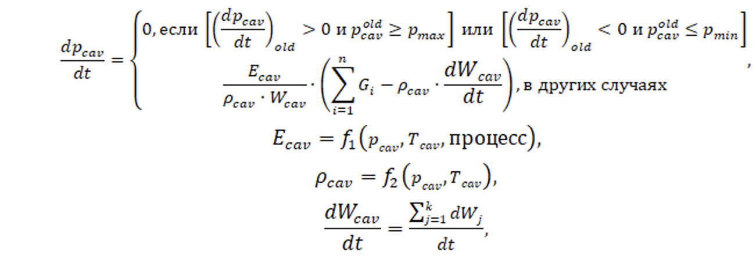
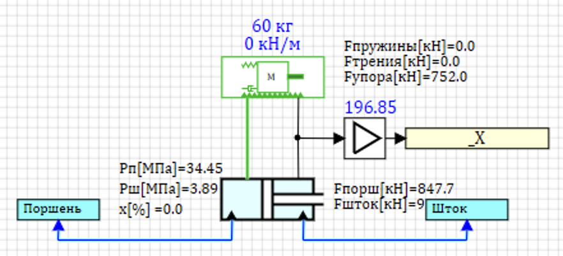
Creating 1D library element
From differential and algebral equations systems we go to P&ID diagram, which is usual tool for engineering design
The equation for compressible fluid
Structural diagram for equations
of a liquid in a closed volume
Single side hydro cylinder
Hydraulic diagram of subsea hydraulic systems (1D simulation)
Double side hydro cylinder
Hydro driver of valve

Slide 5
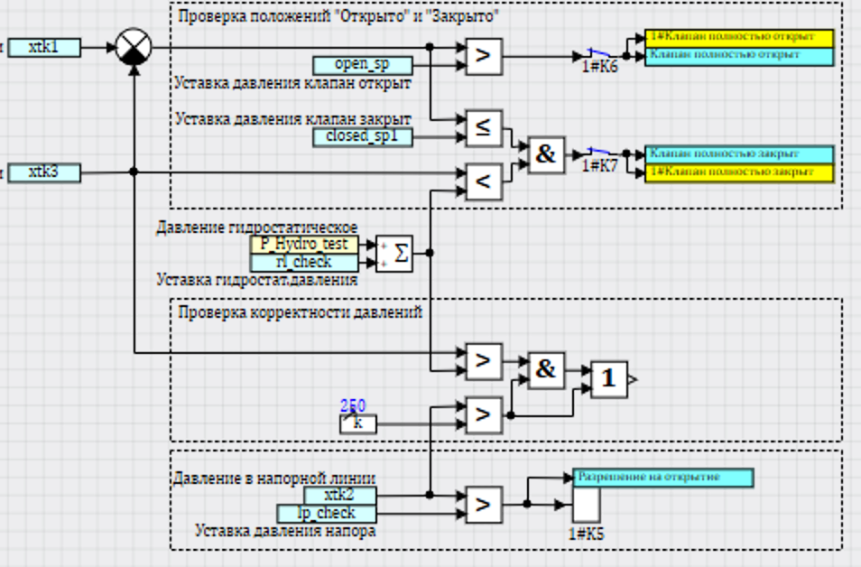
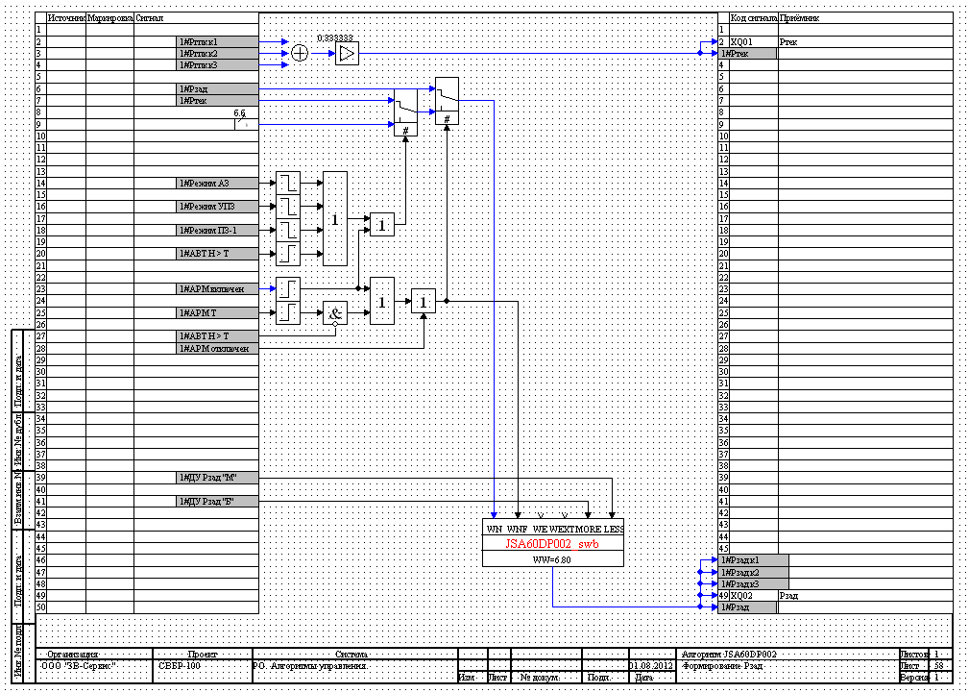
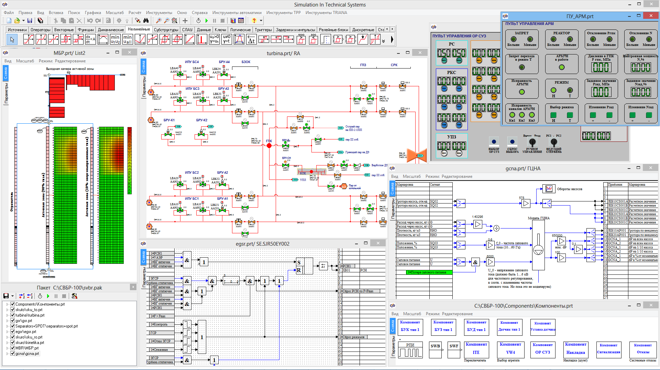
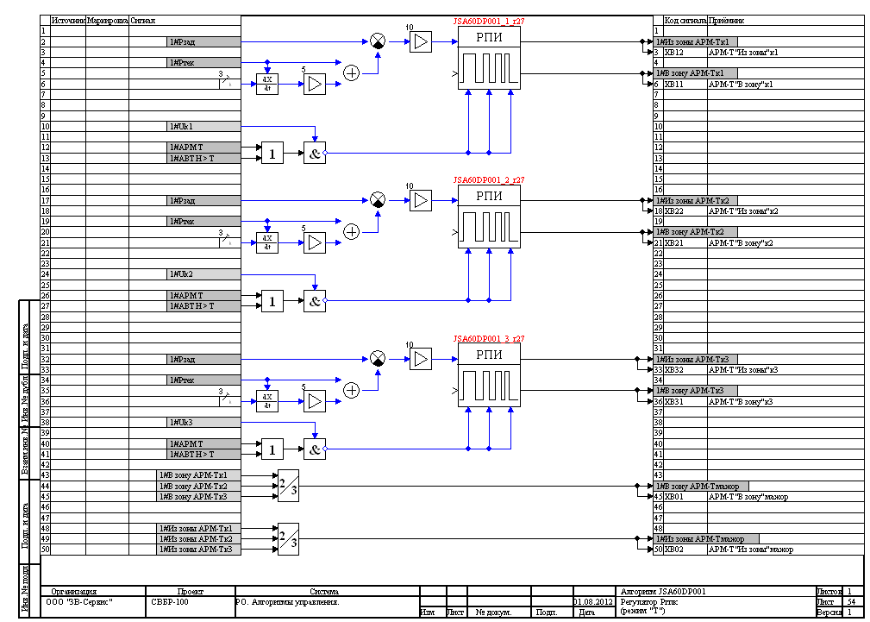
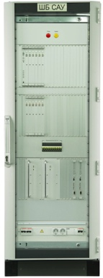
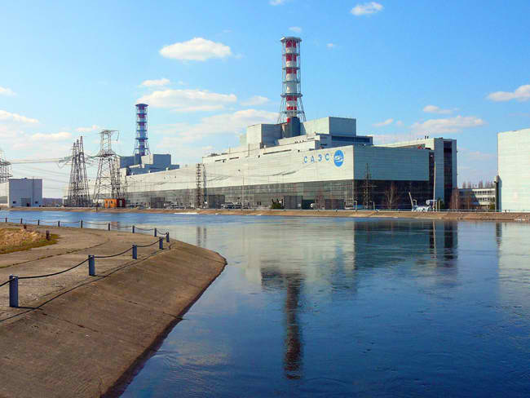
Complex systems must be controlled
SimInTech is graphical integrated developer environment (IDE) to simulate a complex object include physical process and algorithms of control systems
Algorithms
1D simulation of complex object
Object
control system
control
command
controlled
object
simulation
parameters
SimInTech diagram
(application oriented language)
Automated
code generation
Control System
sowtware
(SOFT)
Technical object
(HARD)

Slide 6
Architecture of SimInTech
SimInTech have all necessary tool for 1D simulation in the research and development process in different industries
Soft
1D модель объекта
Hard
HMI Memo
Thermohydraulic
Electrical
Mechanical
Mechanical 3D
Electro driver
Satellite ballistic
Aircraft dynamic
Hydraulic
DSP
Antennas
Video processing
3D Visualization
Piezoelectric
and other
control system
object
Mathematic
Statistic
State Flow
Fuzzy logic
Neural nets
Regulators
Indicators
simulation
1D core
Code generator
Встроенное ПО
Microcontrollers
Different Simulator
Data exchange
DAC/ADС connection
NordWind
Real Time execution
STM32
Milandr
GigaDevice
MK17
Raspberry PI
Arduino

Slide 7
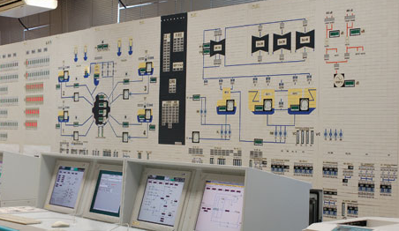
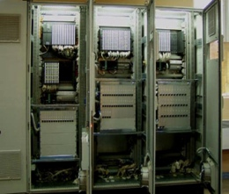
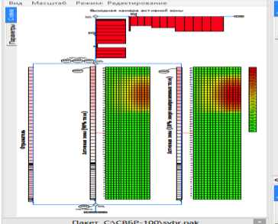
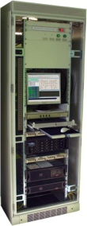
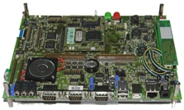
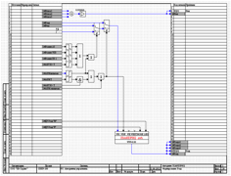
SimInTech in software development
SimInTech allow user to create a full life cycle for control software development for complex technical object in different industries
Abstract level
Top level requirements
Software Requirements
1D simulation (balance)
test
Acceptance test
объект
common
algorithms
1D simulation
(object)
test
integration
test
система
local algorithms
1D simulation
(systems)
test
unit
test
Code generation
Simulation and test
at any step of life cycle
time
Detailed level
Notes:
Симентек позволяет разработать математическую модель объекта управления и исследовать его. (динамические свойстава: выдерживает ли температуры, взывается ли чтото)

Slide 8
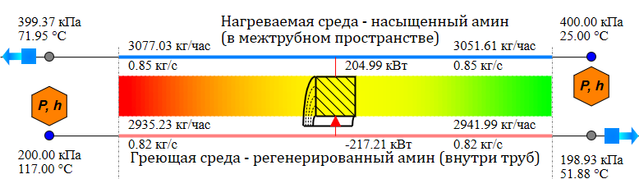
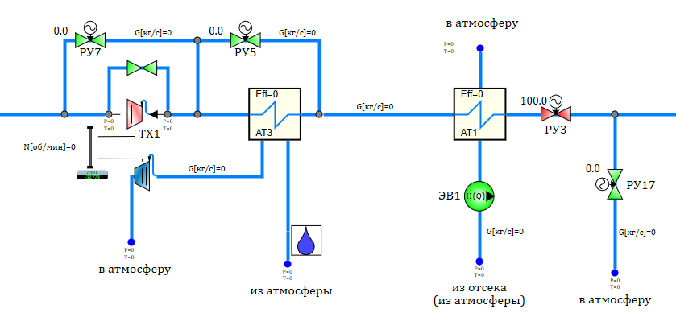
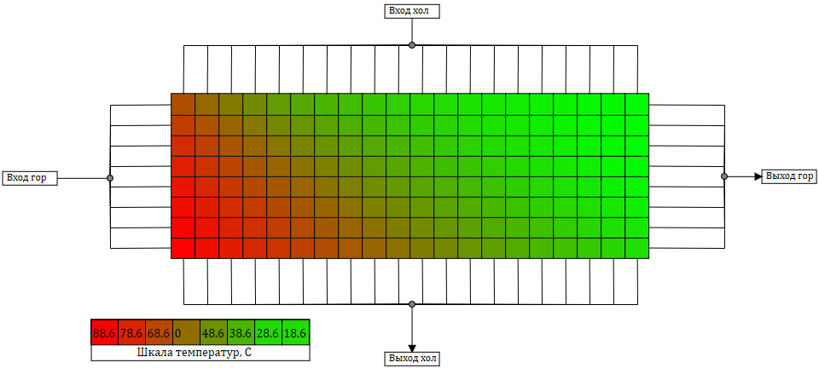
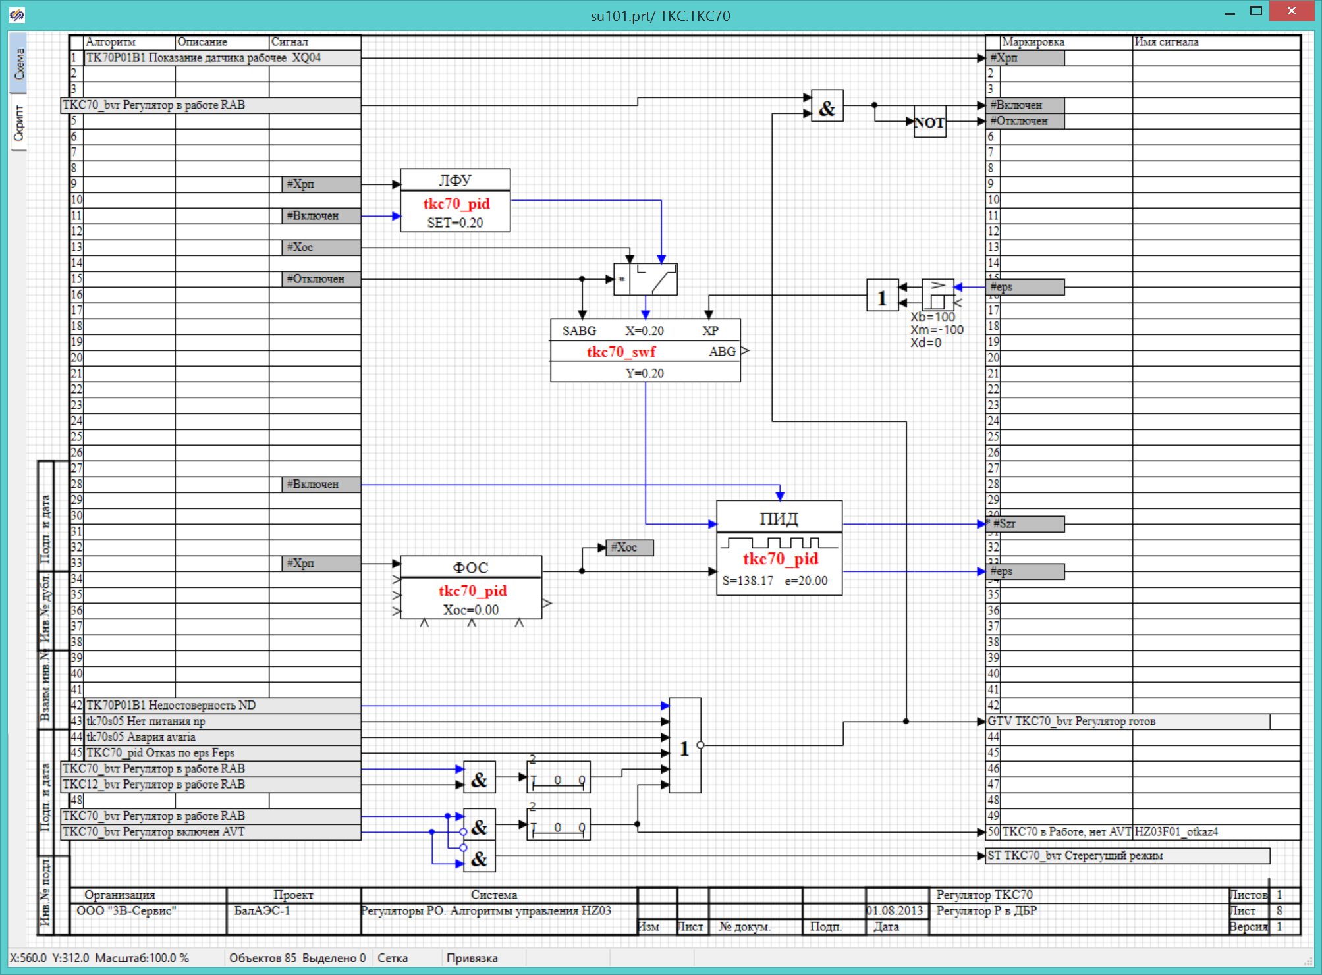
1D simulation in product life cycle
1D model is created at a first stage of a product life cycle and then developed and updated by design information and test results
Requirements
Main equations
Boundary condition
Simplifying
Conceptual design
Models of units
Models of process
Algorithms
Technical design
Accurate model
Systems model
Software specification
Design
1
2
3
Model
1D simulation SimInTech
Elaboration
of model
Optimization and code
generation
Production and
testing
5
6
Product
4
Unit
Unit test
Characteristic
Real parameters
Systems
Software
Controls unit
Final
testing

Slide 9
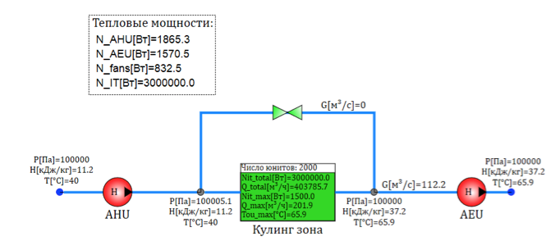
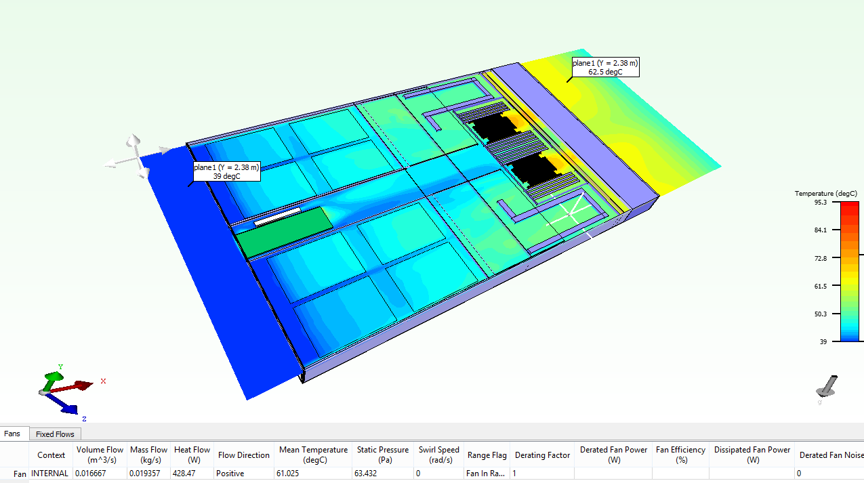
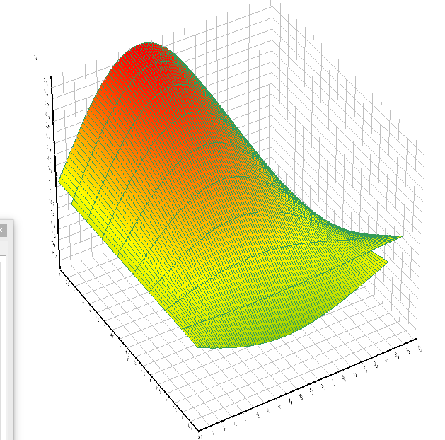
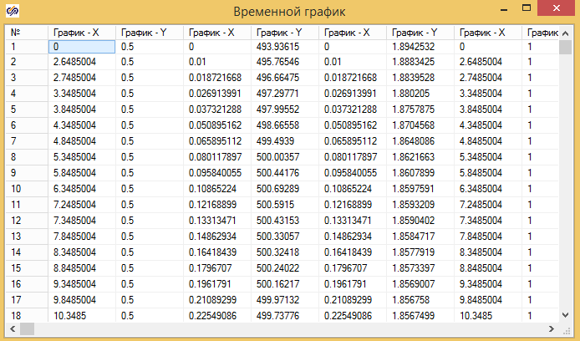
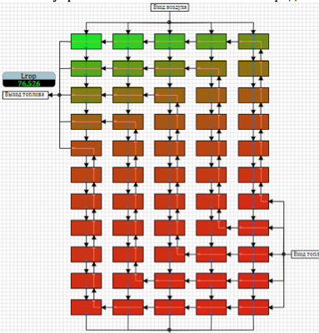
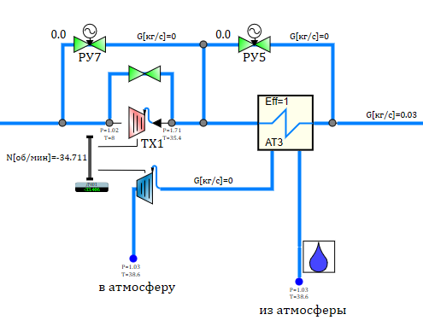
Use 3D simulation to increase accuracy
3D simulation on Supercomputer, can be used to get relation and correlation for 1D simulation in SimInTech
Balance model in SimInTech
3D simulation for unit
(Supercomputer)
Tables and correlation
software requirements
Complex simulation model
Control systems
Process simulation
unit model

Slide 10
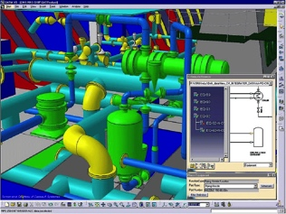
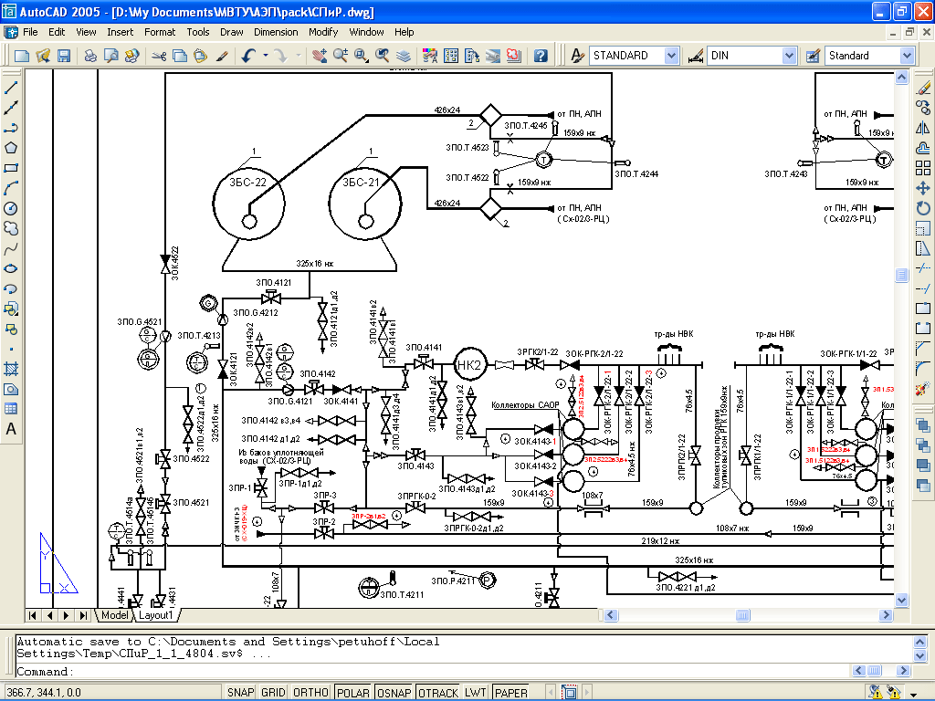
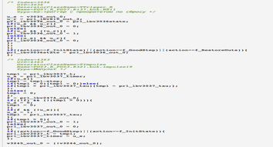
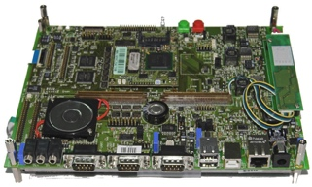
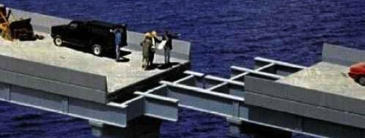
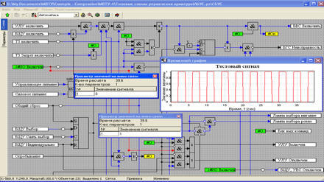
Software for control systems
Control software creating for complex object like NPP, arise a global task of the communication between programmers and engineers with different specialty
Traditional control software development process
interpretation
Code C
Technicla specification
(texts, diagrams, tables)
Testing process, mitigation error in code
Process designer
Programmer
SimInTech code generation
IEC 60880-2010 Sertifivated
Test SW by simulation
No human interpretation error
Certification for nuclear power palnt
100% accordance to specification
генерация
Code С
Specification in
SimInTech diagrams

Slide 11
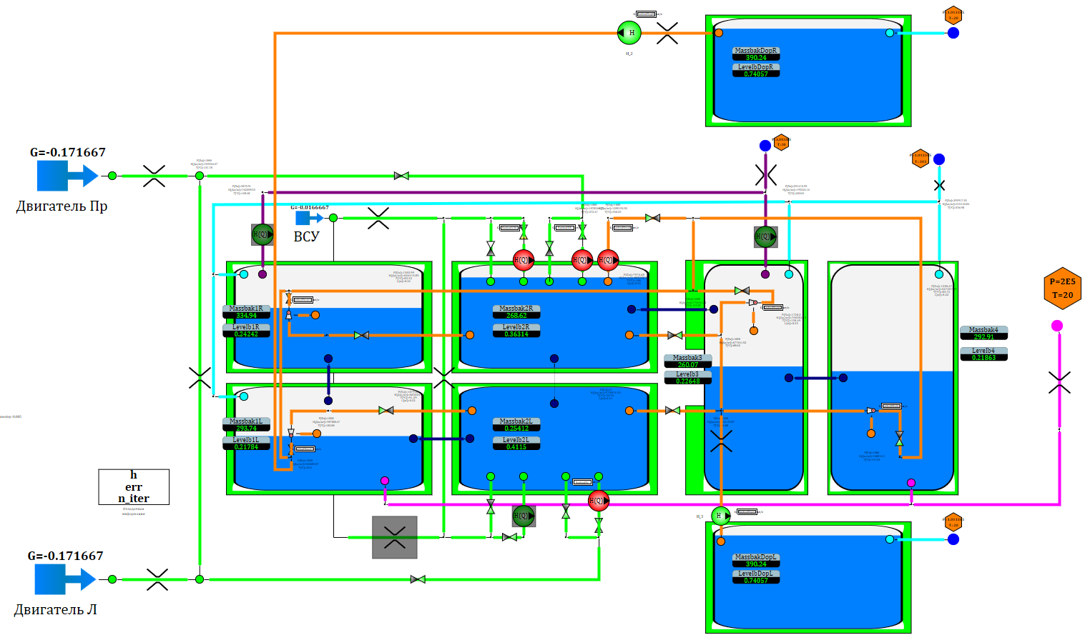
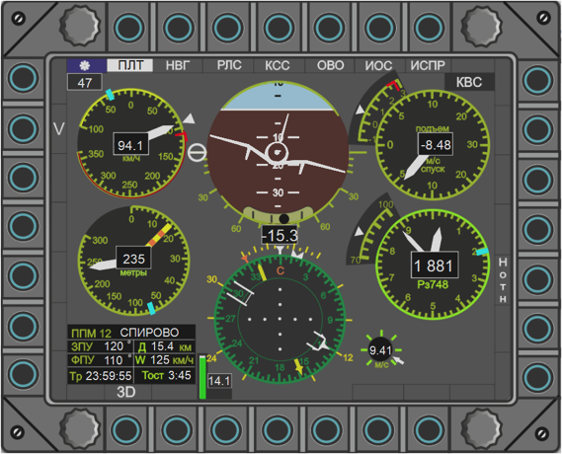
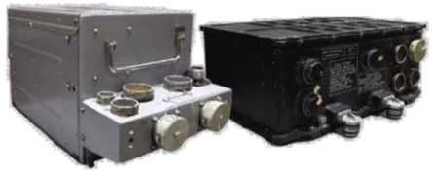
Complex model in SimInTech
Архитектура SimInTech позволяет создать гибридную комплексную модель систем объекта для полунатурных испытания систем самолета
Control software
System model
Actuators
Control
commands
Simulating
parameters
Inputs
Signal data base
DAC
control
points
Indicator
values
Download
and
remote
debugging
Indicators
ADC
Control
commands
Оperator
commands
20%
Control system hardware

Slide 12
Complex model of aircraft
SimInTech в 2017 году был выбран ОКБ Сухой в качестве платформы для создания функционального цифрового двойника самолета
SimInTech is used for creating a complex model which included:
Control systems software
Fuel system.
Air condition
Electricity
Reliability
Requirement

Slide 13
Su-30 simulation example
Demo SimInTech simulation model of Су-30 from MAKS 2018

Slide 14
Viacheslav Petukhov
CEO
+7 (926) 531 88 97
v.petukhov@3v-services.com
3VS, LLS

