Slide 1

Russian software instead of western software
The real examples of using SimInTech for different engineering simulation tasks instead of a western simulation software
3VS LLS
2023

Slide 2
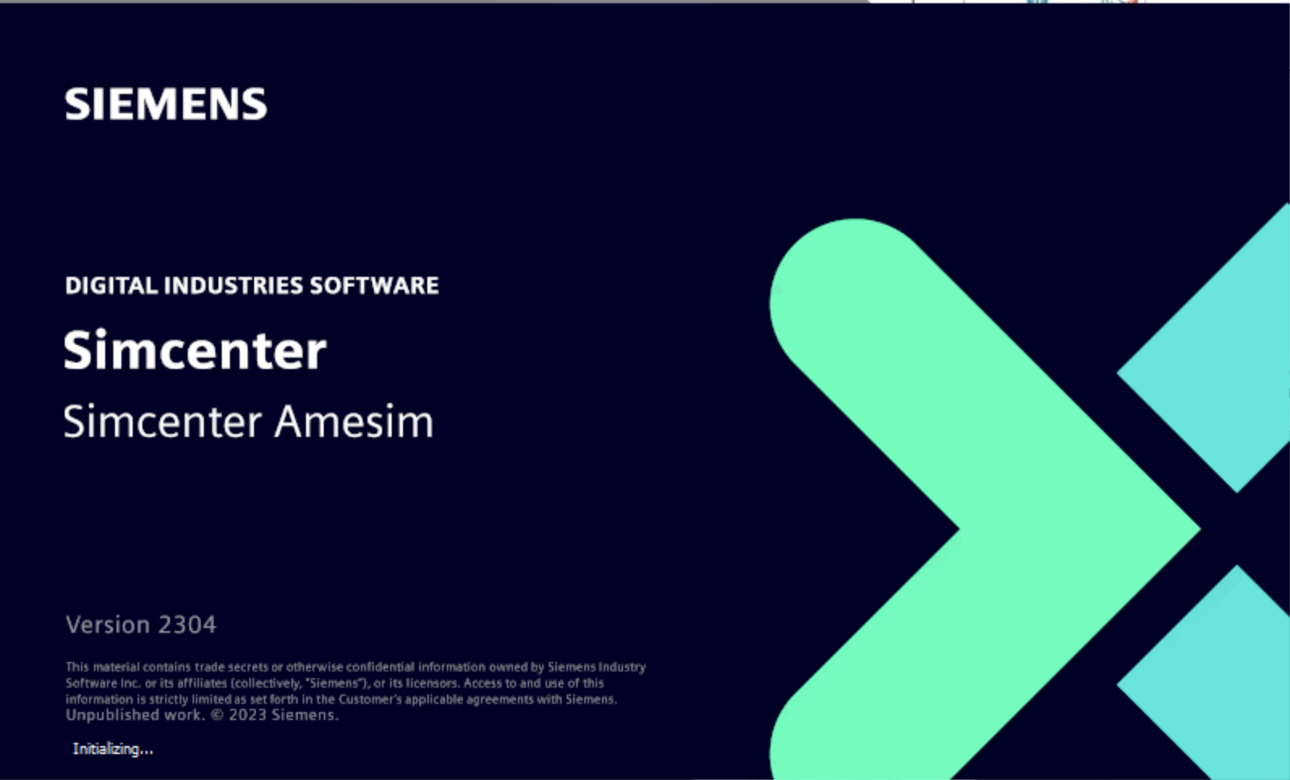


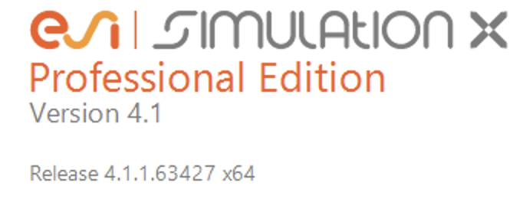
SimInTech everything is possible
SimInTech 20 years of a successful competition with western software as a simulation tool fo difference industrial application in russian
2015:
Direct competition with Siemens Amesim in OKB Sukhoi aviation design company, leader of Russian military aviation.
2018:
Creating a simulation model for hydraulic control systems to replace of The SubSea Hydraulics Library SimulationX.
2022:
Demo simulation model of transonic aviation rocket to compare with MATLAB Simulink.

Slide 3
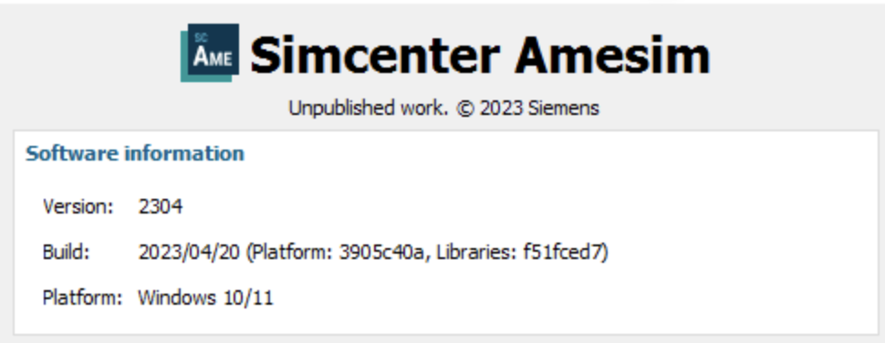
SimInTech vs Siemens Amesim
In 2014 OKB Sukhoi choose SimInTech software after а direct competition with Siemens Amesim in a real project for air condition systems
Starting advantages Siemens Amesim in OKB Sukhoi:
Using of Siemens PLM software in OKB Sukhoi.
A direct access to OKB Sukhoi data for our competitor.
A «Big» library of ”ready to use” elements.
Finished pilot project in OKB Sukhoi.
Completed simulation model in Siemens Amesim.
Why SimInTech win:
Creating time for model of air condition system.
Less calculation time for the same process.
Better accuracy for thermo-hydraulic process.
Several different way for a simulation depends om simulating purpose.
Simplicity of new block creation by customer requirement.
Direct accesses to developer of simulation tools.

Slide 4
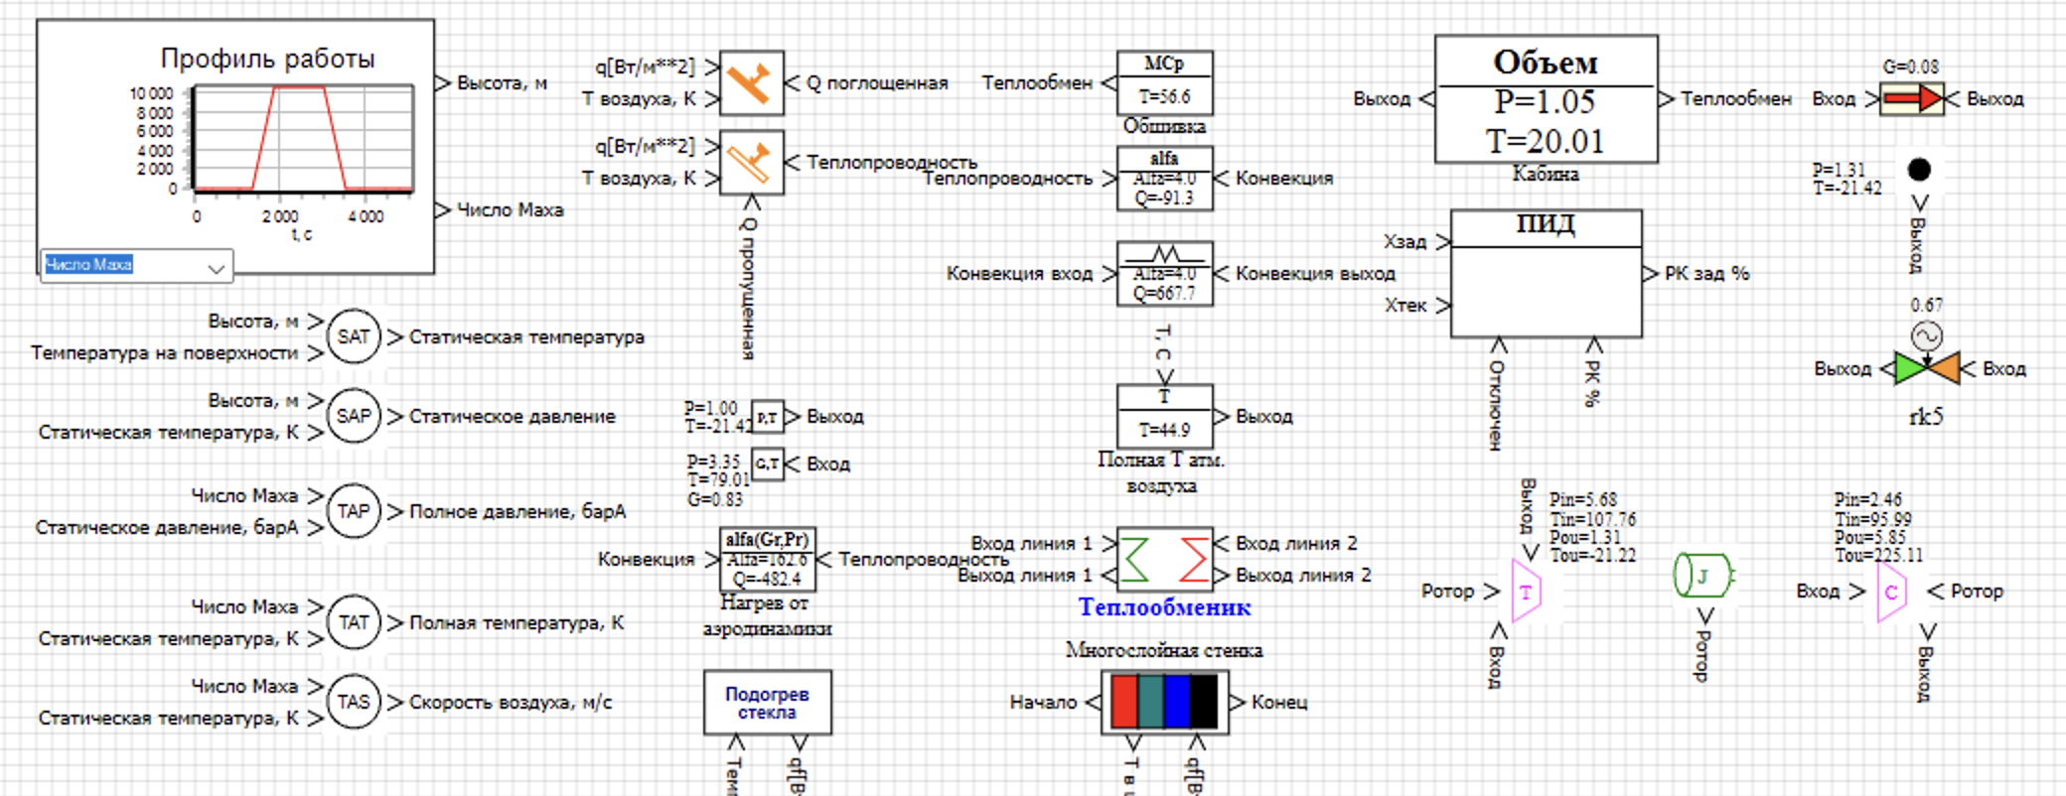
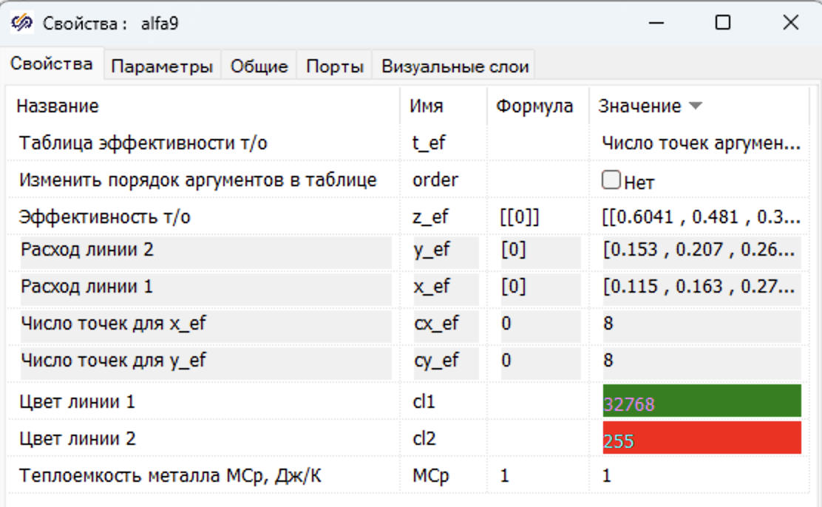
Amesim library blocks in SimInTech
It was shown during a model develop process, that recreate existing Amesim block in SimInTech is not just simple, but very simple!
A simulating model for direct compare SimInTech vs Amesim:
The physical equation from Siemens Amesim were used.
The parameters set of Siemens Amesim were used.
The files with table data material properties created by customer for Siemens Amesim were used.
The time to create new block was less then 10% of all model creating time.
New block library

Slide 5
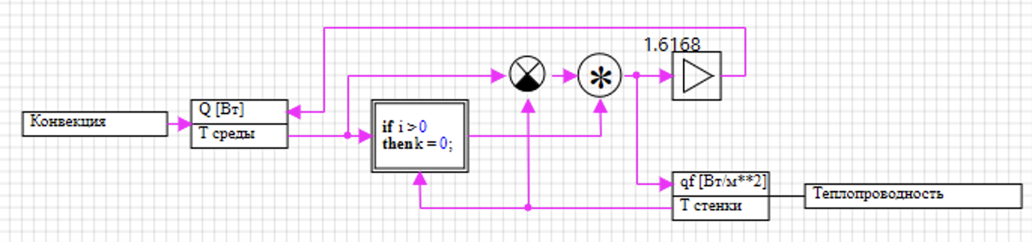
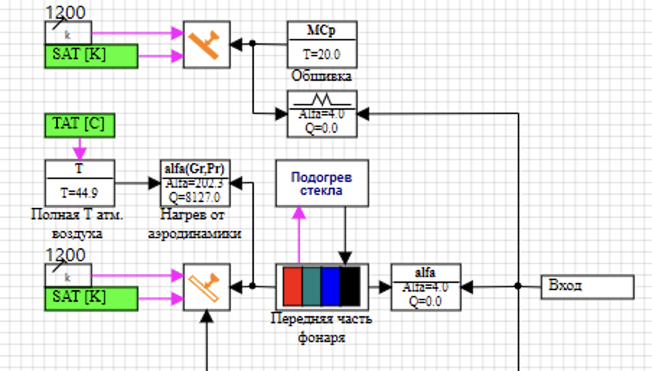
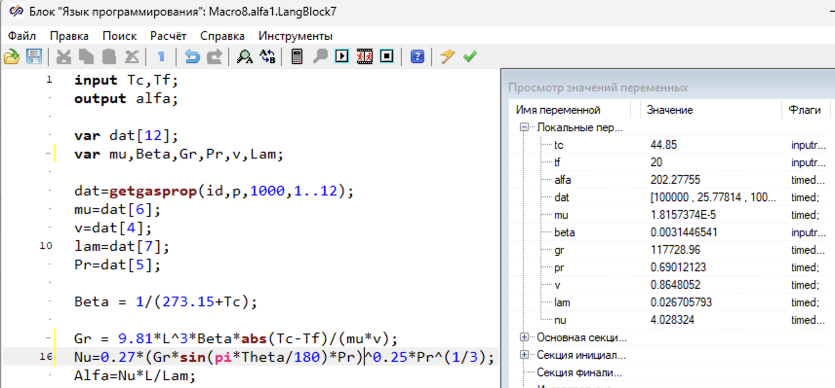
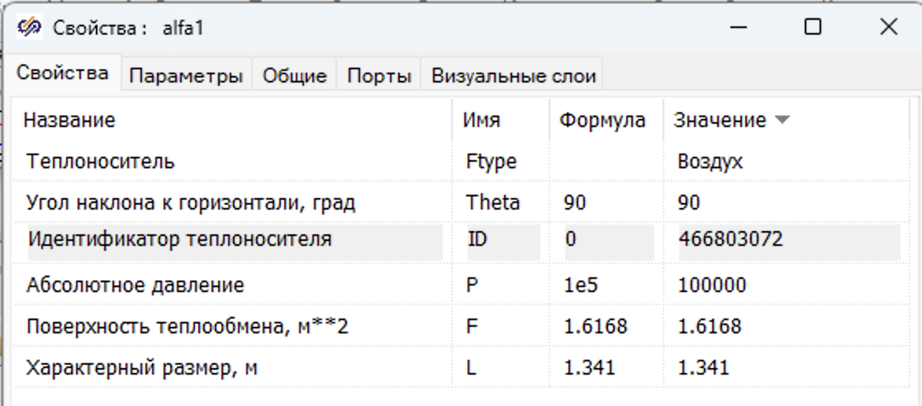
Example of recreating Amesim block in SimInTech
Most of Siemens Amesim library blocks is simple enough for quick recreating by SimInTech built-in tools for creating a new block
The оpen models in SimInTech:
Visibility.
Easy to change.
Full control.
A block diagram
Program of block by SimInTech language
Block properties

Slide 6
The myths busters
The direct compare between two models shows a big advance of SimInTech: Quicker model creating, less calculation time and a flexibility to add new blocks.
«Big» block libraries of Siemens Amesim are not included models of real aircraft component used in the design company Sukhoi.
Most part of Siemens Amesim blocks can be very quickly recreated by SimInTech tools.
The simulation in SimInTech in 5-6 times quicker then in Siemens for the same model and the same accuracy.
The openness of SimInTech model allows users makes modification, analysis and development of equation used for simulation.
Using SimInTech provide possibility of using local specialists in different industry, to develop a new blocks library.
During the Sukhoi pilot project engineers have found the mistakes in standard library of Siemens Amesim.

Slide 7
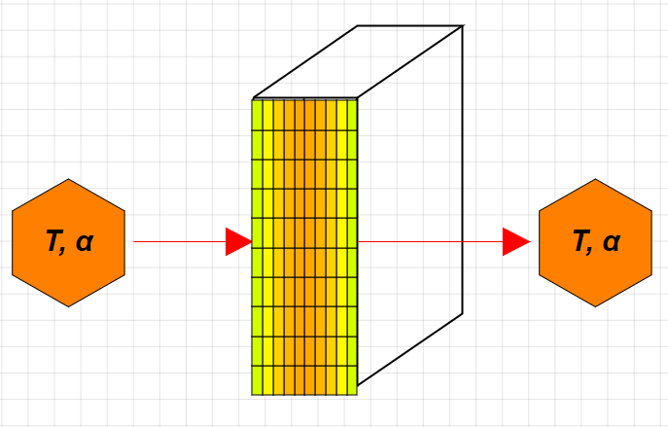
SimInTech is more accuracy then Amesim
After the simulation results were compared, it was found the lack of calculation accuracy in Siemens Amesim, which coul lead to significant errors
The task of colling thin wall was used for compare the simulation accuracy. The SimInTech calculation error less then 0.5 °C at all process
Error of Siemens Amesim:
almost 20 °C от an outer side of the wall;
near 10 °C in wall center.
Calculation error of Siemens Amesim
LMS Amesim model
20%
20°C
SimInTech model

Slide 8
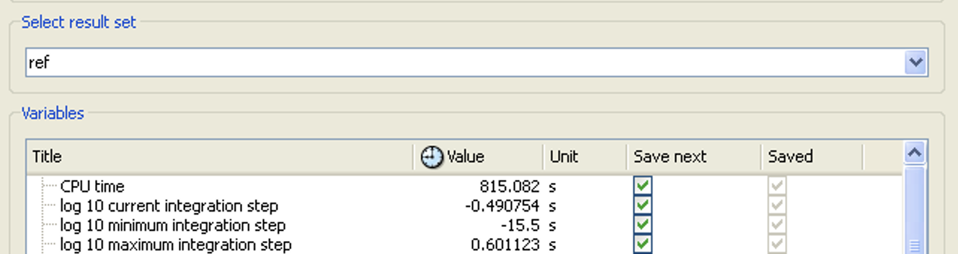
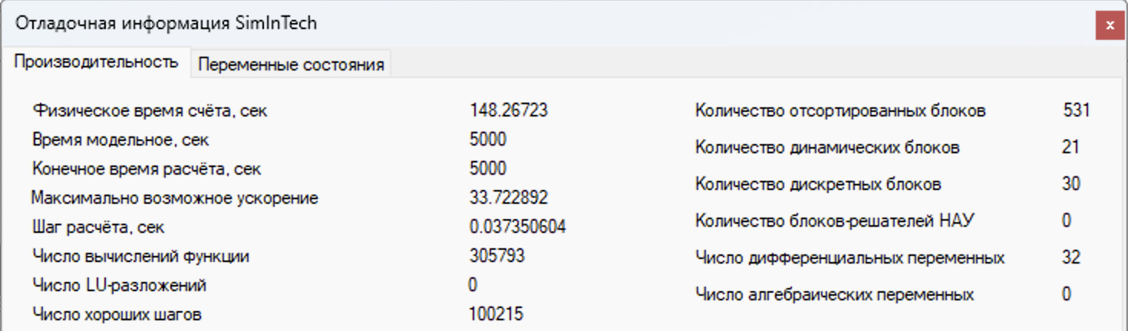
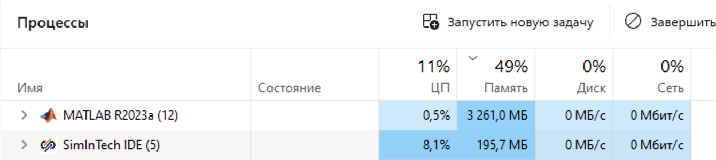
SimInTech is quicker than Siemens Amesim
The pilot project shows clearly a benifit SimInTech over Siemens Amesim with the same simulation setting (tolerance, step and integration method)
Effectiveness data | Siemens Amesim | SimInTech | imprivement
ROM consumption | 318,9 Mb | 195,7 Mb | в 1.6 times
Time of simulation process | 815 s | 148.26 s | в 5.7 times

Slide 9
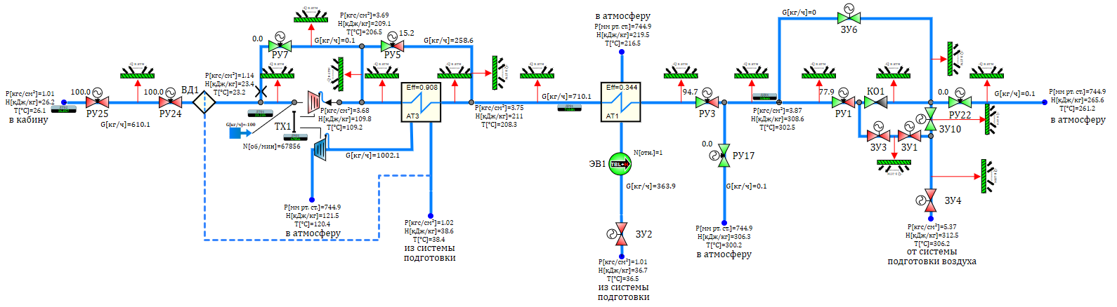
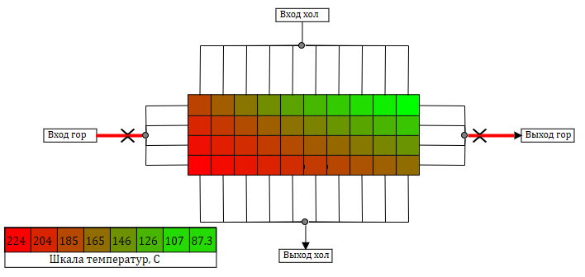
1D thermo-hydraulic simulation
SimInTech 1D thermo-hydraulic model for a high accuracy simulation of real aviation air conditioner systemes
Equations of flow of a compressible medium.
All necessary base blocks for mass and heat transfer in the circuits (fuel systems, air conditioner).
The component model created by using a real data from experiments.
The inner structure of heat exchange

Slide 10
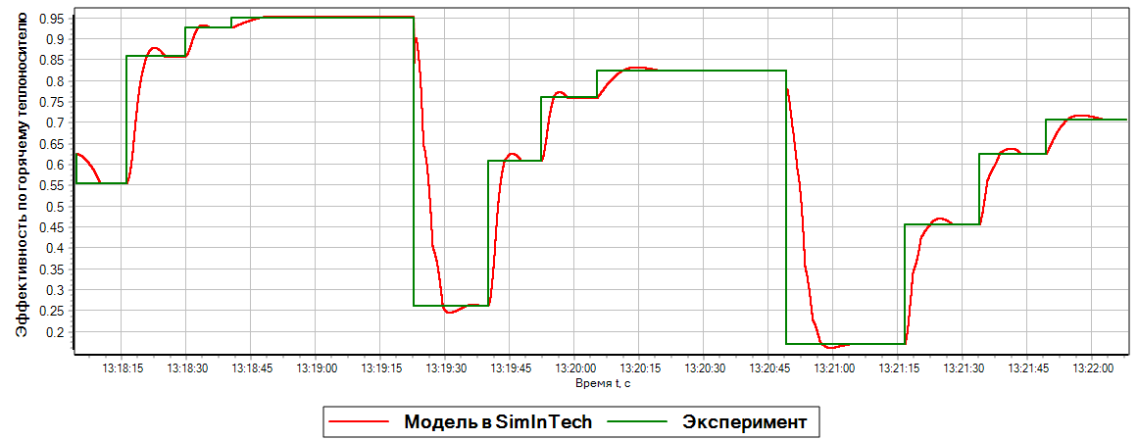
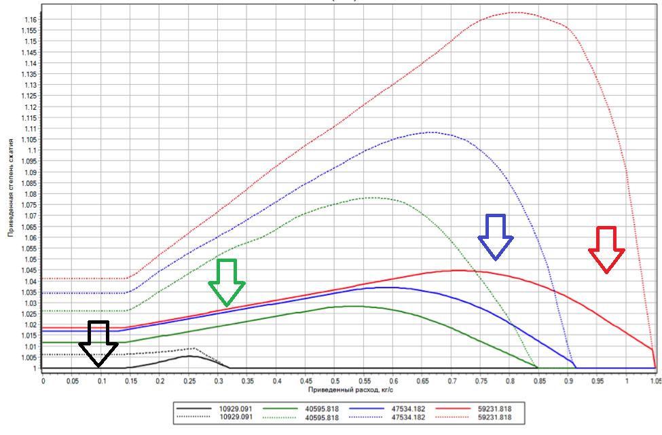
Increase an accuracy by an experimental data
SimInTech has a tool to correct automatically a simulation model by using a data from experimental testing real component
The diagram of tuning process for a heat exchanger simulation model
by finding correction factor for heat exchange increasing coefficients.
Statical error:
less than 0.1 %.
A tuning a turbo-refrigerator simulation model by a correction universal characteristic for a turbine and a compressor
The change of
characteristic
Error before and after correction | before | after
Follow rate | 20.5% | 0.5%
Rotation frequency | 31.1% | 0.4%
Expansion rate | 17.3% | 4.4%
Increase accuracy

Slide 11
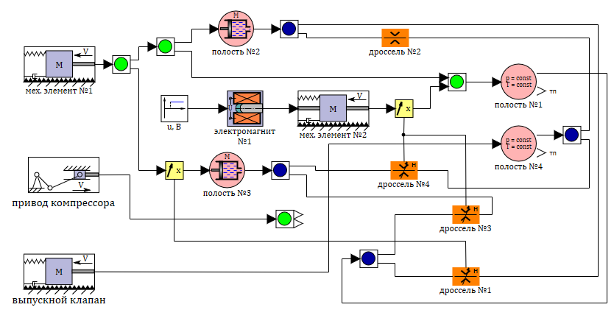
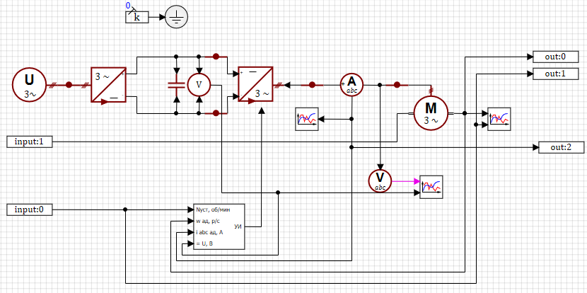
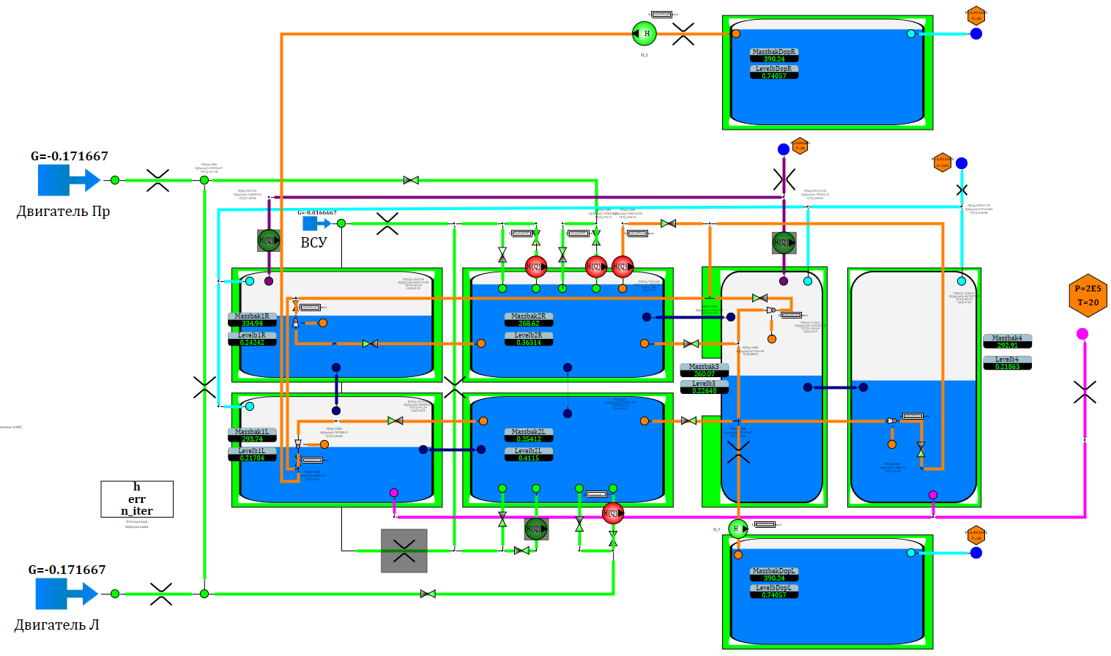
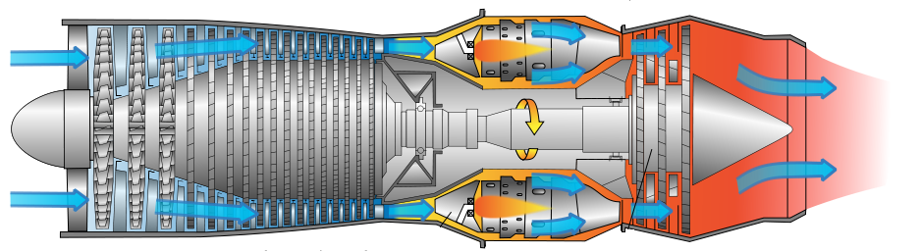
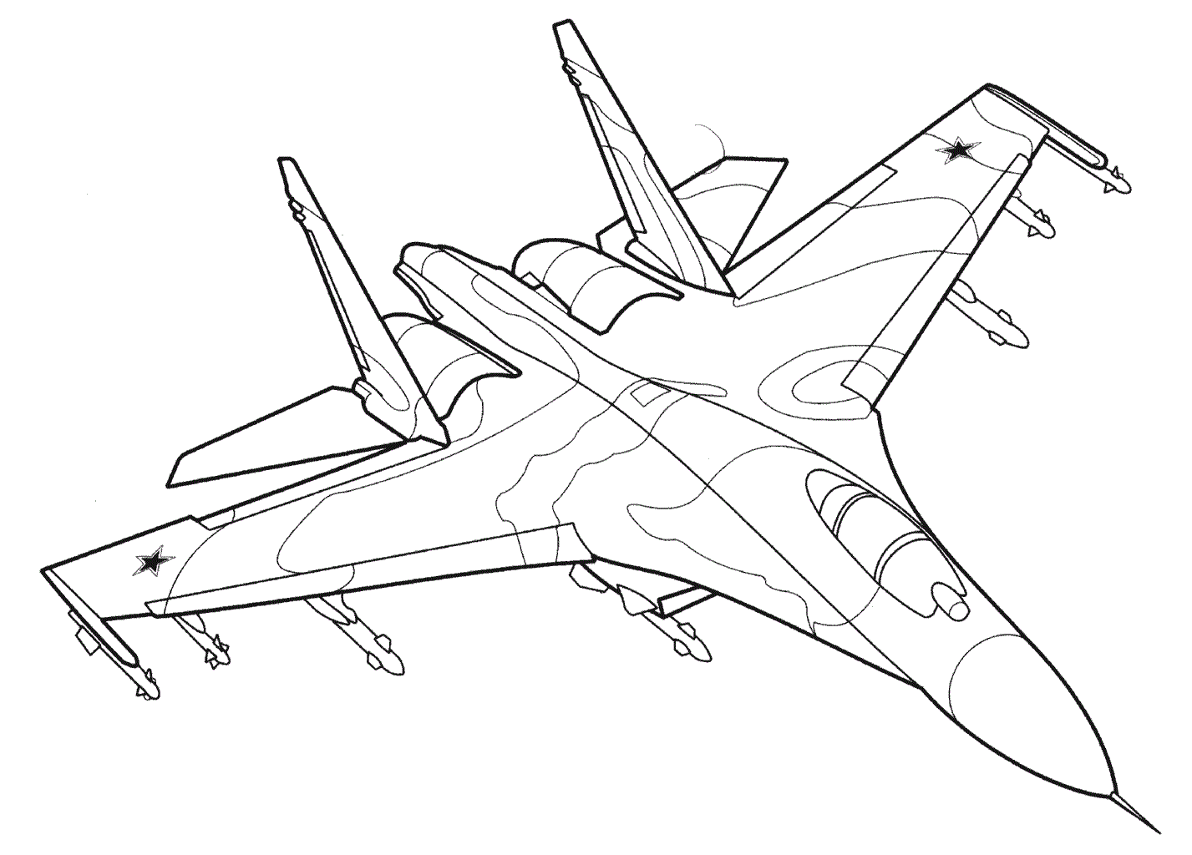
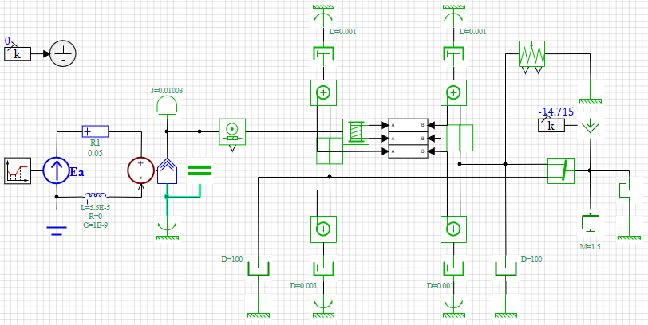
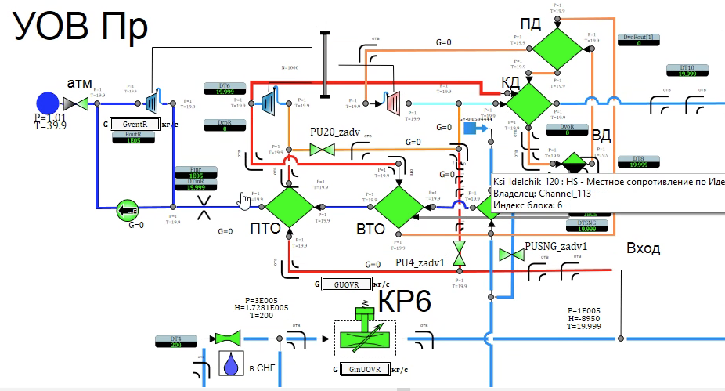
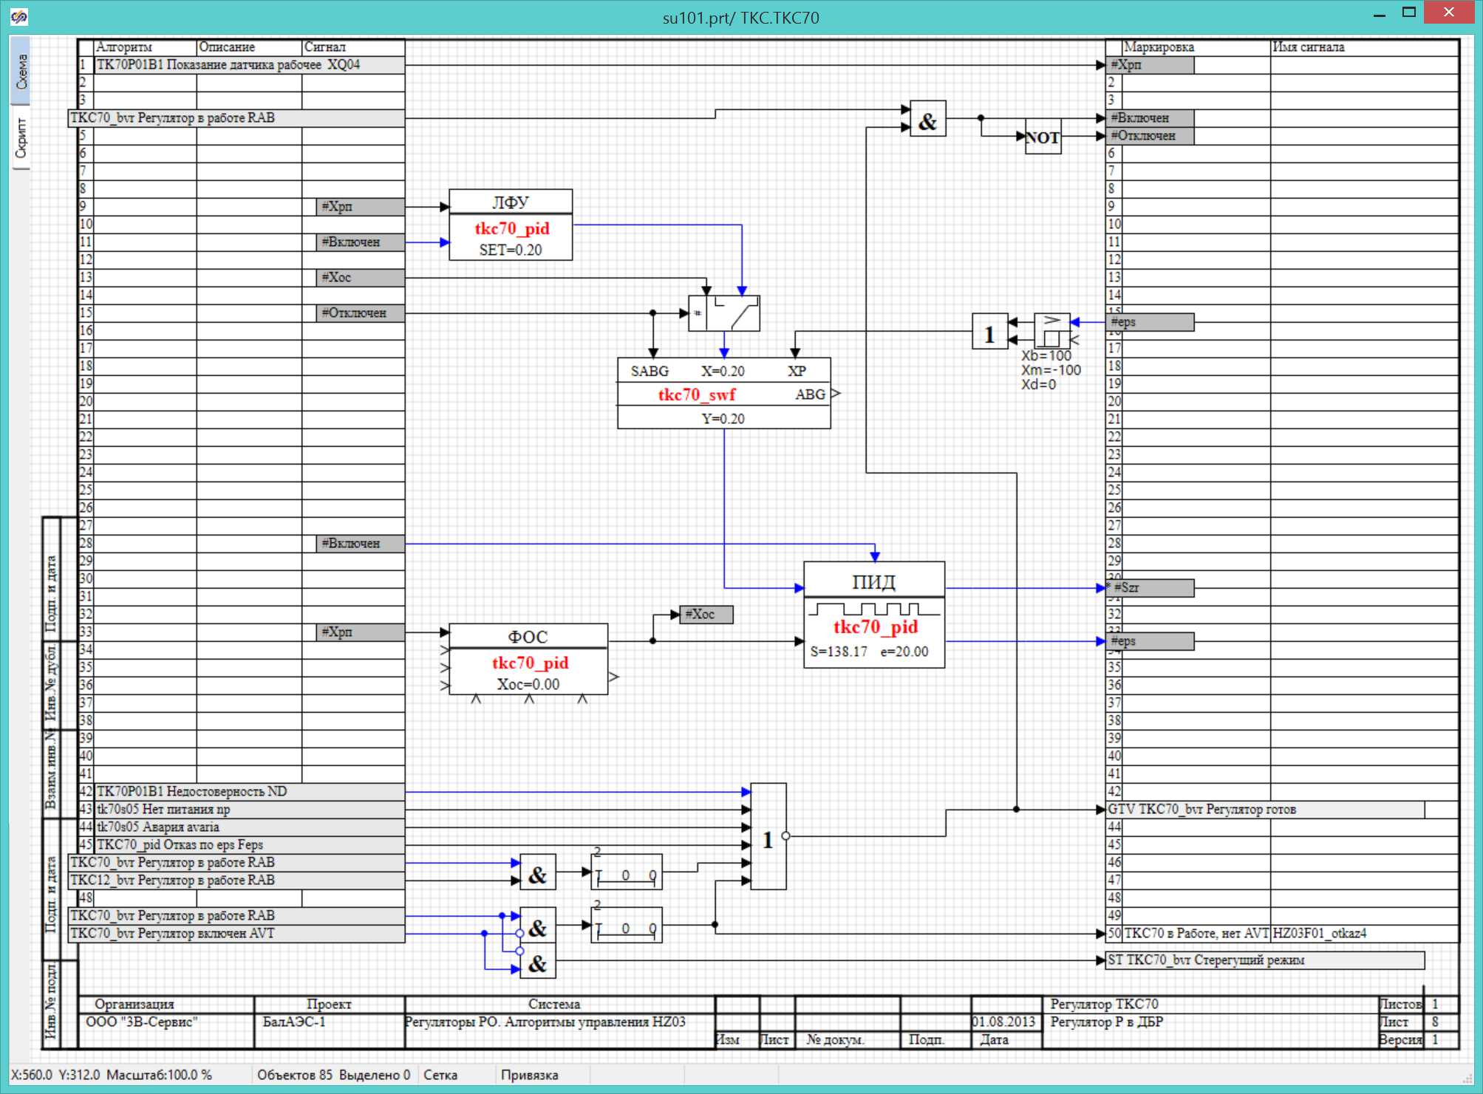
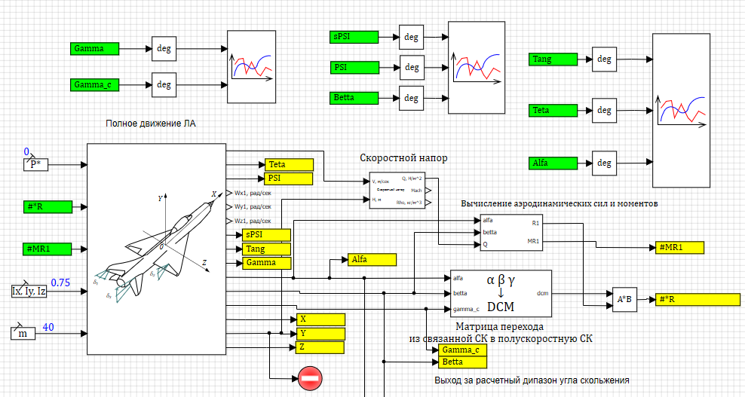
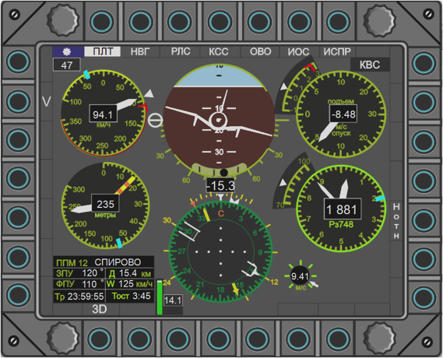
Multiphysics aircraft simulation
SimInTech block libraries alows create a complex model of all aircraft systems to get simulation interaction between systems in different scenarion
Hydro systems
Electrisity
Fuel tanks
Engine
Mechanical
Air conditions
Гидравлика
Software
Aircraft dymamic
Control
Complex simulation in SimInTech

Slide 12

SimInTech is answer to a sanction
2018 a local design of subsea gas extraction modules was started, the part of this project is recreating a SimulationX library to simulating subsea hydraulics systems
Advance of SimulationX: A special library for simulation subsea hydraulic control systemes - The SubSea Hydraulics Library, which was developed in cooperation with Agito Tecно Dynamics – a subsea engineering consulting company.
Results with SimInTech
The special library was created and validated.
Simulation model of subsea control systems for a real project.
More features then SimulationX:
A design of control system software in SimInTech diagrams.
An automagical code generation for real time controllers.
A «Hardware in loop» testing facility for control systems .

Slide 13
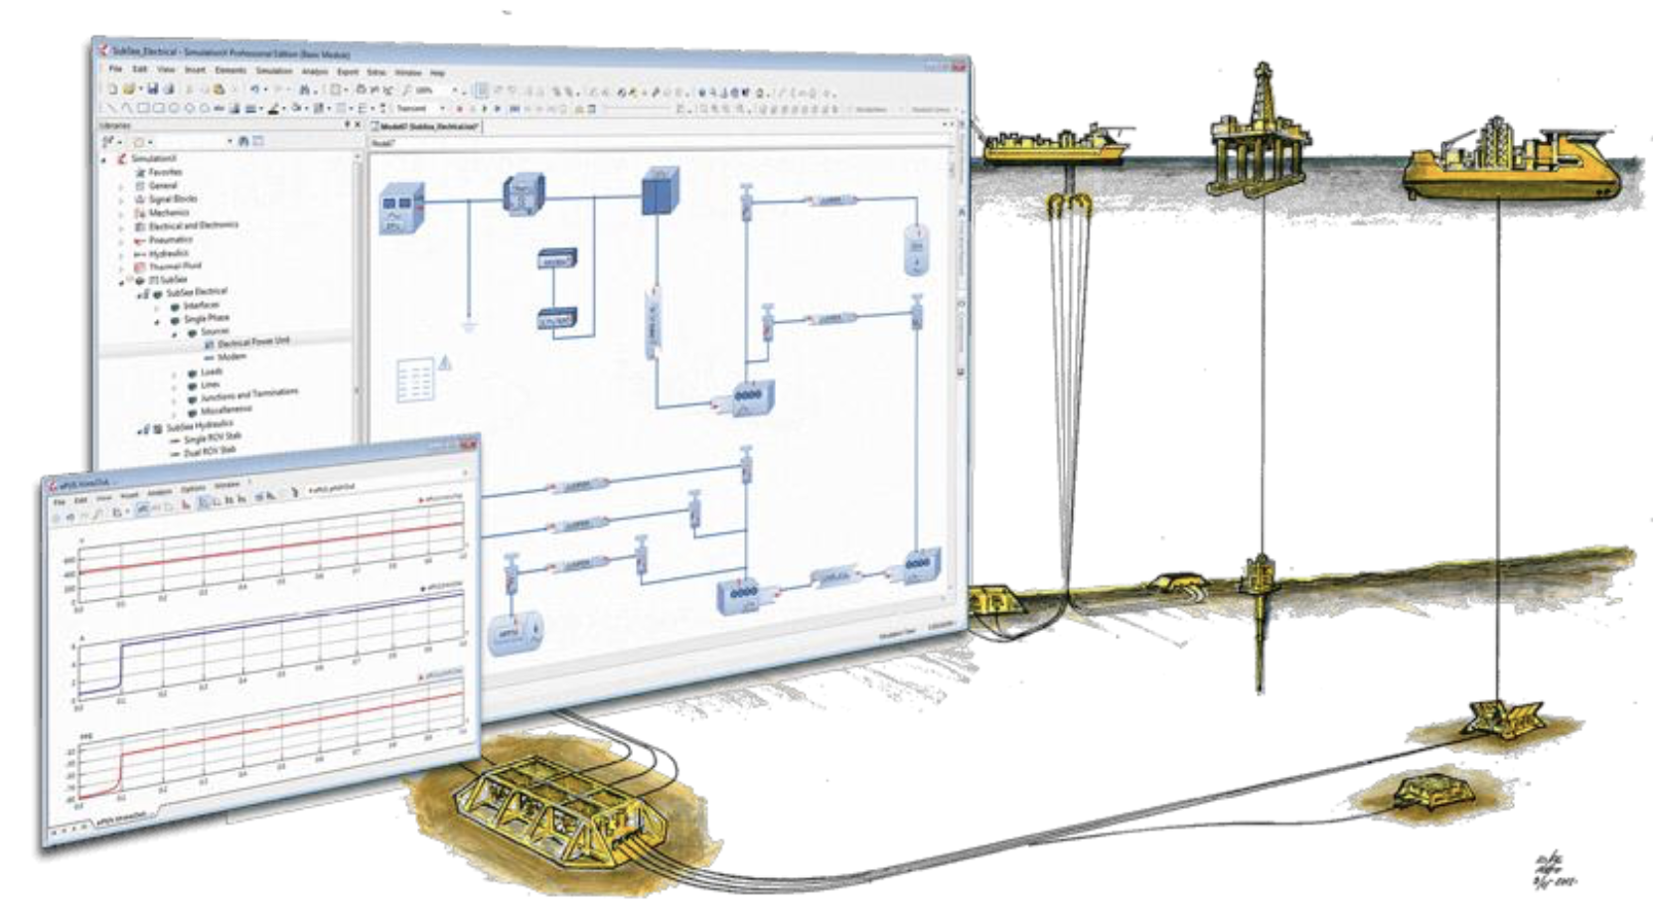
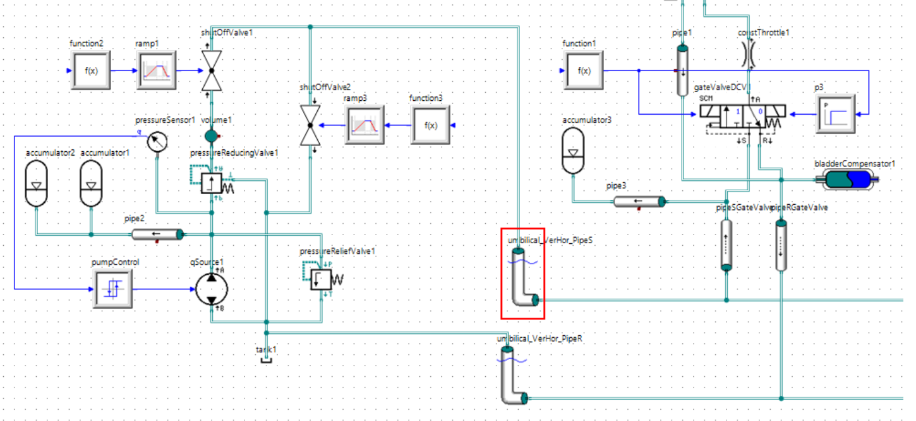
SimulationX Subsea Hydraulics Library
Simulation of a subsea hydraulics control systems needs some special equations and components which exists in SimulationX Subsea Hydraulics Library
Advantages of Subsea Hydraulics Library:
It was created for subsea hydraulic simulation by a professional team with a big experience in subject.
It was validated on a data from real subsea facilities.
It has big history of using by many companies.
Disadvantage
The European sanction for a subsea oil and gas industry

Slide 14
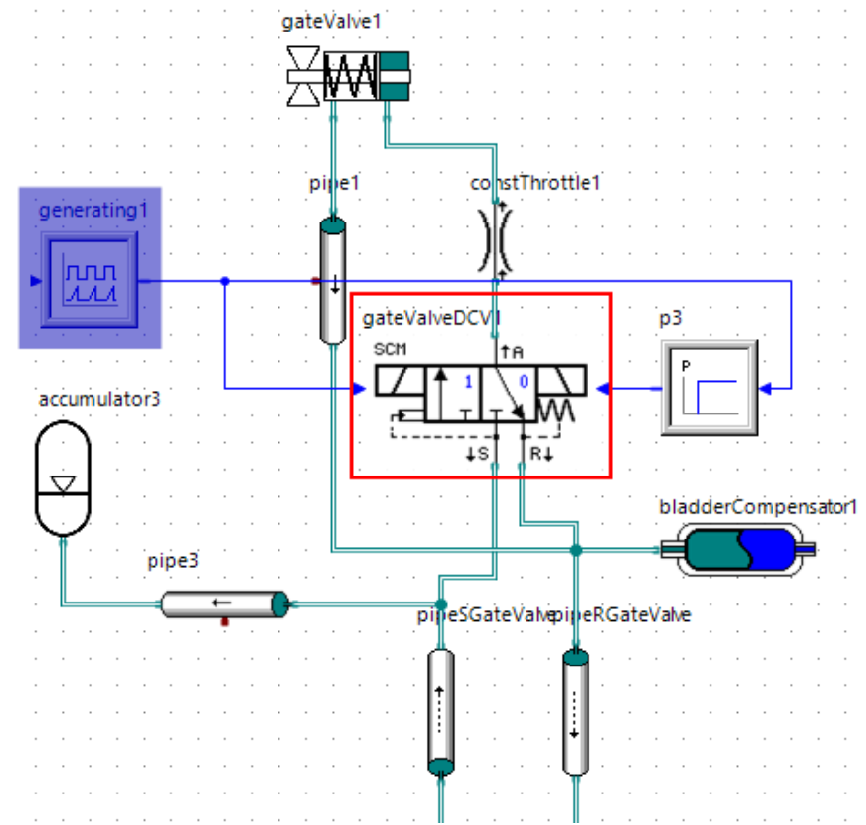
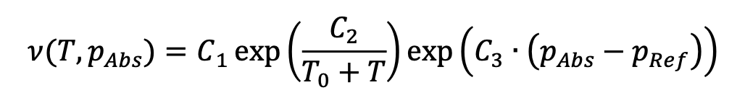
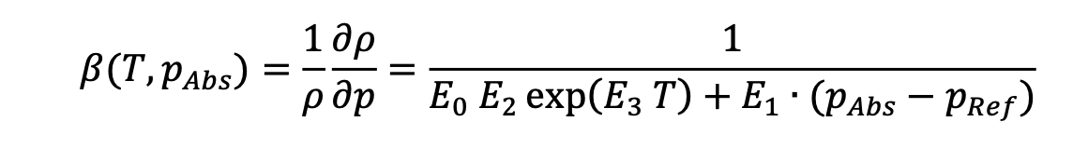
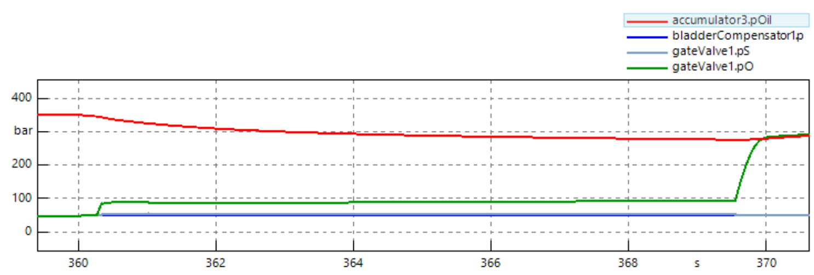
Cross verification with SimulationX
А contract between 3VS and ESI to create a reference simulation model of subsea hydraulic control system in SimulationX software
Simulation model in SimulationX consist of:
A set o main elements for subsea hydraulic systems.
The characteristic of customer equipment.
Setting of control systems to simulate real processes.
ESI made simulation and created a report included:
Main technological processes.
Parameters of equipment during process.
Mathematical equations and simplification used for simulation.

Slide 15
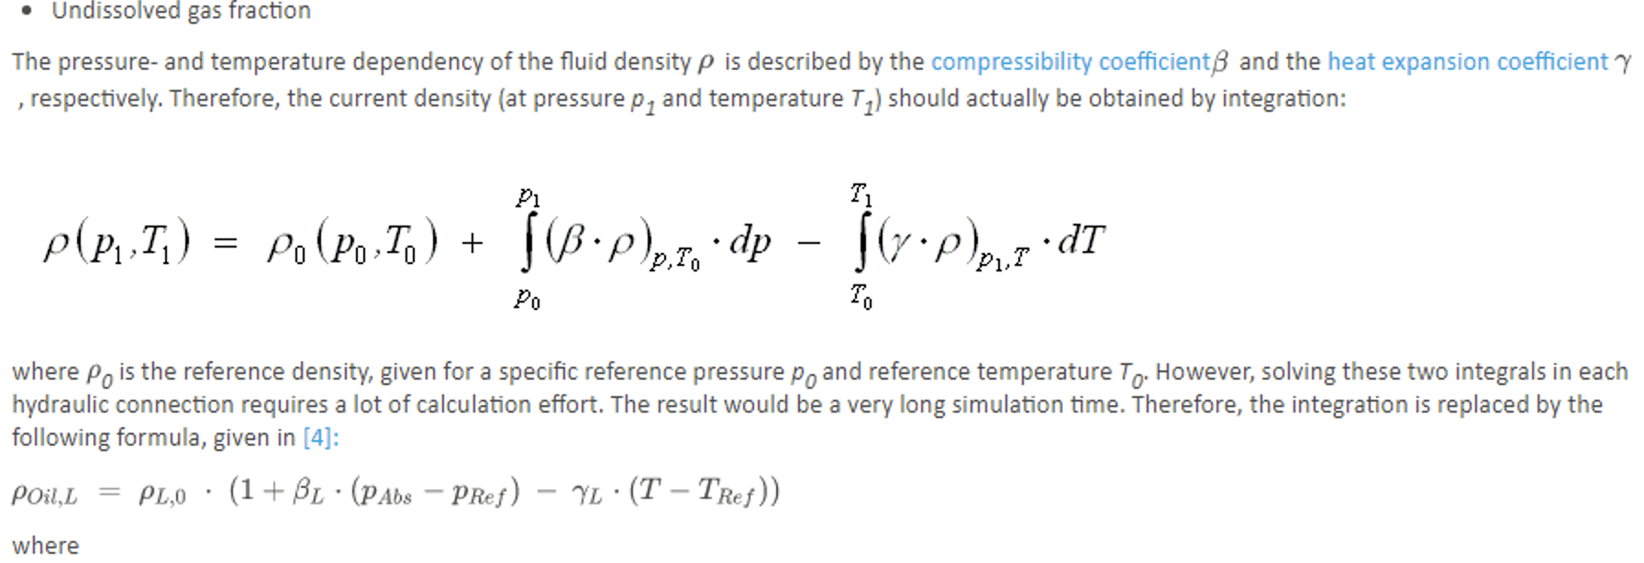
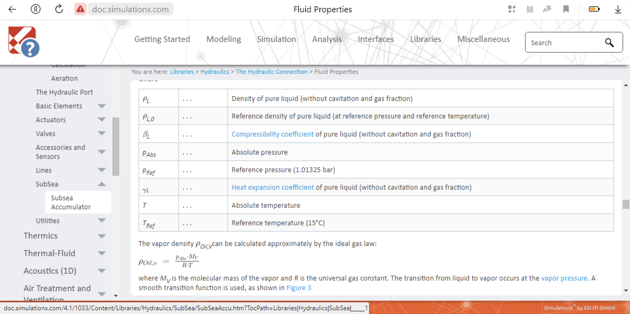
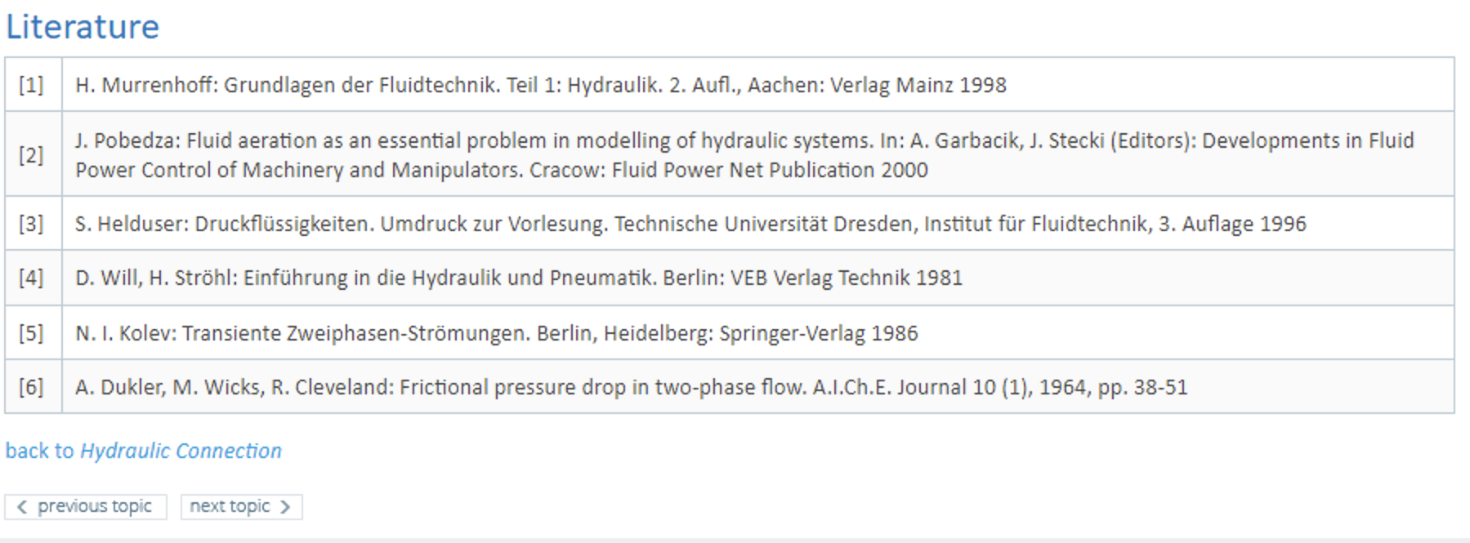
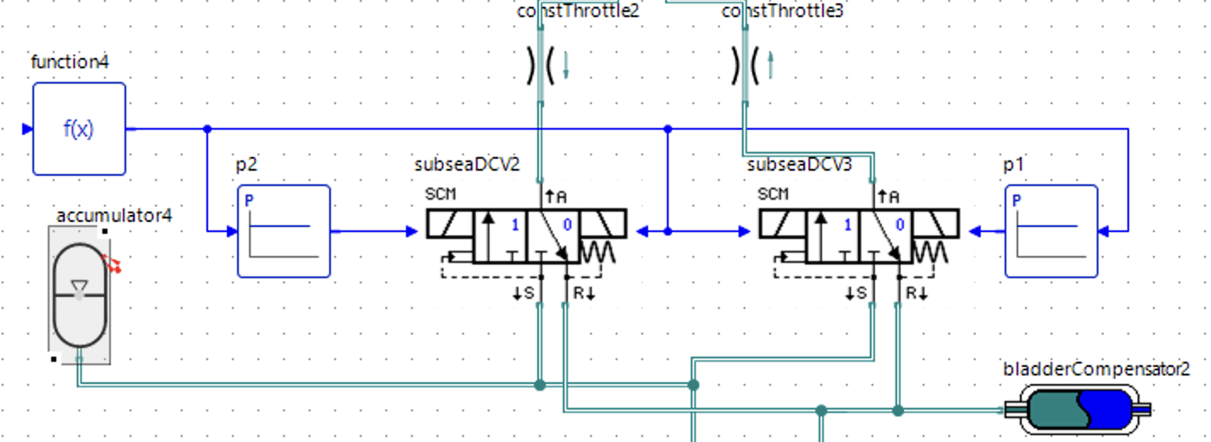
Using a help systems of SimulationX
A SimulationX help documentation was used for a recreation simulation models in SimInTech their «built in» tools allow made a new block easy an quickly
Help documentation includes:
Assumptions and simplifications used for simulation.
Mathematical equations.
Referent list of a science literature.

Slide 16
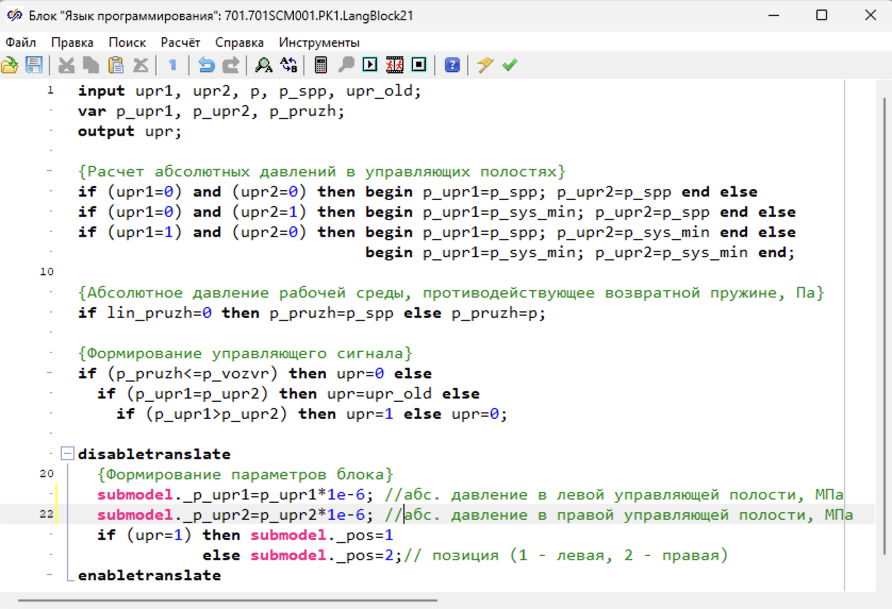
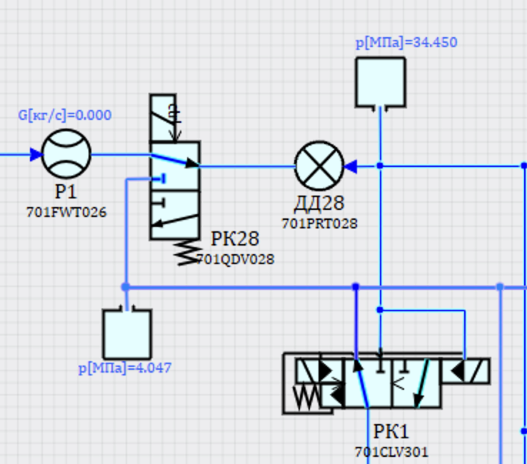
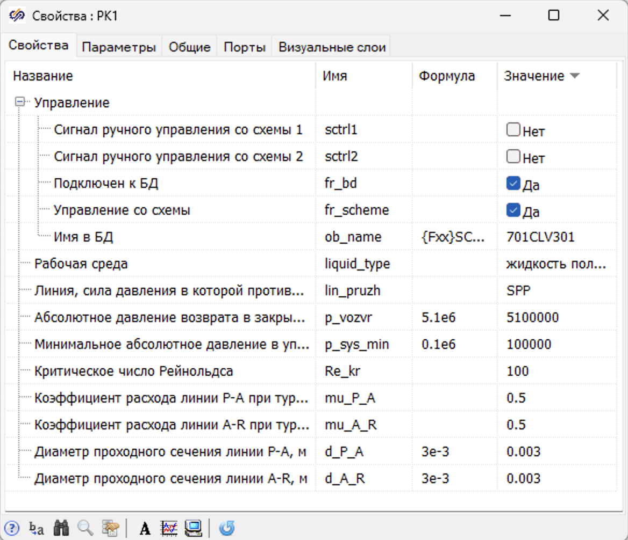
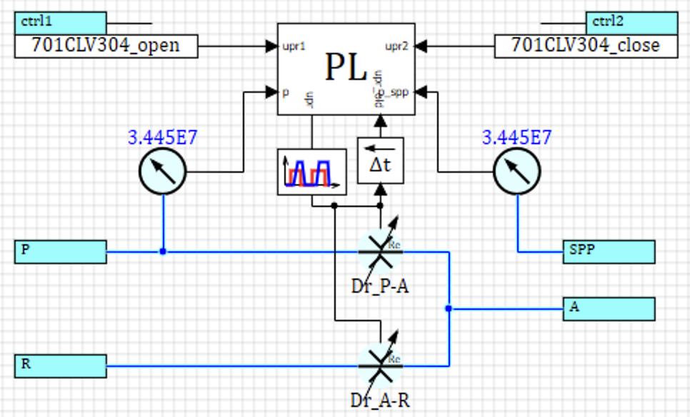
Open block library of SimInTech
Closed SimulationX Subsea hydraulic library was recreated as SimInTech block library, open for analyses and modification by customer
SimInTech open library:
Visual representation for engineers.
Open for modification.
Easy simulation control.
SimInTech script text
Block properties
Block diagram

Slide 17
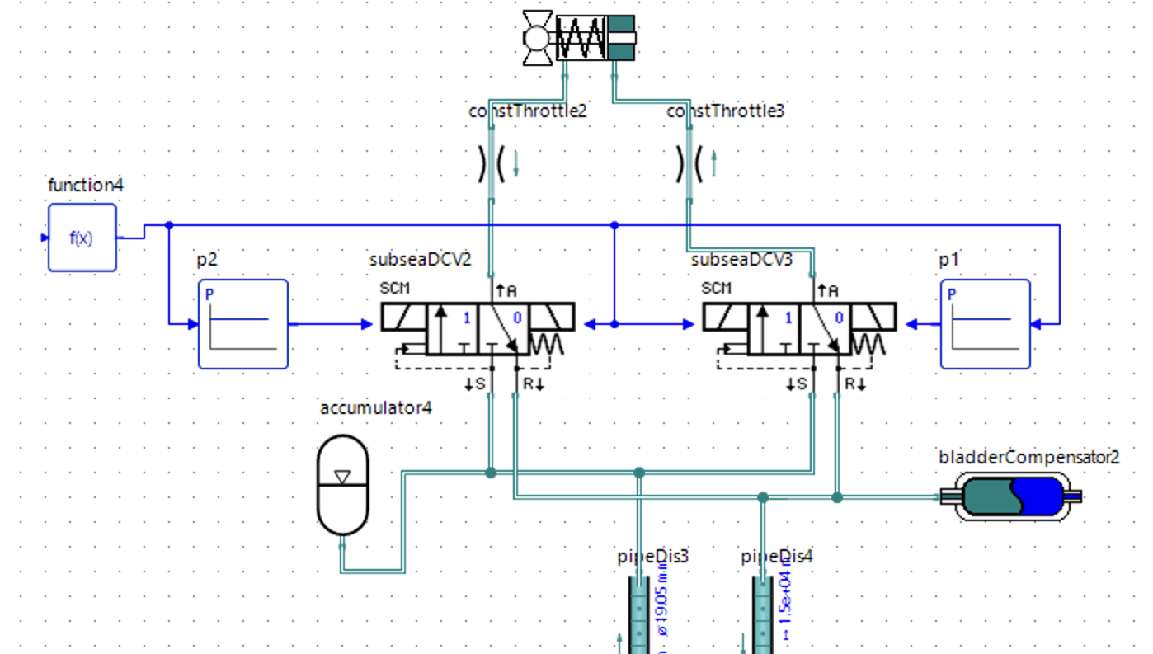
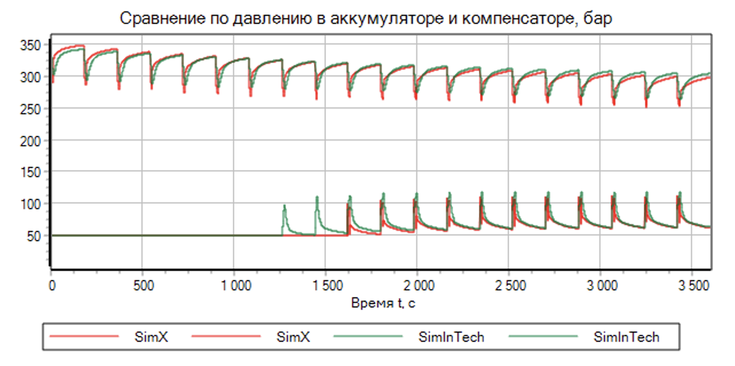
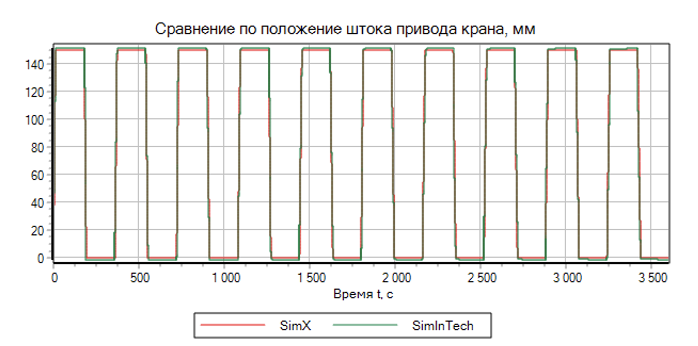
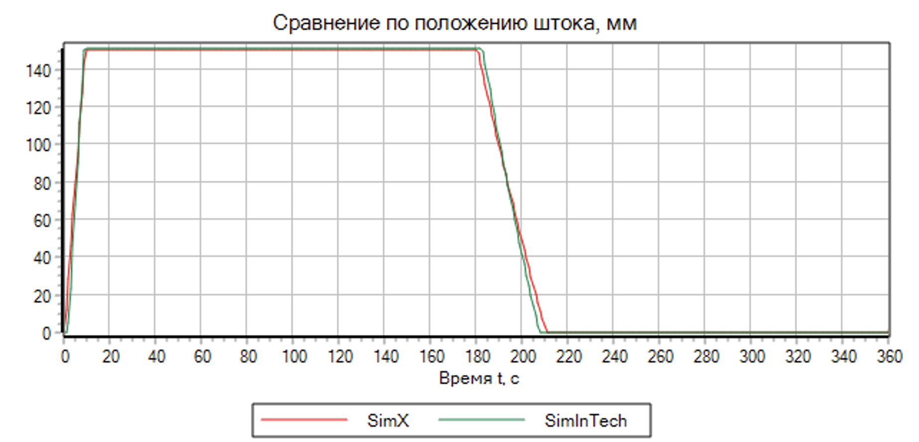
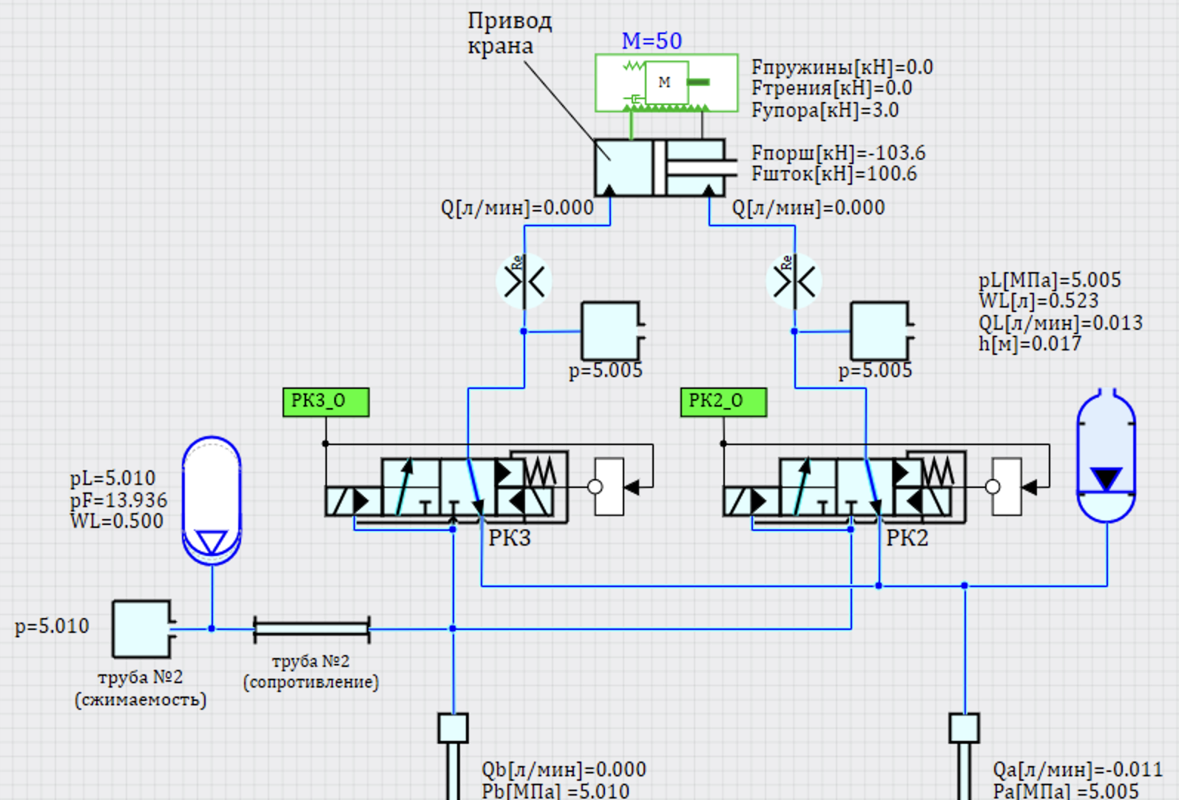
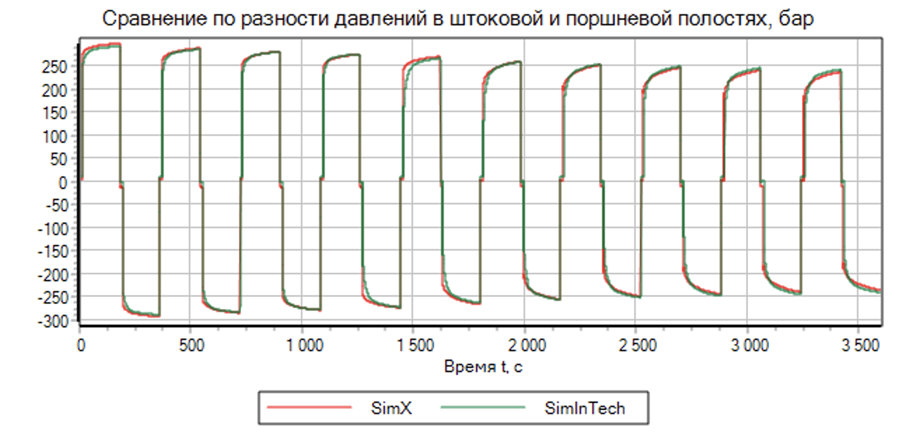
SimInTech block verification
The SimInTech simulation results in some test model was compared with SimulationX simulation results, and was not discovered any sufficient difference
SimulationX diagram
Results of verification
SimInTech diagram

Slide 18
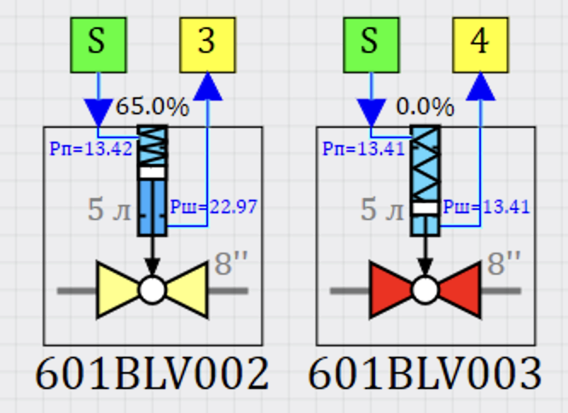
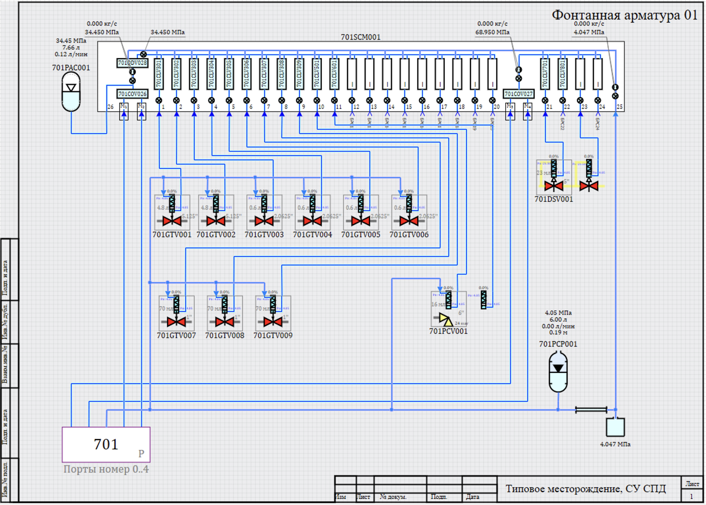
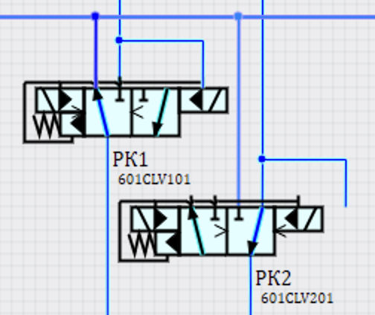
Subsea hydraulic systems in SimInTech
The subsea hydraulic control systems simulation model in SimInTech has significant advanced features over the model in SimulationX
Advance features od simulation:
Visual representation model as standard P&ID diagrams.
Animation of process on diagram during simulation.
Code generation for control software.
Animated valve position
Position of switcher
Simulation model as P&ID diagram

Slide 19
MATLAB Simulink vs SimInTech
Switch from Simulink to SimInTech is easy task, which is increase effectiveness
of a simulation process by more effective original mathematical core
Simulink:
Big amount of installation in Russia, and a lot of simulation models at customer.
Special aerospace toolbox (“ready to use” blocks) for aircraft dynamics.
Existed experienced engineers, who don’t want to change simulation tools.
Big amount of demo examples and learning materials.
SimInTech:
A Transfer Simulink model to SimInTech – simple and quick process.
Permanente developing new special blocks library in SimInTech.
Support Russian standards.
Lesson material and SimInTech course.
An direct access to SimInTech developers
Прямой доступ к разработчикам моделей и библиотек.
Speed calculation and effectives of calculation эффективность использования вычислительных ресурсов вырастают в 4 – 17 раз.

Slide 20

Source model of missile in MATLAB Simulink
The the missile model is created by using Aerospace Toolbox. As example 6DOF(Euler angels) equation of motions, a Atmosphere Model
Goals od simulation:
Missile trim
Stability analysis
Autopilot deisign
Source model can be obtained from:
https://github.com/JohannesAutenrieb/MissileSimulation

Slide 21

Missile model in SimInTech
The missile model in SimInTech repeated a missile simulation model Simulink
(to demonstrate a capability of SimInTech)
The goals of demo project:
Using SimInTech instead of Aerospace Toolbox
Time and cost assessment
Compartment of a software functionality
Compartment of a simulating tolerance
Assessment in computing power usage

Slide 22


Problems of direct сomnipresent with Simulink
For a simulation model of moving object there are difference in axis direction in Russia and USA standards of aircraft design
Axis direction in Simulink (USA)
Axis direction in SimInTech (Russia)
Model of aircraft in SimInTech:
Take in account the moving of Earth.
Using the Russian standards for axis directions.
Two variants of creation as a block diagrams or a SimInTech language scripts.

Slide 23





Myths about Aerospace Simulink ToolBox
Most part of blocks in Aerospace Toolbox is simple blocks which can be recreated in SimInTech ieasy n very short time
Pilot simulation Model
Turbofan Engine System

Slide 24


Recreation «nonstandard» model in SimInTech
Existed Simulink block you can be easy recreated by a blocks for a direct comparison between Simulink and SimInTech
Conversion from Simulink to SimInTech:
Automated for standard blocks.
Manual for blocks, which is not have corresponded block in SimInTech.
Test SimInTech model.

Slide 25


How can you read m-file in SimInTech?
To read MATLAB Scripts form m-file you can use «Export form MATLAB», which can allow you to convert a script code and comments
SimInTech script
МATLAB script

Slide 26





Easy recreate = easy testing!
Создаваемые блоки проверяются путем создания идентичных тестовых входных данных и сравнения результатов расчета Simulink - SimInTech
Simulink model
Save to file
Simulink result
A result difference
Test
input
SimInTech model
SimInTech result

Slide 27


There is no difference in simulation result
Simulation result shows that the difference in result between Simulink and SimInTech is less than a simulation tolerance
The project result:
The results in SimInTech the same as Simulink.
Assessment of time and cost of a transfer Simulink model to SimInTech.
Demonstrate saving a knowledge in SimInTech.

Slide 28



SimInTech – citius, altius, forties.
Advantage of SimInTech model over MATLAB Simulink model with equivalent simulation setting (tolerance, integration time step and integration method)
Effectiveness parameters | MATLAB Simulink | SimInTech | advanced
RAM consumption | 3 262,9 Mb | 195,7 Mb | in 17 times
CPU load | 34.1% | 8.1% | in 4 times
Simulating time | 4.28 sec. | 0.909 sec. | in 4.5 times

Slide 29









SimInTech for control software
SimInTech can be used as a full cycle tool for design and production of control systems software from a scratch to code generation
A big scale of control systems simulation (Nuclear Power Plant as example).
A standard and customizable form for a software documentation.
A simulation control software with model of controlled object in complex model.
Auto generation a source code for controllers.
An optimization of control systems algorithms.
Hardware
equipment
Code
generation
Upload
20%
Source code
The diagram of algorithm

Slide 30


Example of optimization
SimInTech was used for control system optimization for an aviation air condition systems with at design stage of real equipment
Transient process before and after optimization
Control parameters | Flow rate |  | Pressure |  | Temperature
value before and after optimization | До | После | До | После | До | После
Integral error | >1620.25 | 87.31 | 481.52 | 410.69 | >4000 | >2875
Overshoot, % | 0 | 19.91 | 17.69 | 24.40 | 0 | 0
Total transient time, sec | >148 | 9.2 | 59.39 | 26.65 | >650 | 301
Имение характеристик
Increasing control accurasity

Slide 31





SimInTech сcomplex simulation
SimInTech can be used to create complex model consist of operator control panel, object model, control software (include hardware in loop)
Object model
Control software
actuators
command
simulated
parameters
input
signals
database
sensor
data
indicator
values
Upload and debagging
command
Control panel
operator
command
20%
Control system
Object model
Hardware

Slide 32
Conclusion
SimInTech can be used together or instead of wester simulation software in design and development different technical production
Switch from wester software to SimInTech is not difficult and high expensive process.
New toolbox and specific industrial simulation solution can be created on SimInTech base.
Simulation in SimInTech use hardware in more effective way.
Welcome to partnership!

Slide 33
  www.SimInTech.ru
  Viacheslav Petukhov
  +7 (926) 531 88 97
  info@3v-services.com
  т: +7 (495) 221 22 53
  ООО 3VS LSS

