Slide 1

Software Design for Computer-Based Instrumentation and Control Systemes
Use of SimInTech technologies for designing and development
of I&C systems.
Author: V. N. Petukhov
v.petukhov@3v-services.com

Slide 2

Content
General Information on SimInTech
SimInTech for Design and Development of Control Systems
SimInTech Graphics
SimInTech Mathematical Core and Code Generation
I&C System Design and Development Life Cycle
NordWind Executive Environment
Main Examples of SimInTech Implementation
Conclusion

Slide 3


Challenge
Computer-aided design of I&C System and creation the application software for control systems powered real time operating system
Better (quality of code)
Faster (reduction of terms)
Cheaper (cost-efficiency)
From idea to result in natural environment:
process design of control algorithms;
verification of algorithms by means of mathematical
modeling;
development of programs in the C language for devices based on real-time OS;
control program debugging in controllers powered by RTOS.
20%

Slide 4
What is SimInTech Main Purpose ?
SimInTech Integrated Development Environment enables visual programming, i.e., development of programs for QNX by creating function block diagrams
Problem
  Informational gap between system designer and programmers implementing control programs.
Solution
SimInTech provides end-to-end design of control systems and automatic generation of initial code in C for QNX directly from the design of I&C algorithms without attendance of programmers.
SimInTech is the first Russian algorithm design environment certified for application in systems critical for nuclear safety (IEC 60880).
20%

Slide 5
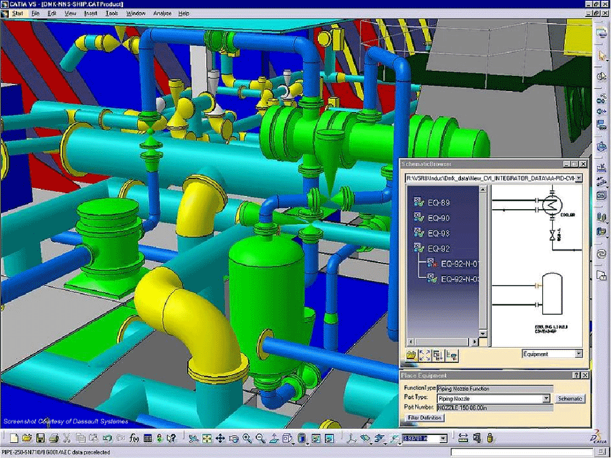
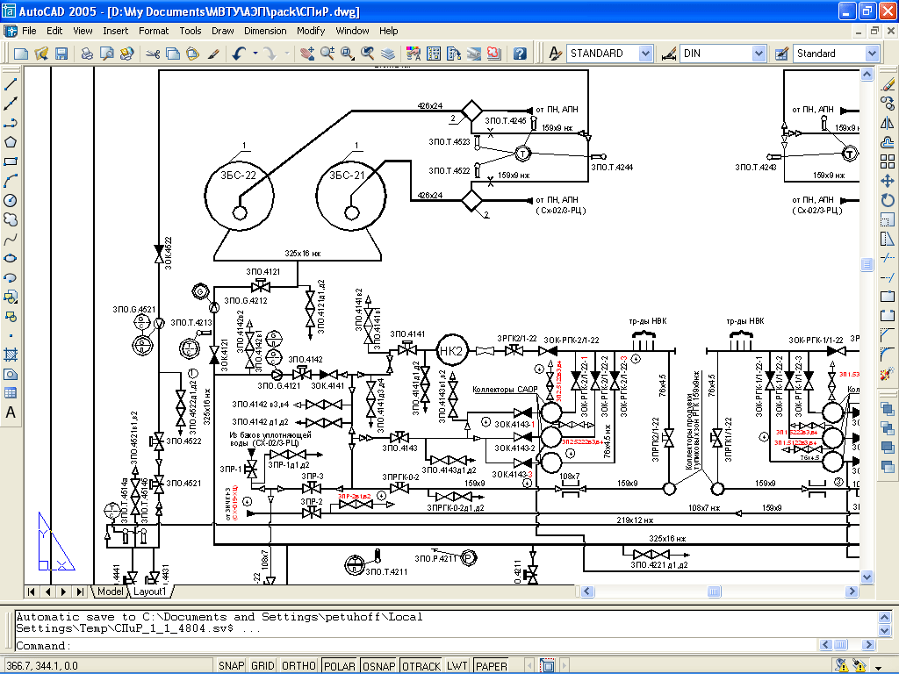

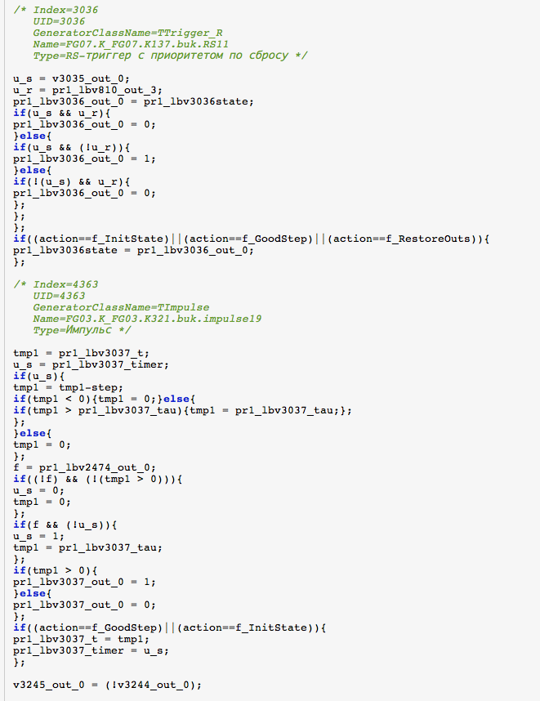
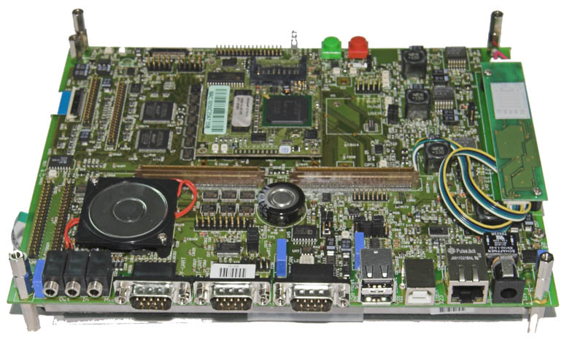



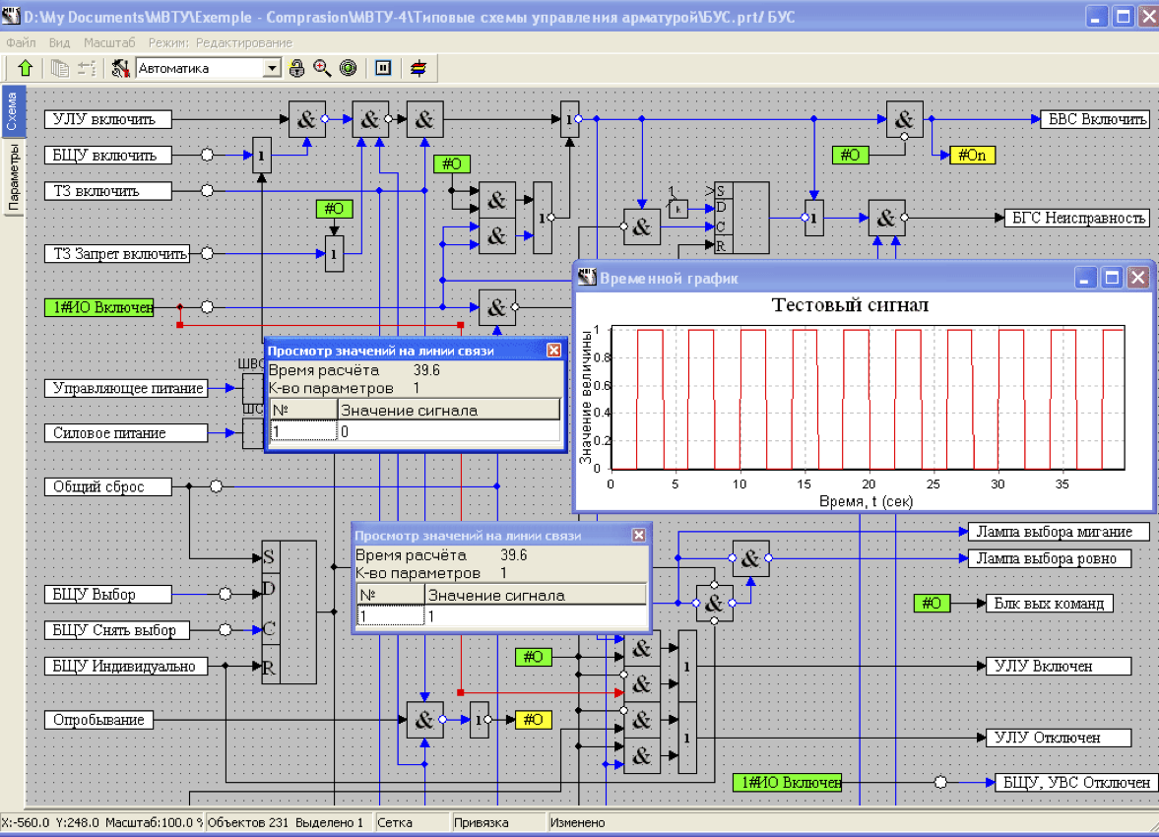
APCS Programming Problems
Development of APCS for a complex facility requires iterative interaction to be arranged between APCS technologist, designer and programmer.
Traditional pattern for development of control programs
interpretation
C-program
technical specifications
(text, diagrams, tables)
I$C testing, rectification of programming errors
System designer
programmer
Application of SimInTech
test calculations of algorithms
no programming errors
certified C-code
100% compliance with Technical Specifications
generation
C-program
technical specifications
in SimInTech format

Slide 6
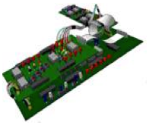

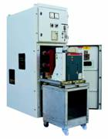
General Application Pattern
Development of control algorithm in graphics environment as a checkable mathematical model and generation of C-code directly from the model.
idea (model)
algorithm
C-program
controller
code generation
program debugging
in controller
data exchange
20%
I&C testing
Algorithm designing IDE
APCS

Slide 7
Solution Capabilities
SimInTech visual design environment is a solution for replacing the traditional “manual” programming of controllers
SimInTech ensures the following functions:
check of control algorithms by modeling, including a model of an object under control;
development of documents related to the design of control algorithms;
feedback among algorithm designers and I&C hardware executers;
automated monitoring of introduction of changes into control algorithms;
representation of algorithm operations within a device in debugging mode;
classification of data on I&C algorithms within the whole life cycle of an object;
storage and re-use of ready design solutions and projects.
20%

Slide 8
Content
General Information on SimInTech
SimInTech for Design and Development of Control Systems
SimInTech Graphics
SimInTech Mathematical Core and Code Generation
I&C Design and Development Life Cycle
NordWind Executive Environment
Main Examples of SimInTech Implementation
Conclusion

Slide 9
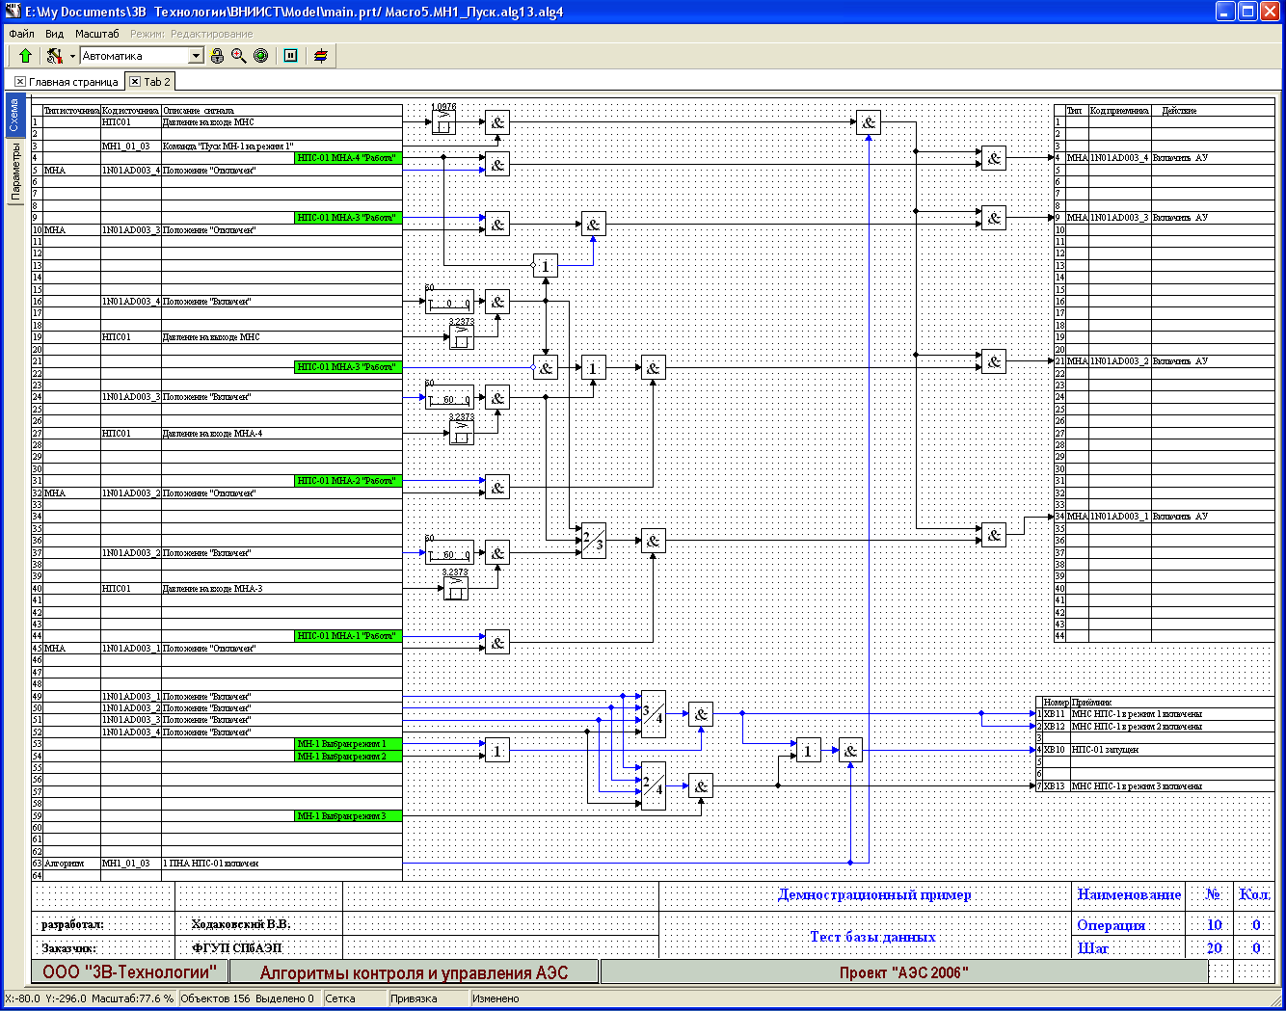
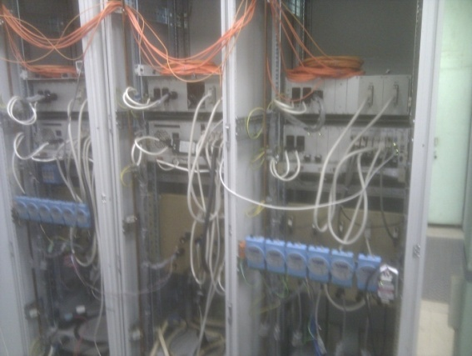
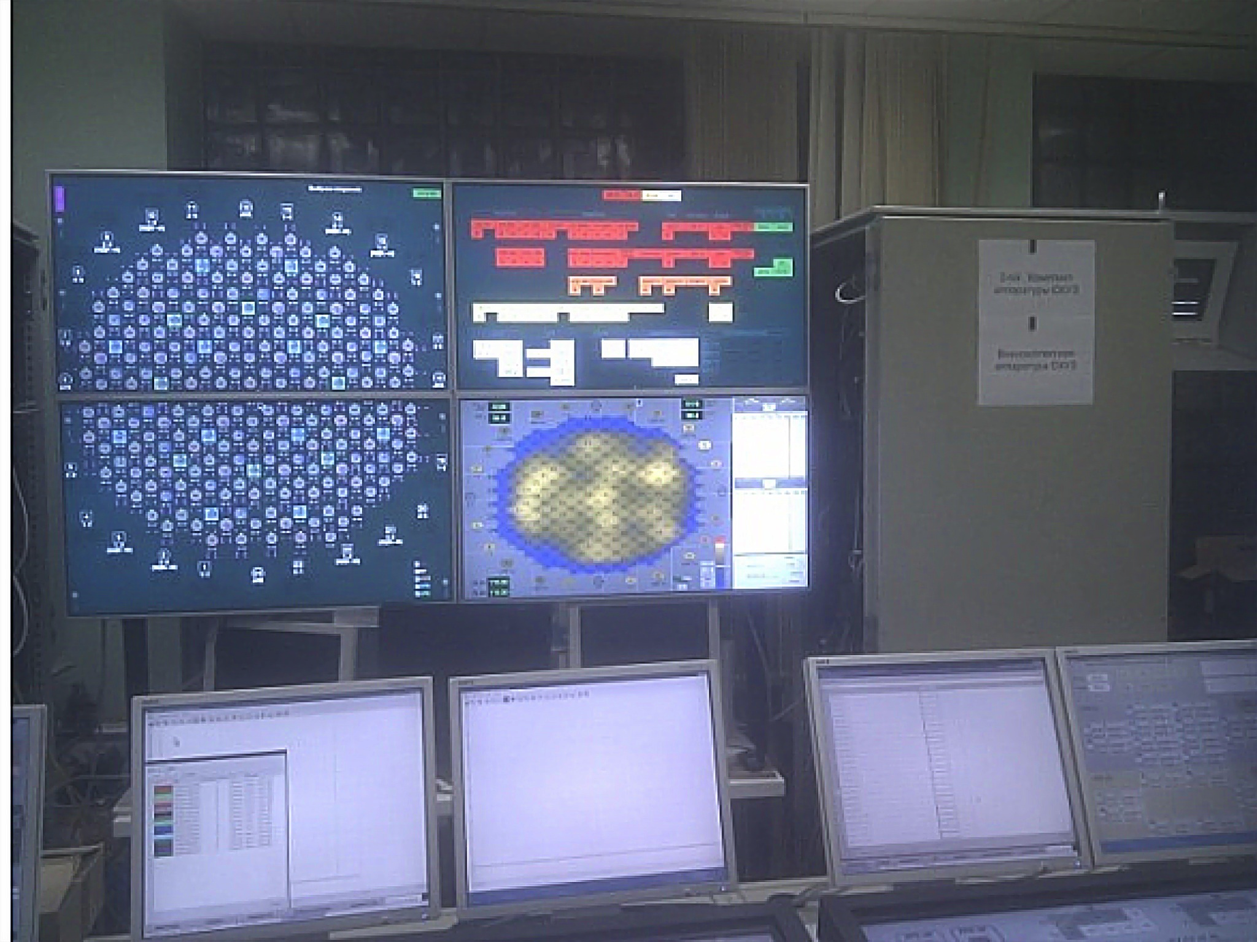
APCS Development Process
SimInTech contains all tools required for complete automation of programming
and debugging application software for computer based I&C Systemes
Design of algorithm diagram and local modeling
Design of diagram in diagram graphics editor
Development of program for controller using algorithm diagrams
Analysis of topology by means of automatics local core
Algorithm debugging in controller
Running of loaded programs for debugging via controller exchange server
Local modeling by means of automatics modeling core
Loading of generating module and generation of algorithm C-code for external executive system
Compilation of program code for controller using QNX pattern and cross-compiler
Loading of compiled programs into controller via ftp
Connection of the diagram via client’s debugging module and data exchange server

Slide 10
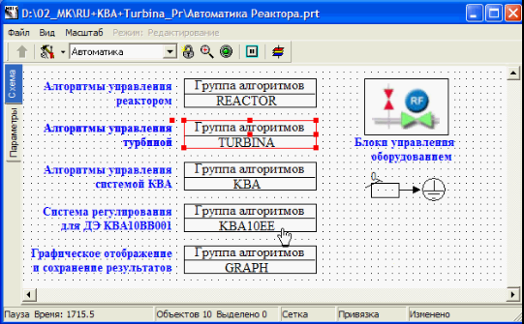
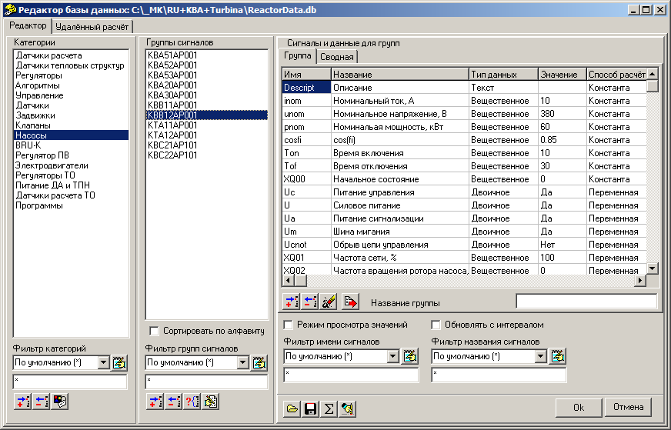
Algorithm Design
SimInTech ensures development of fully verified and documented algorithm design for applicatopn software for computer based I&C Systemes
Peculiarities:
design structure as nested blocks;
sheets of algorithms as function block-diagrams;
structured signal database.
20%

Slide 11
Signal Database
Object-oriented database for development, storage and use of signals.
Intended for categorization and structuring I&C systems data.
Includes:
Categories – named sets of signals related to any type of objects of the design (pumps, gates, sensors, algorithms);
Groups of signals – signals related to a certain object;
Signals – design variables to be used in algorithms.
Example: Pump start-up time
KBB12AP001_Ton
20%
Pump name in the design
Signal name in the pump-dedicated set

Slide 12
Visual Design
SimInTech ensures development of I&C systems design as a classified set of functional block diagrams
Advantages of SimInTech:
Multy-language interface;
Random adjustability of algorithm diagram appearance;
Generation of patterns for structuring the algorithm design (algorithm system, group, sheets);
Execution of documentation as per ISO state standard and (or) standards applicable in company:
  Designation of blocks on the diagram;
  Frames, clarifying notations.
Visual layers available for different elements of the algorithm diagram;
Automation of document blank filling with service information.
20%

Slide 13
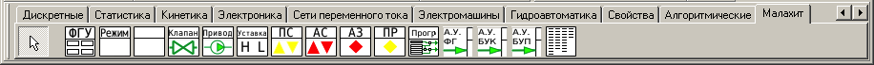
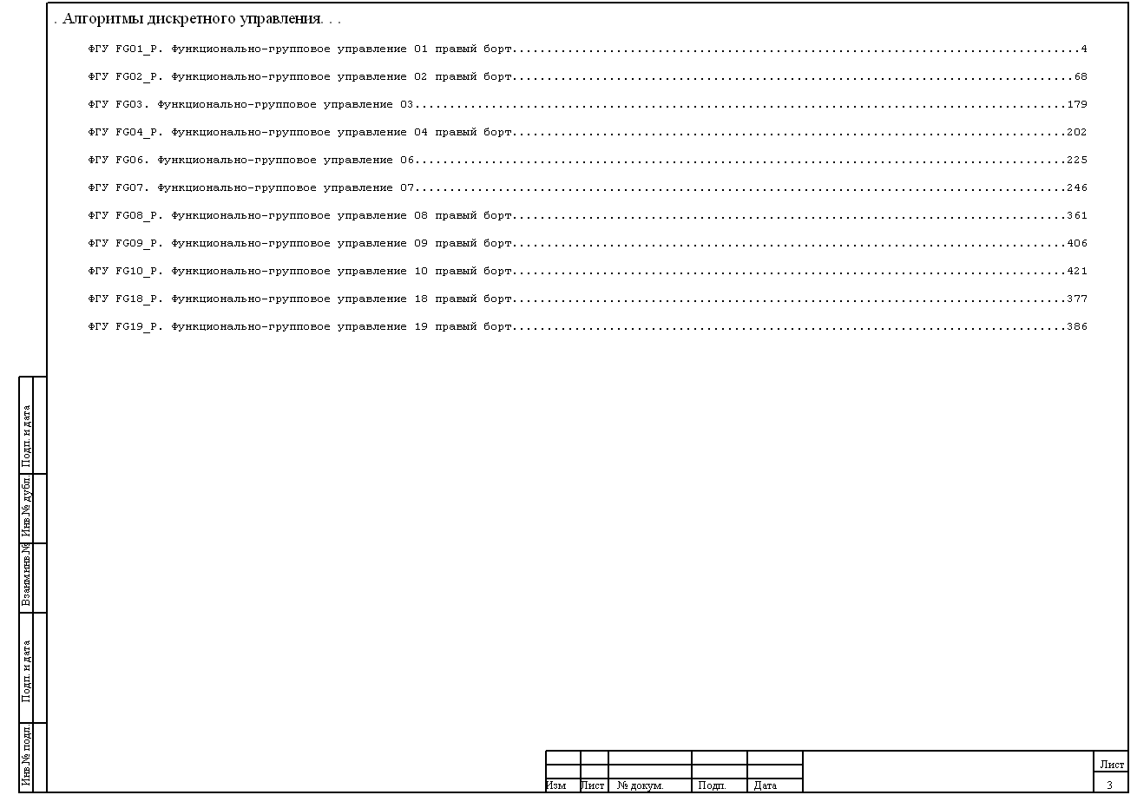
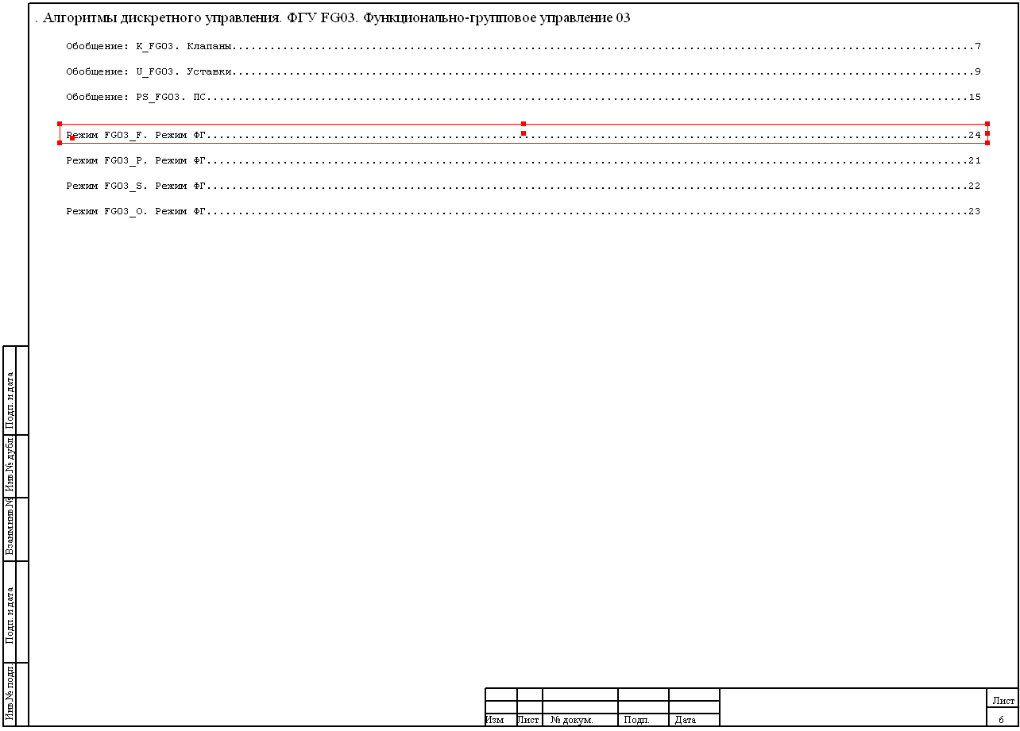
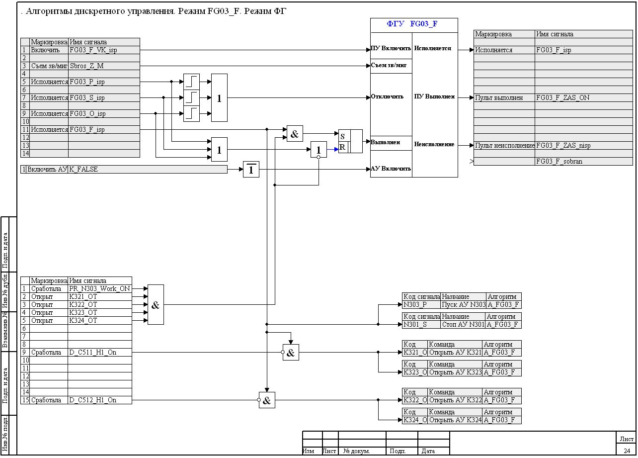
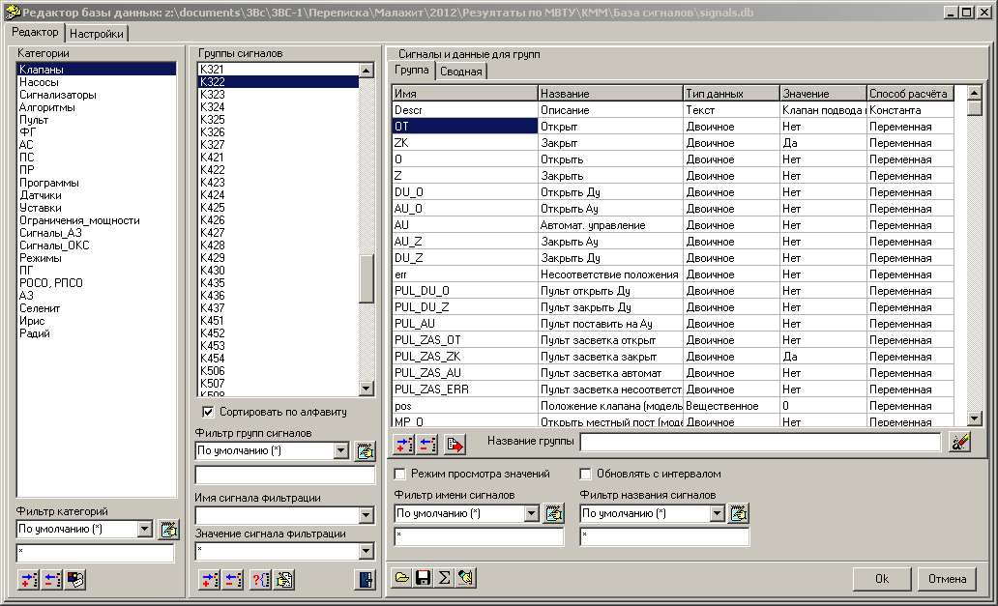
Custom Diagrams Form
To implement particular requirements of organization, individual blocks are generated ensuring “intellectual” behavior of elements in the diagrams
Individual design blocks:
meet requirements of the design;
form the design content;
contain the algorithm pattern;
enable communication with signal base.
20%

Slide 14
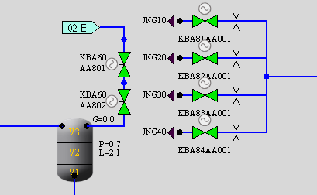
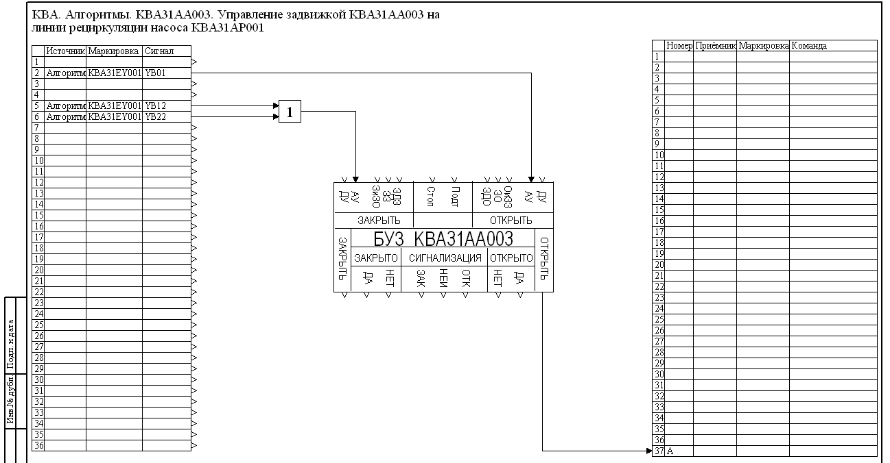
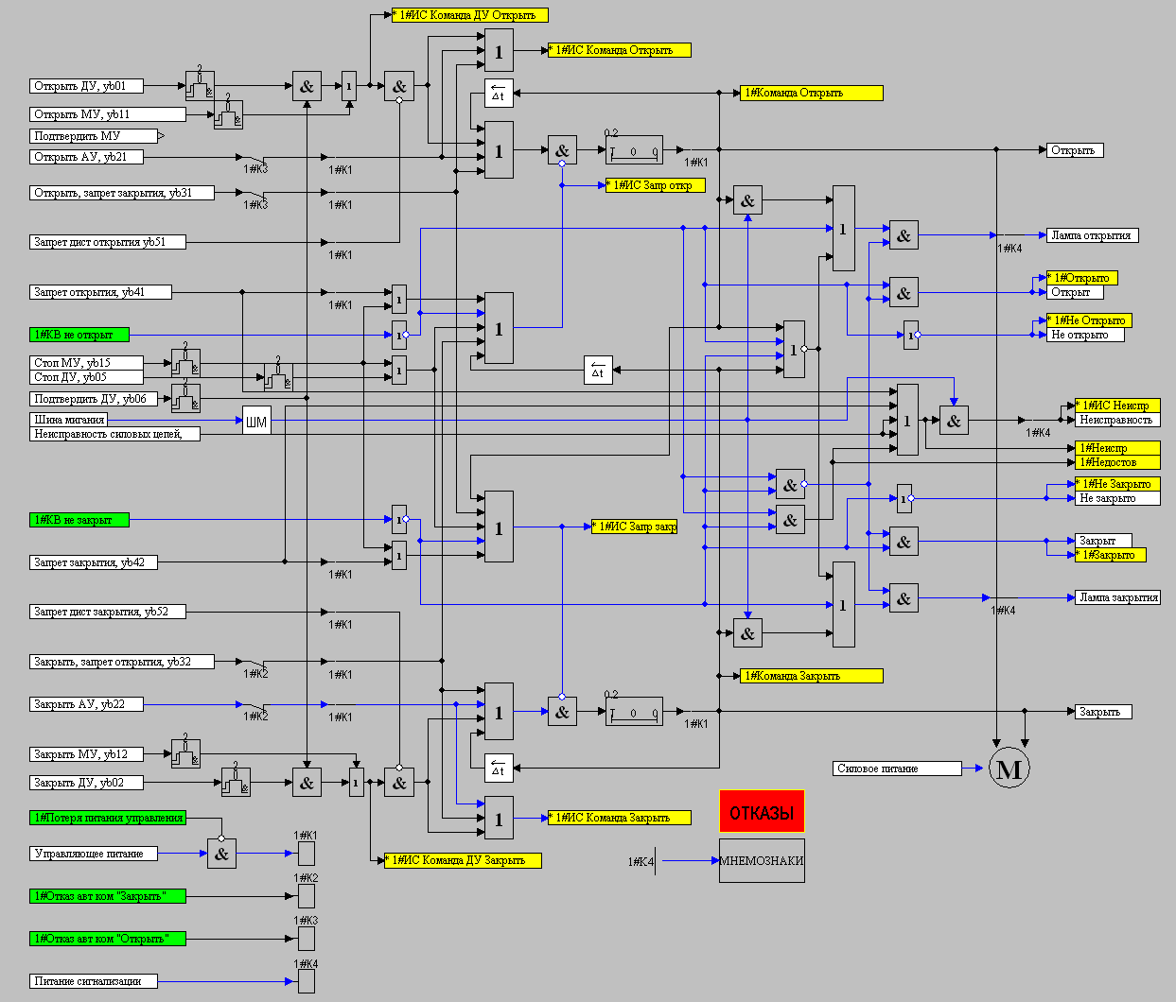
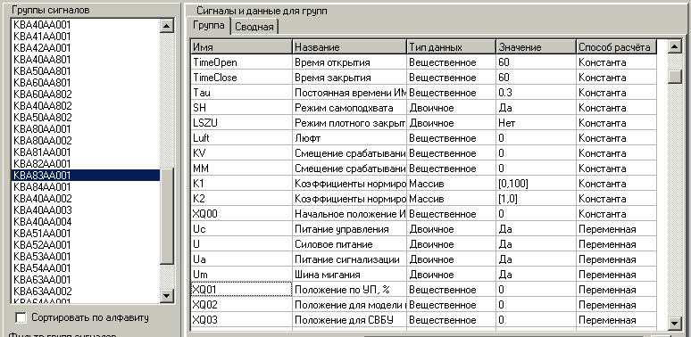
Vector Signals Processing
Majority of blocks in SimInTech are vector ones, which provides independent processing of a set of algorithms of the same type by one diagram
One typical control block processes all valves in the project
View of algorithms on a diagram
Valve name
Process flow diagram
20%
Diagram of a typical block
List in signal database

Slide 15
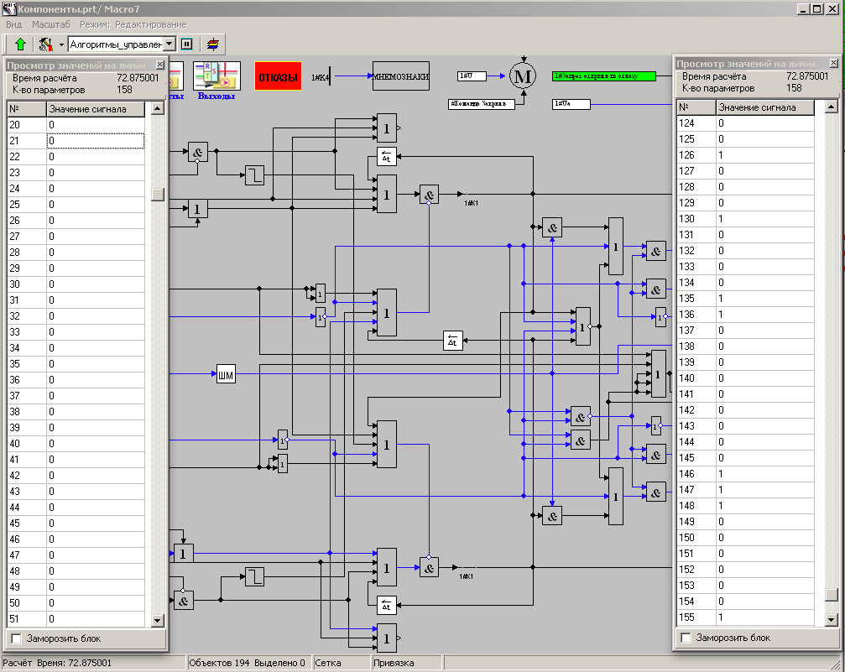
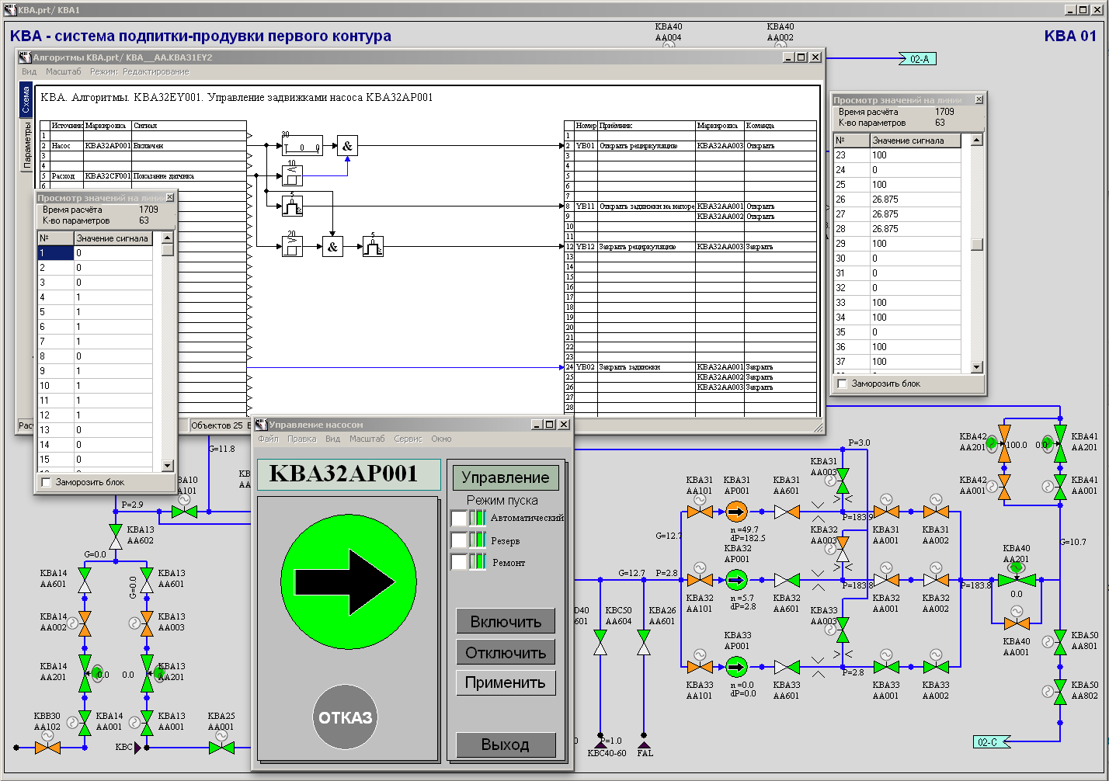
Test Simulation
The I&C System project in SimInTech format is a ready-made mathematical model to enable simulation of algorithm operability
Testability:
Test run by setting input signals and checking control system response;
Dynamic simulation using virtual control panels;
Simulation within a complex model along with a model of the object.
20%

Slide 16
Complex Simulation
SimInTech provides a check of algorithm design by means of dynamic modeling of object behavior (complex simulation)
Methods for creation of a model of object:
As SimInTech “input-output” block diagram for description of the dynamics of processes, whose differential equations can be represented as the Cauchy form;
Using specialized libraries of blocks included into SimInTech;
Connection of external dynamic modeling programs for technical facilities via special communication blocks (OPC, TCP/IP, UDP) for integrated calculation in data exchange mode;
Integration with external modeling programs including integration with creation of common model preparation interface in SimInTech graphics environment.
20%

Slide 17
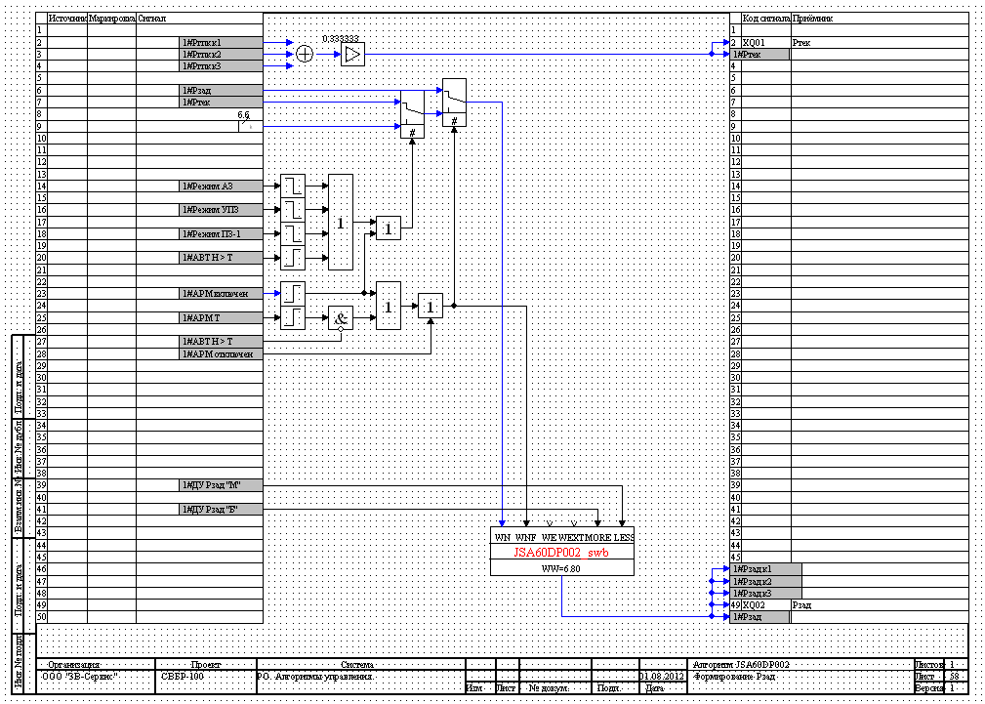
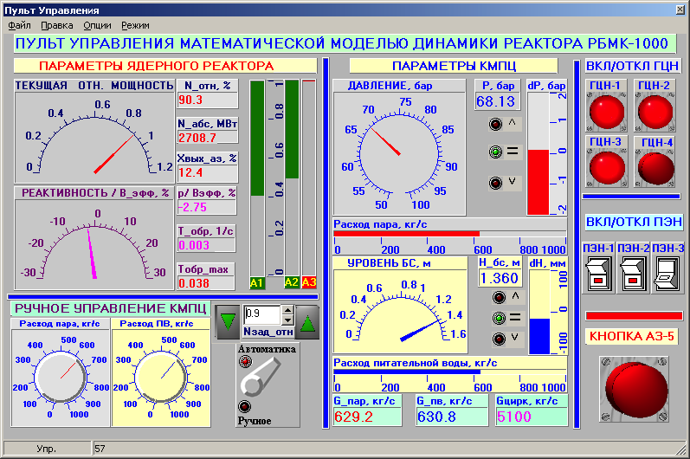
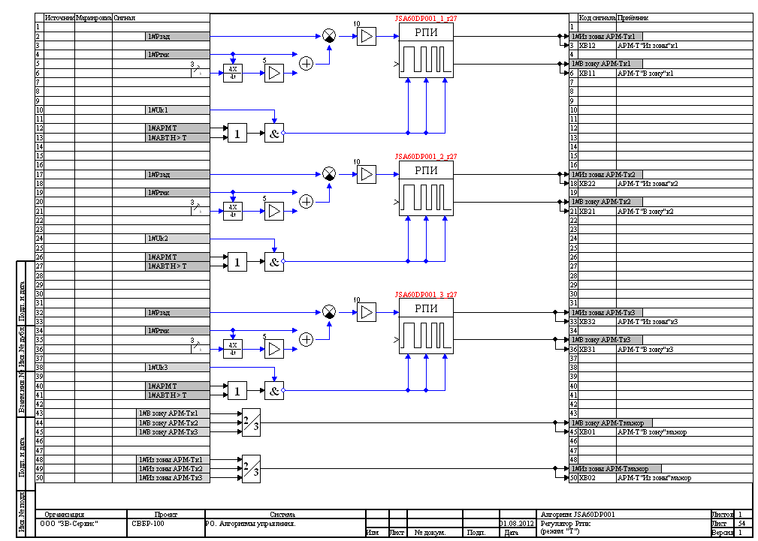
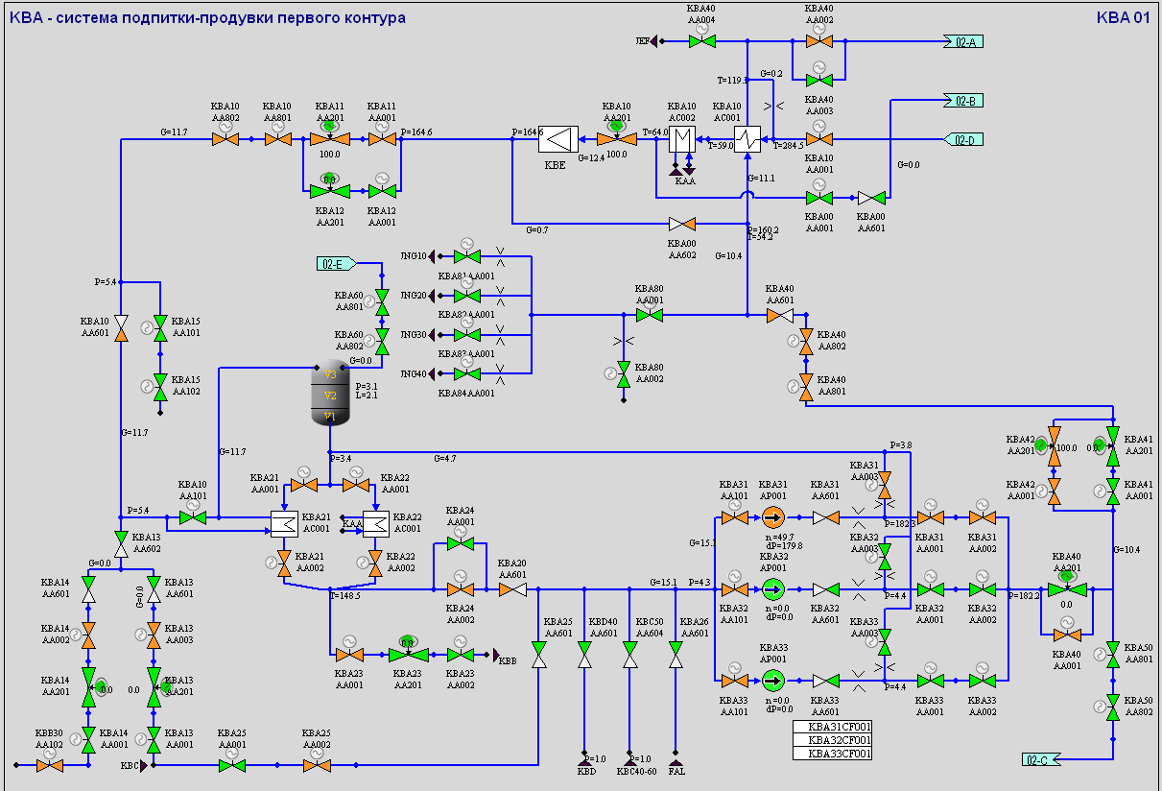
Integrated Model of an Object
Architecture of SimInTech base allows the control system model and jobject model to be connected similar to actual APCS to test the algorithms
Design of algorithms - model
SCADA system
instrument readings
operator commands
I&C commands
actuators
signal database
control points
Model of object
20%
This approach allows a design of algorithms to be checked and debugged under conditions close to actual operation of an object.
calculated parameters

Slide 18
Content
General Information on SimInTech
SimInTech for Design and Development of Control Systems
SimInTech Graphics
SimInTech Mathematical Core and Code Generation
I&C Design and Development Life Cycle
NordWind Executive Environment
Main Examples of SimInTech Implementation
Conclusion

Slide 19
High-Level Representation System
SimInTech contains all components necessary for generation of true higher-level SCADA system
Graphics system of SimInTech provides generation of video frames, mnemonics for representation of process flow, as well as virtual control panels.
Capabilities:
Development of design in Windows;
Application of graphics in Windows and Linux.
Vector graphics built-in editor – creation of 2D picture of a random complexity, zooming, use of visual layers, etc.;
High level programming language – provides animation of high complexity degree;
Signal base – link between animation and process parameters.

Slide 20
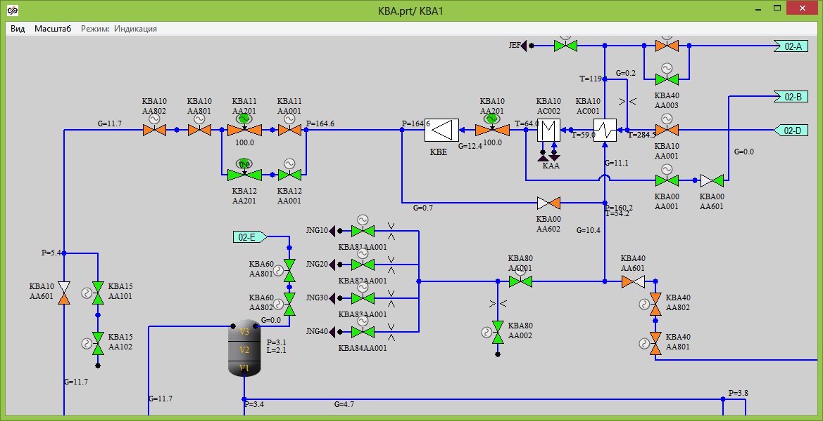
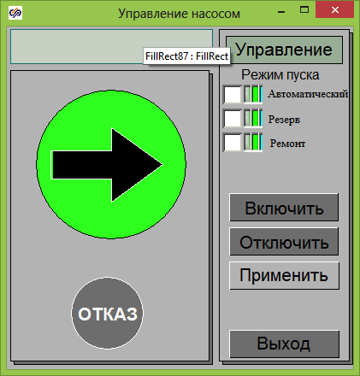
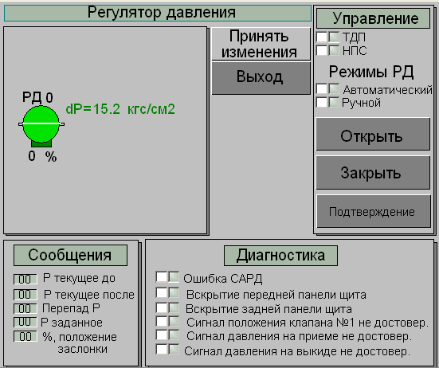
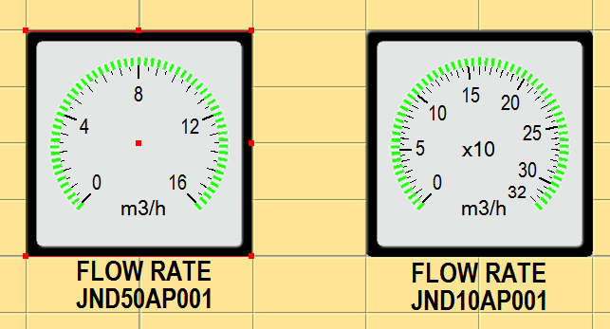
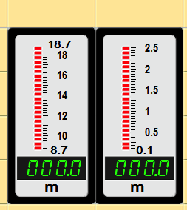
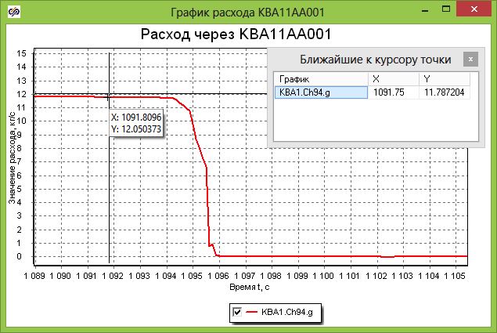
Representation and Control of Processes
SimInTech graphics environment provides generation of all necessary components of higher-level SCADA systems
Mnemonics/process flow diagrams
Contextual control windows
Photorealistic images
Graphics and archiving of parameters
20%

Slide 21
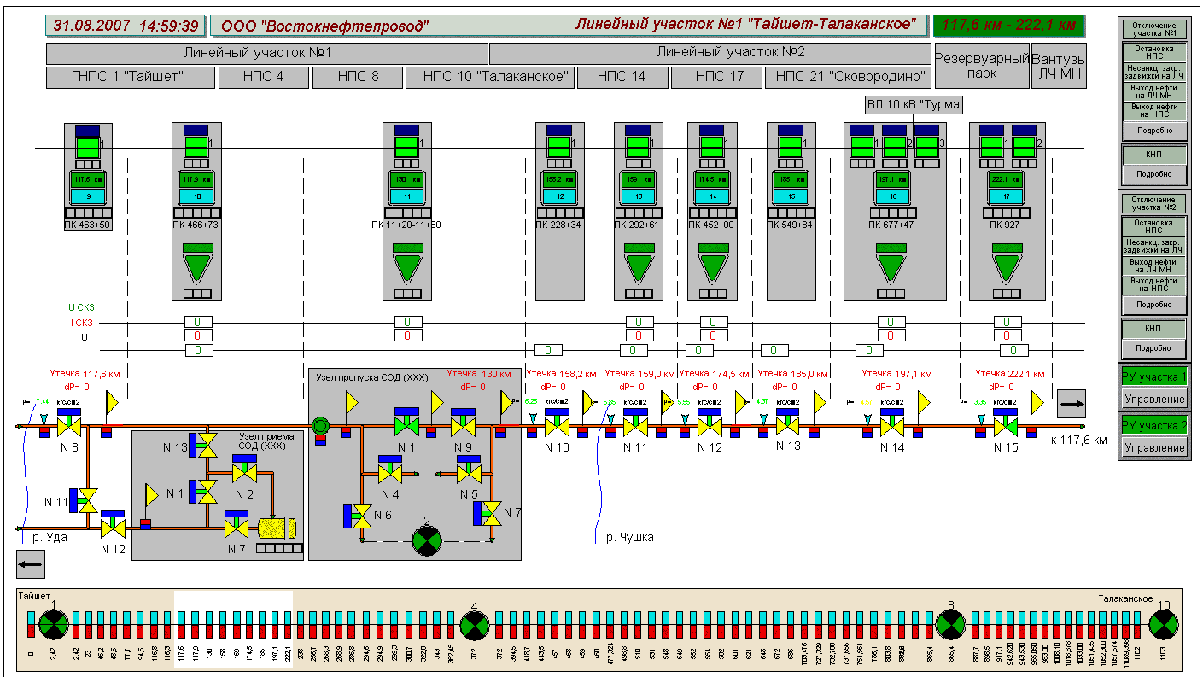
Video Frame Ergonomics Testing
Testing of video frame ergonomics is enabled as early as at the stage of design by means of simulation of operator’s work and modeling of processes
Oil pipeline control video frame
Turbine control video frame
20%
Generation of a video frame at early stage of designing allows:
man-machine interface ergonomics errors to be detected and excluded;
periods of development of higher-level representation systems to be reduced.

Slide 22
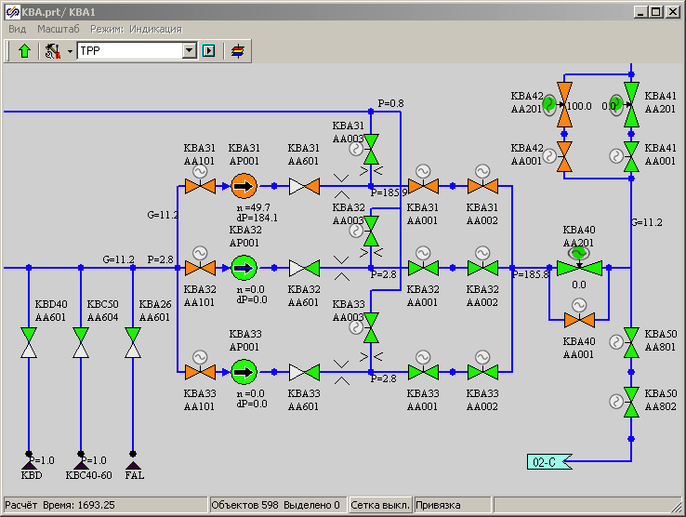
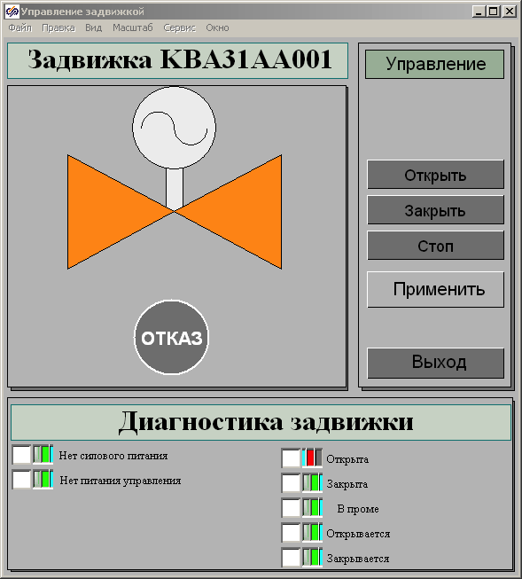
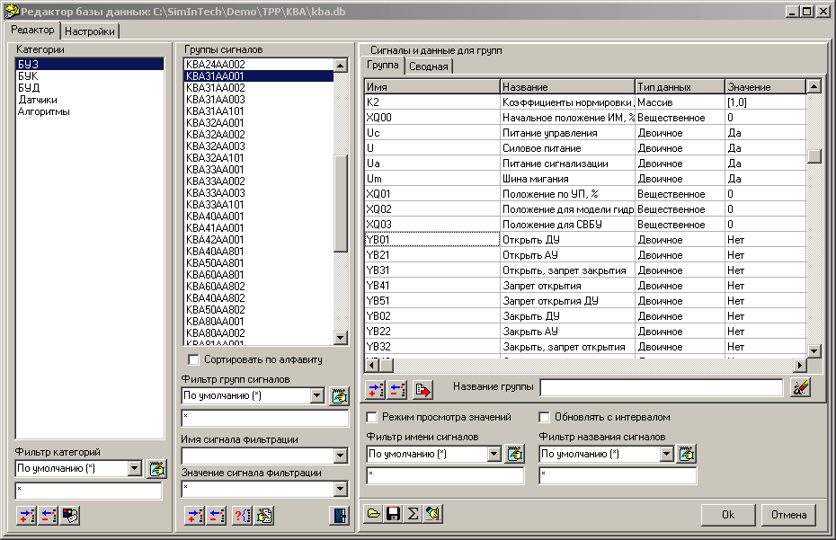
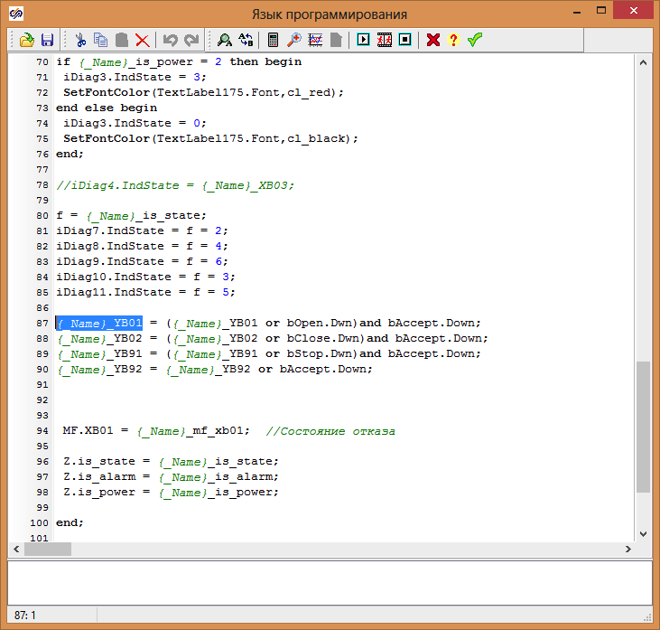
Signal Processing Automation
SimInTech signal database ensures automatic link of signals to graphics representation and control components
Mnemonics
Control window
object name
signal name
20%
Signal database
Animation script

Slide 23
Content
General Information on SimInTech
SimInTech for Design and Development of Control Systems
SimInTech Graphics
SimInTech Mathematical Core and Code Generation
APCS Design and Development Life Cycle
NordWind Executive Environment
Main Examples of SimInTech Implementation
Conclusion

Slide 24
Analysis of Algorithm Calculation Diagram
SimInTech contains a calculation core providing mathematical analysis of algorithm diagram for code generation
Calculation core created for modeling of dynamic processes contains mathematical methods for diagram analysis to prepare code generation process in the C language.
Main tasks of code pre-generation:
Analysis of algorithm diagram topology. Determination of relations, link between calculation blocks of the diagram, correctness of mathematical operations, preparation of global list of variables and functions.
Algebraic loops solving. In case a closed communication line is detected in algorithms initial values shall be correctly set.
Block sorting in terms of the order of calculation.
20%

Slide 25
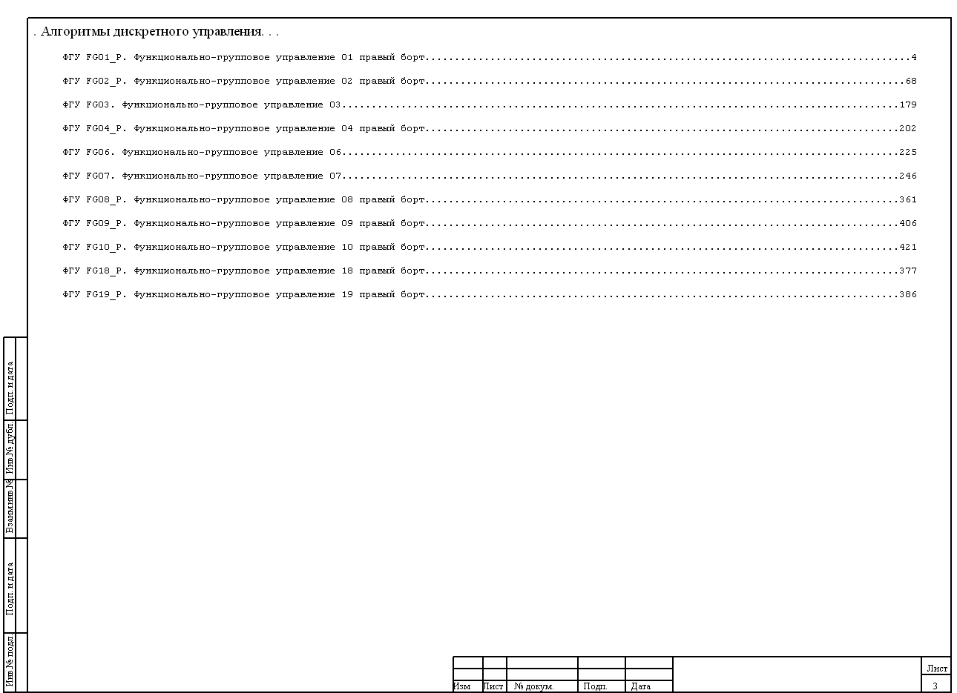


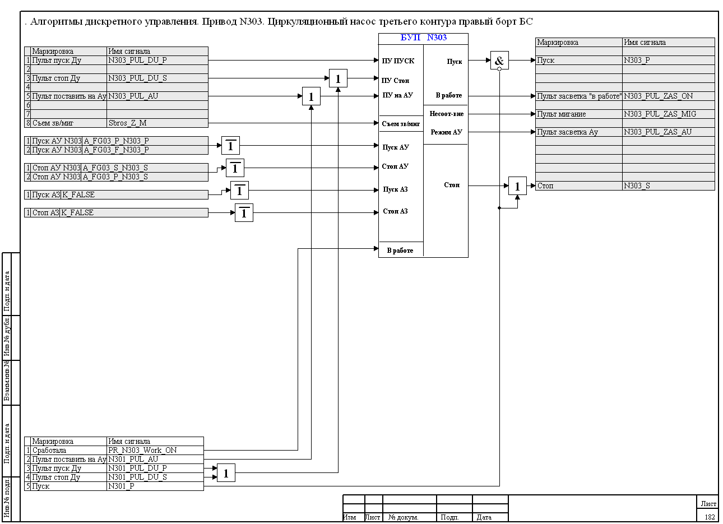
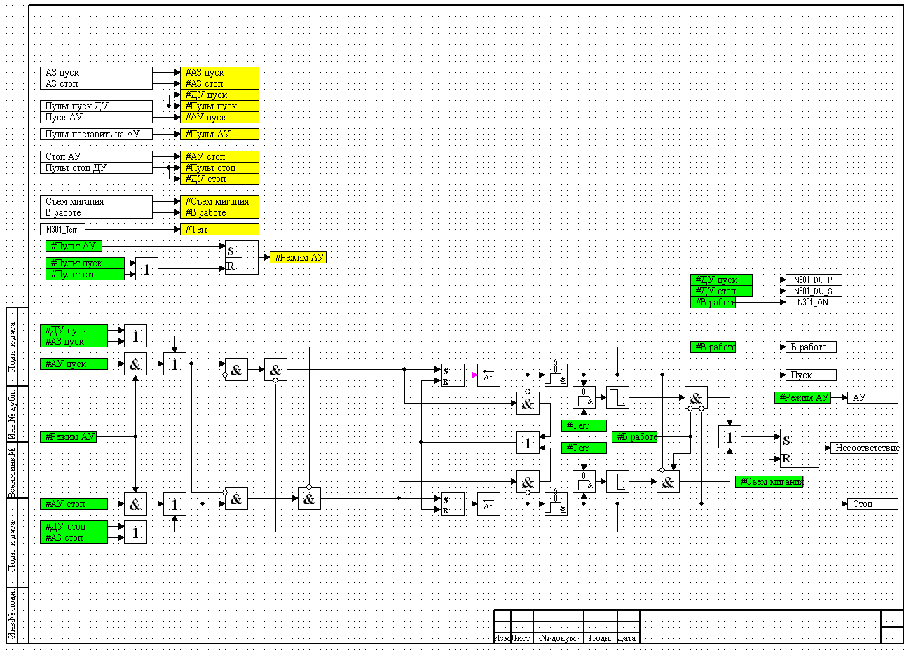





Initial Code Generation by Diagram
Code generation in SimInTech is implemented on the basis of patterns, which enables generation of a code compatible with different compilers
Algorithm design
Patterns
Compilers and OS
ST
Schneider Unity
C
MS Visual Studio
C
GCC Linux
C
GCC QNX
20%
SimInTech environment generates standard ANSI С code.
Different comments, file names, auxiliary description files generated according to different adjustable patterns can be used for different target platforms.

Slide 26
Requirements to Program Source Code
Automatic generation of program initial code allows data entry errors to be avoided and program development process to be considerably accelerated
The following requirements to program source code are met in the process:
compliance with algorithm diagram in terms of mathematical operations executed;
meeting the requirements to the C language syntax from the side of compiler generating programs for controller;
contains identifiers that can, when needed, debug the program using SimInTech software;
allows compilation in running program to be carried out for device using a certified compiler;
compilation does not require SimInTech software to be applied.
20%

Slide 27
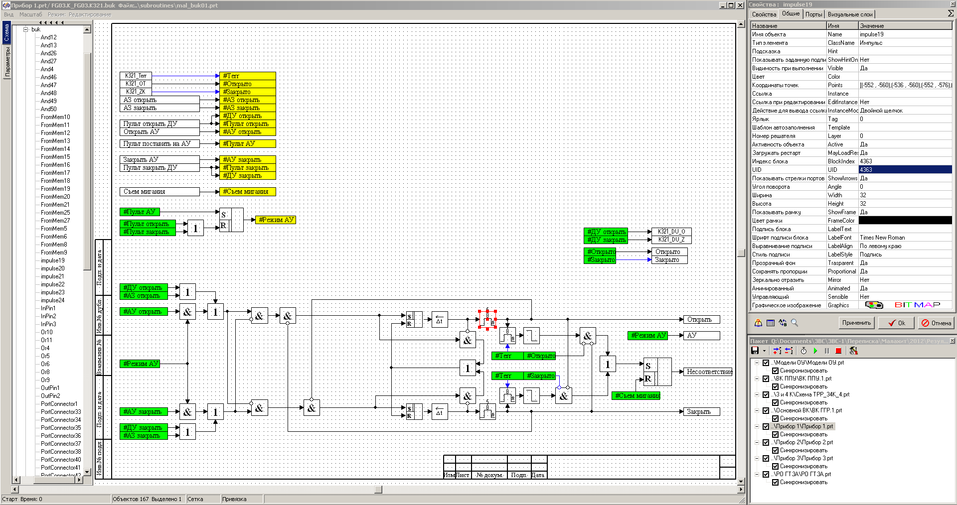
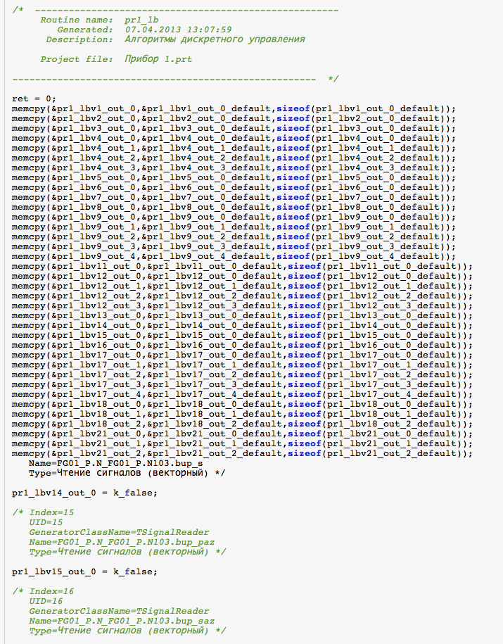
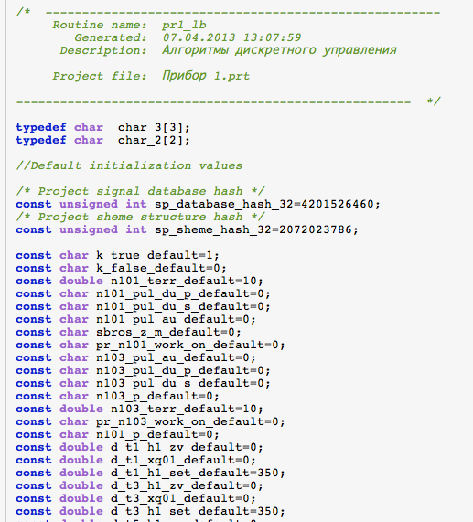
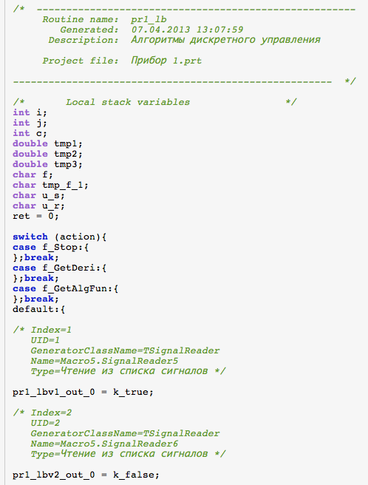
Control Program Source Code
SimInTech operation results in a code containing description of mathematical blocks in the C language documented as per the requirements of the compiler
Algorithm design
Algorithm in the C language
20%
IEC 60880-2010
CERTIFIED for I&C systems important for NPP safety performing category A function
Set of required files

Slide 28
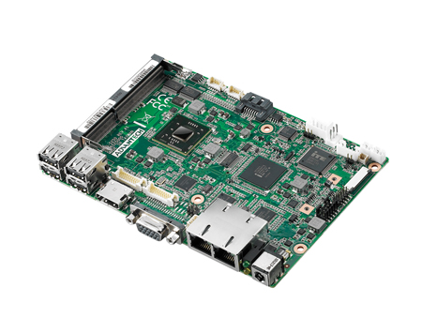
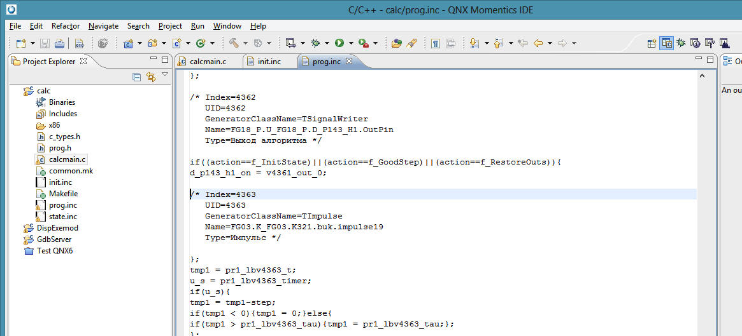
Program Source Code Compilation
Code automatically generated from SimInTech is compiled with the use of standard tools of target platform
RTOS IDE, standard programming environment is used for program compilation.
Files prepared by SimInTech
Initial C-source
Controller controlled by
RTOS
Configuration files
loading
20%
loading
compilation
Program for QNX
RTOS Tool IDE

Slide 29
Content
General Information on SimInTech
SimInTech for Design and Development of Control Systems
SimInTech Graphics
SimInTech Mathematical Core and Code Generation
I&C Design and Development Life Cycle
NordWind Executive Environment
Main Examples of SimInTech Implementation
Conclusion

Slide 30
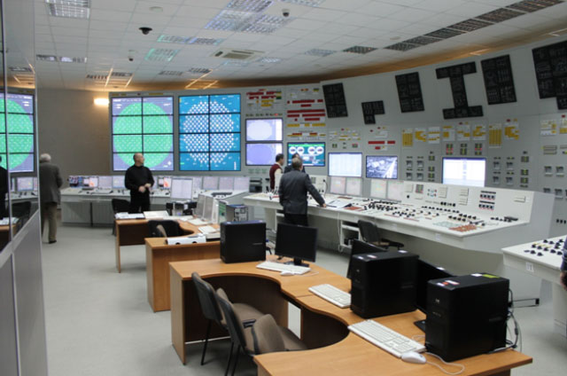
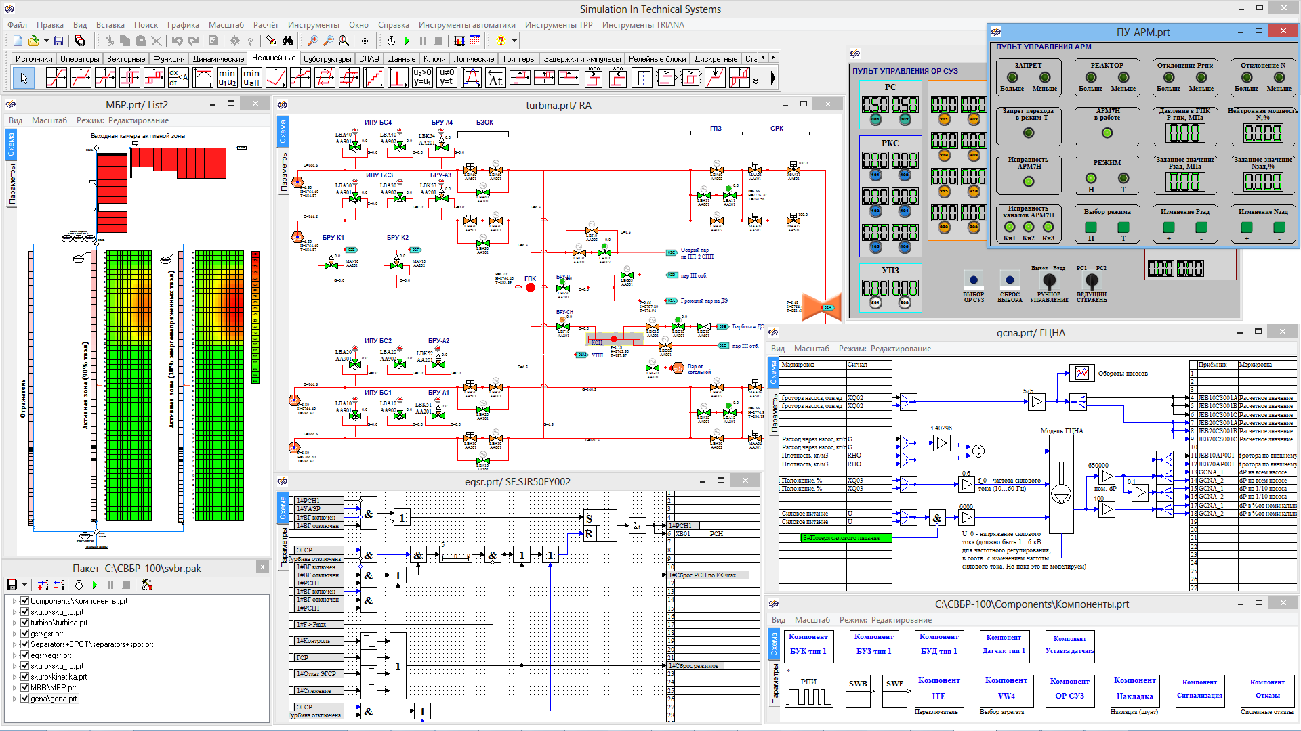
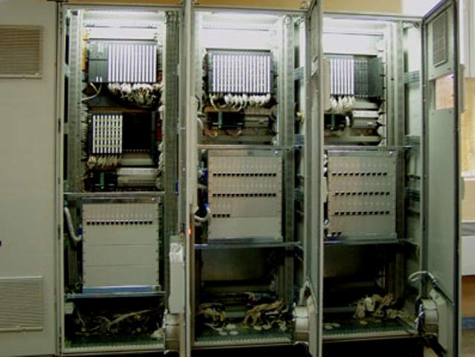

I&C System Full Life Cycle Designing
SimInTech IDE supports end-to-end design of I&C System from the stage of conceptual systems design to start-up
Abstract level
requirements
commissioning
general design
complex test
detail design
unit test
program development
20%
Verification at all stages of life cycle
time
Detail level

Slide 31
Recommendations of International Standards
SimInTech provides generation of I&C System application software critical for NPP safety according to recommendations of IEC 60880
Designing
Validation processes
Requirements
Validation of the system
Conceptual design
Functional testing
Equipment testing
Math. model
Integration on target system
Specifications for
APCS equipment
APCS functional specifications
Engineering Tools
SimInTech Diagrams
Code generator
20%
P&ID Diagram
Software compilation
Life cycle of generation of APCS control programs in SimInTech environment corresponds to recommendations of IEC 60880 (Life cycle for Application Oriented Software Engineering)

Slide 32



I&C Systems Design Levels
There are different types of abstract representations of the project at different stages of I&C Systems design and generation life cycle
Process flow algorithm – description of automatics system operation without any link to control equipment (requirements, working procedure);
Signal processing and I&C System equipment control algorithms;
Link of variable parameters with input cards from sensors and output cards to actuators.
Input/output cards
Signal processing
20%
Process flow algorithm

Slide 33

I&C Control Design Process Part
SimInTech IDE provides the technologist with all tools required for creation of control algorithm process design
Coding system for variables (signals) accepted in the design;
Values of parameters in physical units accepted in the design;
Reception of values of parameters from dynamic model of the object.
20%
Signal code
Readings
in SI units
Setup in SI units

Slide 34
I&C System Hardware Signal Processing
To transfer signals received from I/O cards from electric current parameters to process flow parameters special processing blocks can be created
Signal processing includes:
Conversion to physical units with preset coefficients;
Signal filtration, smoothing;
Processing of hardware errors, validity check.
Hardware errors
Setups, diagnostics
Falling outside the range
Readings
in SI units
20%

Slide 35



Interface for I/O Cards
To arrange communication between measuring instruments and control devices of equipment special interface blocks are used
Each interface block provides as follows:
Graphic representation of physical contacts of I/O cards;
Communication between contacts and variables in the signal database;
Generation of hardware-specific code for processing card signals.
Card contacts
Database signal names

Slide 36
Content
General Information on SimInTech
SimInTech for Design and Development of Control Systems
SimInTech Graphics
SimInTech Mathematical Core and Code Generation
I&C Design and Development Life Cycle
NordWind Executive Environment
Main Examples of SimInTech Implementation
Conclusion

Slide 37
Nord Wind Executive Environment for QNX
Correct operation of control algorithms in QNX real-time OS is provided by Nord Wind executive environment operating on controller
Nord Wind executive environment has modular architecture, relies on the mechanism of dynamically loaded libraries and meets IEC 60880 requirements.
Composition and functionality:
NordWind – main module of algorithm-program dispatcher;
GdbServer – in-device algorithm debugging module;
Libio – I/O cards data exchange library;
Libnet – library for adjustment and implementation of inter-controller data exchange; controlled by QNX within APCS Ethernet;
NetRecSys – recovery system for backed up control channels;
Libtrends – data archiving library;
Libsdk – developer’s kit.

Slide 38


Distributed I&C Systems Architecture
SimInTech ensures generation of distributed control systems on several networked QNX controllers
Development station
GbdServer
exchange
QNX controller
Libio exchange
Libtrends writing
SCADA
SimInTech environment
Libnet
exchange
I/O cards
SimInTech video frames
archiving server
QNX controller

Slide 39
Run Diagram for Algorithm Execution
Nord Wind DispExemod dispatcher provides algorithm execution considering its configuration set by the designer
1 Start-up of NordWind with a preset configuration file
3 Data reading from external algorithm variables
4 Generation of shared storage areas
5 Loading of algorithm initial state
6 Start-up of calculation modules
7 Start-up cycle for calculation programs
2 Data reading from the configuration file
8 Program start-up:
program 1… ……………… program N…

Slide 40
Algorithm Debugging in Controller
When in remote debugging mode, connection to controller can be established and presentation of algorithm running can be obtained on SimInTech diagram
To debug programs executed in QNX environment Nord Wind GdbServer program module is used. This module provides as follows:
access to programs executed from client’s working station from SimInTech environment via Ethernet;
access to program (algorithm) variables during operation including modifiability of values of variables, constants, coefficients without any re-compilation of the program;
control of program execution including:
  Loading of device state;
  Start-up of the program for execution;
  Pause (continuation) of execution;
  Stop of program execution.

Slide 41
In-Controller Algorithm Debugging Diagram
GbdServer provides an access to controller storage area containing program (algorithm) variables for SimInTech graphics environment
Loading configuration file
NordWind dispatcher process
SimInTech client
data acquisition during initialization
Common storage area
/header
Common storage area
/exemod_struct
Common storage area
/extvars_struct
Ethernet remote exchange
Common storage area
/extvars_value
GbdServer debugging server
Program (algorithm)
in-operation
writing-reading
Common storage area
of internal variables

Slide 42
Libnеt Network Exchange Module
Adjustment of network data exchange for distributed APCS is implemented automatically by means of Libnet module
Common signal database in SimInTech design provides automation process for adjustment of network data exchange. Each controller in network at the same time operates as signal source and receiver.
Functions of Libnet module:
during switch-on of the system:
transmission of a request for controller algorithm input signals;
processing of input requests;
generation of a list of output signals to be sent to receiving controller.
in the process of operation:
reception of input signals and their recording into variables (asynchronously);
transmission of output signals via the network to all destinations.

Slide 43
In-Controller Program Execution
Nord Wind executive environment provides real-time operation considering time quantum setting
reading from libio
I/O cards
writing to libio
I/O cards
writing
libtrends trends
transmission of variables via libnet network
algorithm
execution
time
time quantum start-up
asynchronous process
Data acquisition via
libnet network

Slide 44
Advantages of Nord Wind
Nord Wind executive environment provides complete implementation of SimInTech capabilities at the level of in-controller execution
Application of Nord Wind executive environment for developing of I&C Systems on the basis of QNX real-time OS provides a reliable solution for the most complicated and vital control systems. Set of Nord Wind modules provides operation of control systems designed in SimInTech environment at the level of controller. When using Nord Wind, users are granted with:
verified and debugged low-level software;
complete use of all peculiarities and advantages of QNX;
work with graphics interface in the process of algorithm debugging in controller;
reduction of design period;
improved quality of application software.

Slide 45
Content
General Information on SimInTech
SimInTech for Design and Development of Control Systems
SimInTech Graphics
SimInTech Mathematical Core and Code Generation
APCS Design and Development Life Cycle
NordWind Executive Environment
Main Examples of SimInTech Implementation
Conclusion

Slide 46





SimInTech Projects
3V Services, LLC has implemented several significant projects for automation in the process of creation of control systems in different industries
Design and representation system for NPP simulators
Customer – Rosatom Concern;
Manufacturer – GET JSC, VNIIAES OJSC.
APCS and pipelines modeling
Customer – TRANSNEFT JSC;
Designer – Giprotruboprovod JSC.

Slide 47







Application of SimInTech for QNX in Russia
QNX real-time OS is applicable in nuclear submarine control systems, as well as for nuclear reactor control
Nuclear submarine control systems
Customer – Ministry of Defence of the RF;
Designer – SPMBM Malakhit
APCS Manufacturer – Concern Avrora
Scientific and Production Association.
RBMK reactor safety control system
Customer – Rosatom Concern
Designer – “NIKIET” JSC
APCS Manufacturer – OKSAT
20%

Slide 48





Balokovo NPP Reactor Compartment ACS
SimInTech is an environment for hardware-software complex of Balokovo NPP reactor compartment automatic control system
The following is implemented in SimInTech environment:
Design of reactor compartment control system;
Archiving system;
Higher-level representation system.

Slide 49


SPbAEP Virtual Power Unit
In 2012 3V Services, LLC took part in creation of a virtual power unit for Joint-Stock Company Atomenergoproekt
SimInTech software is used for creation of:
Model information display video wall;
Graphics system for creation of thermo-hydraulic models;
APCS modeling systems.

Slide 50


OKB SUKHOY
In 2016 OKB SUKHOY started used SimInTech for the digital twin and developed complex 1D model of aircraft
SimInTech software is used for creation of a complex model of an aircraft witch include:
Control Systems;
Fuel system;
Electrical system;
Air condition systems;
Safety and reliable;
APCS modeling systems.

Slide 51
Content
General Information on SimInTech
SimInTech for Design and Development of Control Systems
SimInTech Graphics
SimInTech Mathematical Core and Code Generation
APCS Design and Development Life Cycle
NordWind Executive Environment
Main Examples of SimInTech Implementation
Conclusion

Slide 52
Benefits from SimInTech IDE
SimInTech provides test calculation in the processes of algorithm designing and excludes the human factor when programming I&C Systems
Reduction of total period of I&C Systems design due to accelerated programming by controllers;
Reduction of commissioning period due to testing I&C Systems by means of mathematical models of the object;
Reduction of errors in I&C Systems due to the human factor excluded from the process of interpretation of technical specifications by technologists and programmers.
Simplified maintenance and upgrading of I&C Systems due to documented design information available as algorithm function block diagrams.
Generally improved quality of I&C Systems along with cost effectiveness and reduction of design period.

Slide 53
  3V Services, LLC
  +7 (495) 221 22 53
  info@3v-services.com

