Slide 1
«Electrical drive» blocks library
3VS LLS

Slide 2
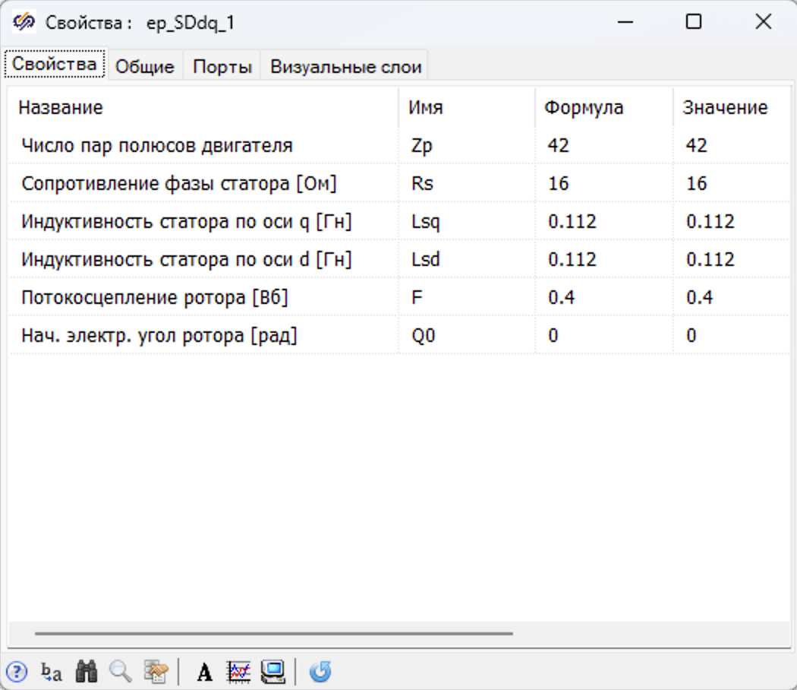
Example setting parameter for PMSM
These parameters must be set to tune a model of the motor:
A start angle of a rotor
An Inductivity for axis q
An Inductivity for axis d
A rotor flux linkage
A stator resistance
A number of pair op poles
Additional parameters of motor can be take in account for simulation such as:
A form of an electromotive force
A loss in the steel
and so on

Slide 3
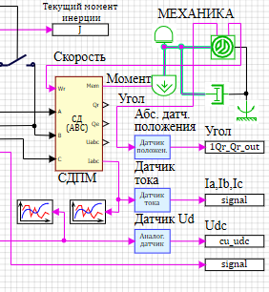
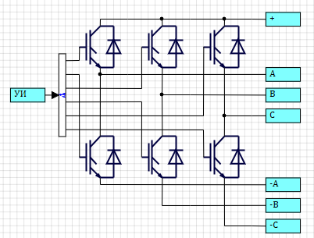
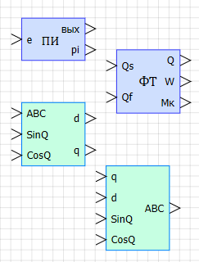
The model of an electro driver
The electro driver model consists:
a model of a motor
a model of power converse unit
a model of mechanical transmission
a model of control systems
The model of electro driver is created by using a standard blocks from the «electro driver» library. IGBT-invertor, controller, PWM-generator and so on.
User set a parameters for this elements.
SimInTech provide a set of demo projects which can be used as a prototype for a real project.

Slide 4
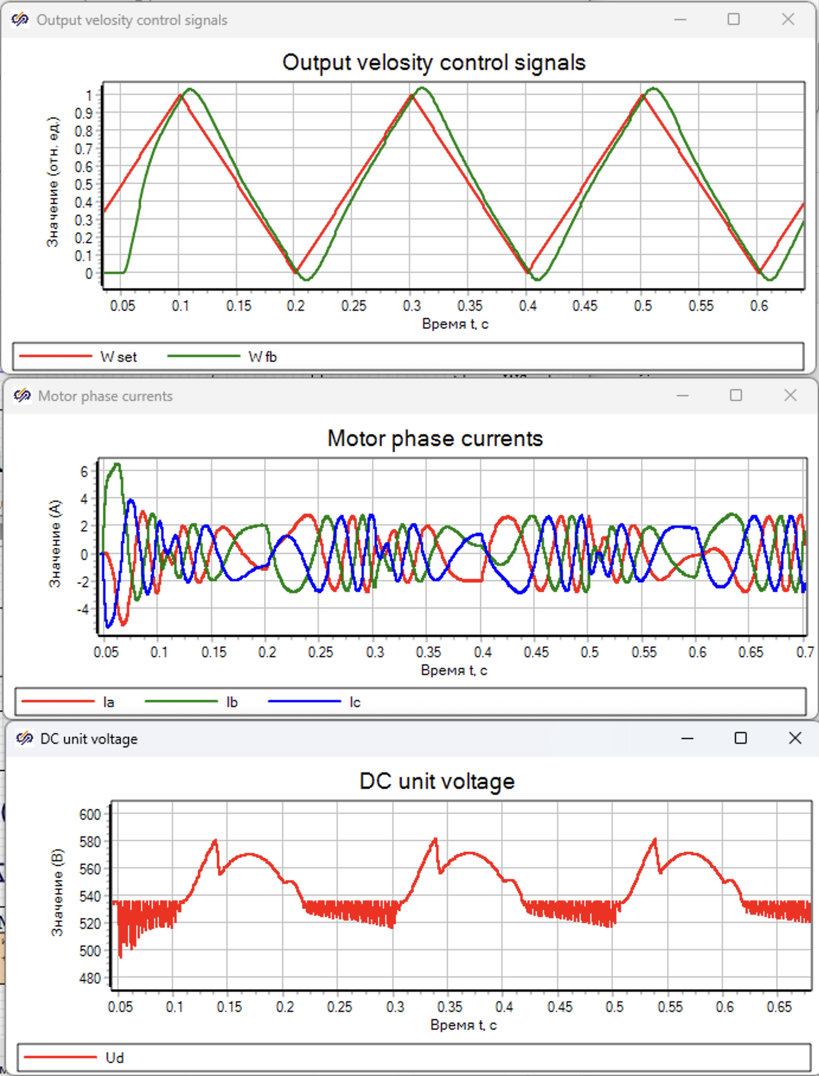
Example of a vector control for velocity of PMSM

Slide 5
SimInTech features
SimInTech use a different integration time step for different part of an electro driver model. It makes possible easy simulation a digital system with a different time discretization. The simulation model becomes more authentical.
An automatically generation С code for control unit of electro drive.
(SimInTech diagram = Program)

Slide 6
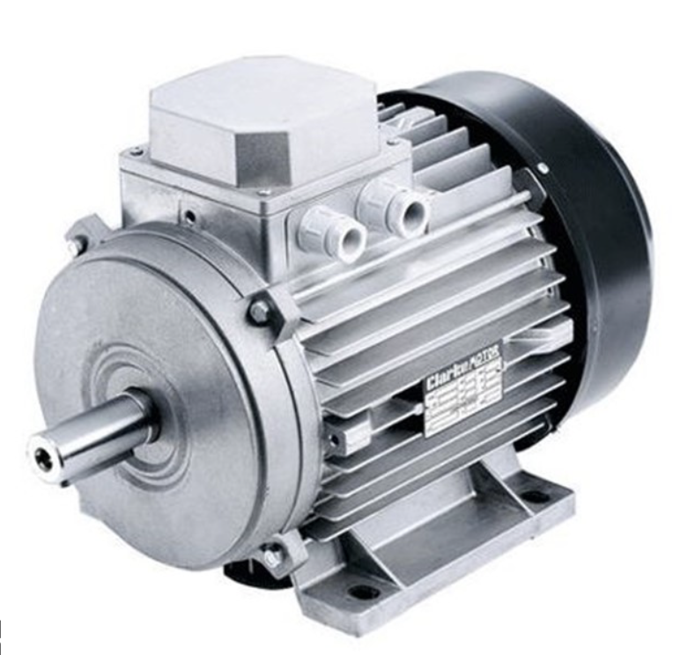
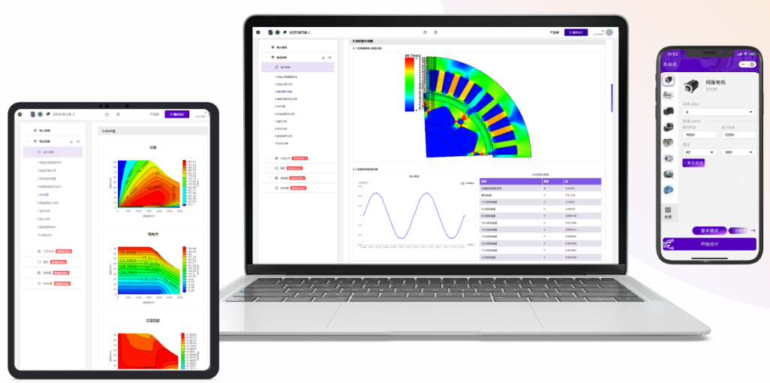
SimInTech + EASITECH for electro driver
Manufacture
date
motor
MOTOR DESIGN
Manufacturing
simulation
model parameter
control
software
1D model
Software design

Slide 7
Viacheslav Petukhov
+7 (926) 531 88 97
info@3v-services.com
т/ф: +7 (495) 221 22 53
3VS LLS

